Slide 1
Zahušťování digestátu z bioplynových stanic pomocí vakuového odpařování
Marek Vondra, m.vondra@vut.cz
Michal Touš
Vítězslav Máša
VUT v Brně, Fakulta strojního inženýrství, Ústav procesního inženýrství
TVIP, 19.10.2021, Hustopeče

Slide 2
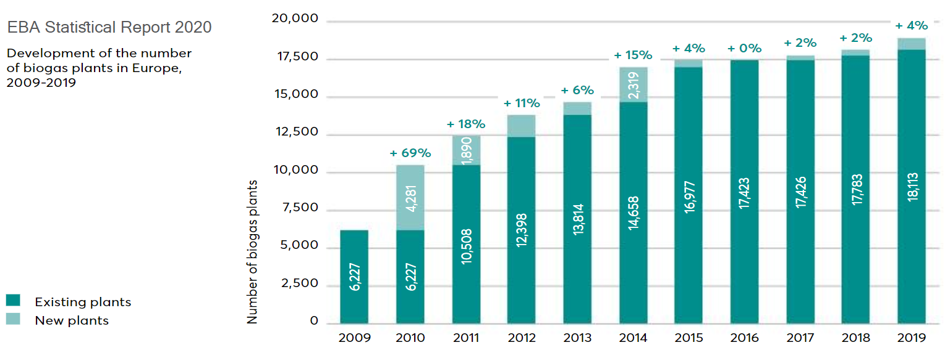
Motivation: number of biogas plants in Europe
Source: EBA, Annual Report 2020, January 2021

Slide 3
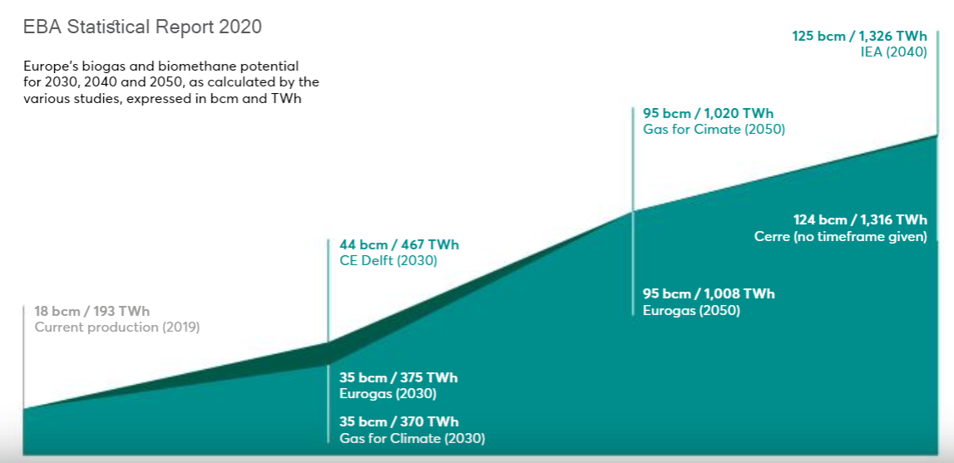
Motivation: Biogas and biomethane potential
Source: EBA, Annual Report 2020, January 2021

Slide 4
Motivation: BGP operation
Ineffective
use of
heat
= natural
fertilizer
50 %
wasted
nutrients (N,P,K)
+
90 % water
180 Mt/y
in EU
(360 Mt/y
in 2030?)
Demand for volume reduction
High storage & transport costs
250 kW
available

Slide 5
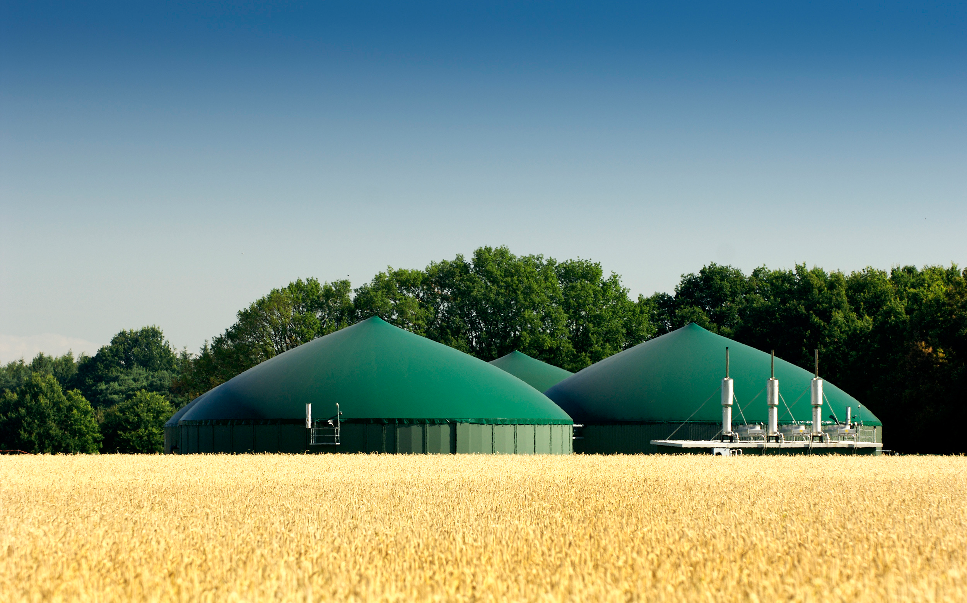
Motivation: Benefits of the volume reduction
Reduction of the storage space
Fuel savings during digestate transportation
Fewer passes of agricultural machinery over farmland…
…and
through populated areas
50-80 %
2-25 EUR/t
50-80 %
Reduction of nitrogen
losses
Reduced
fees for
digestate
disposal
Water
savings
Emissions reduction (air, water, noise)
5000 m³/y

Slide 6
Solution

Slide 7
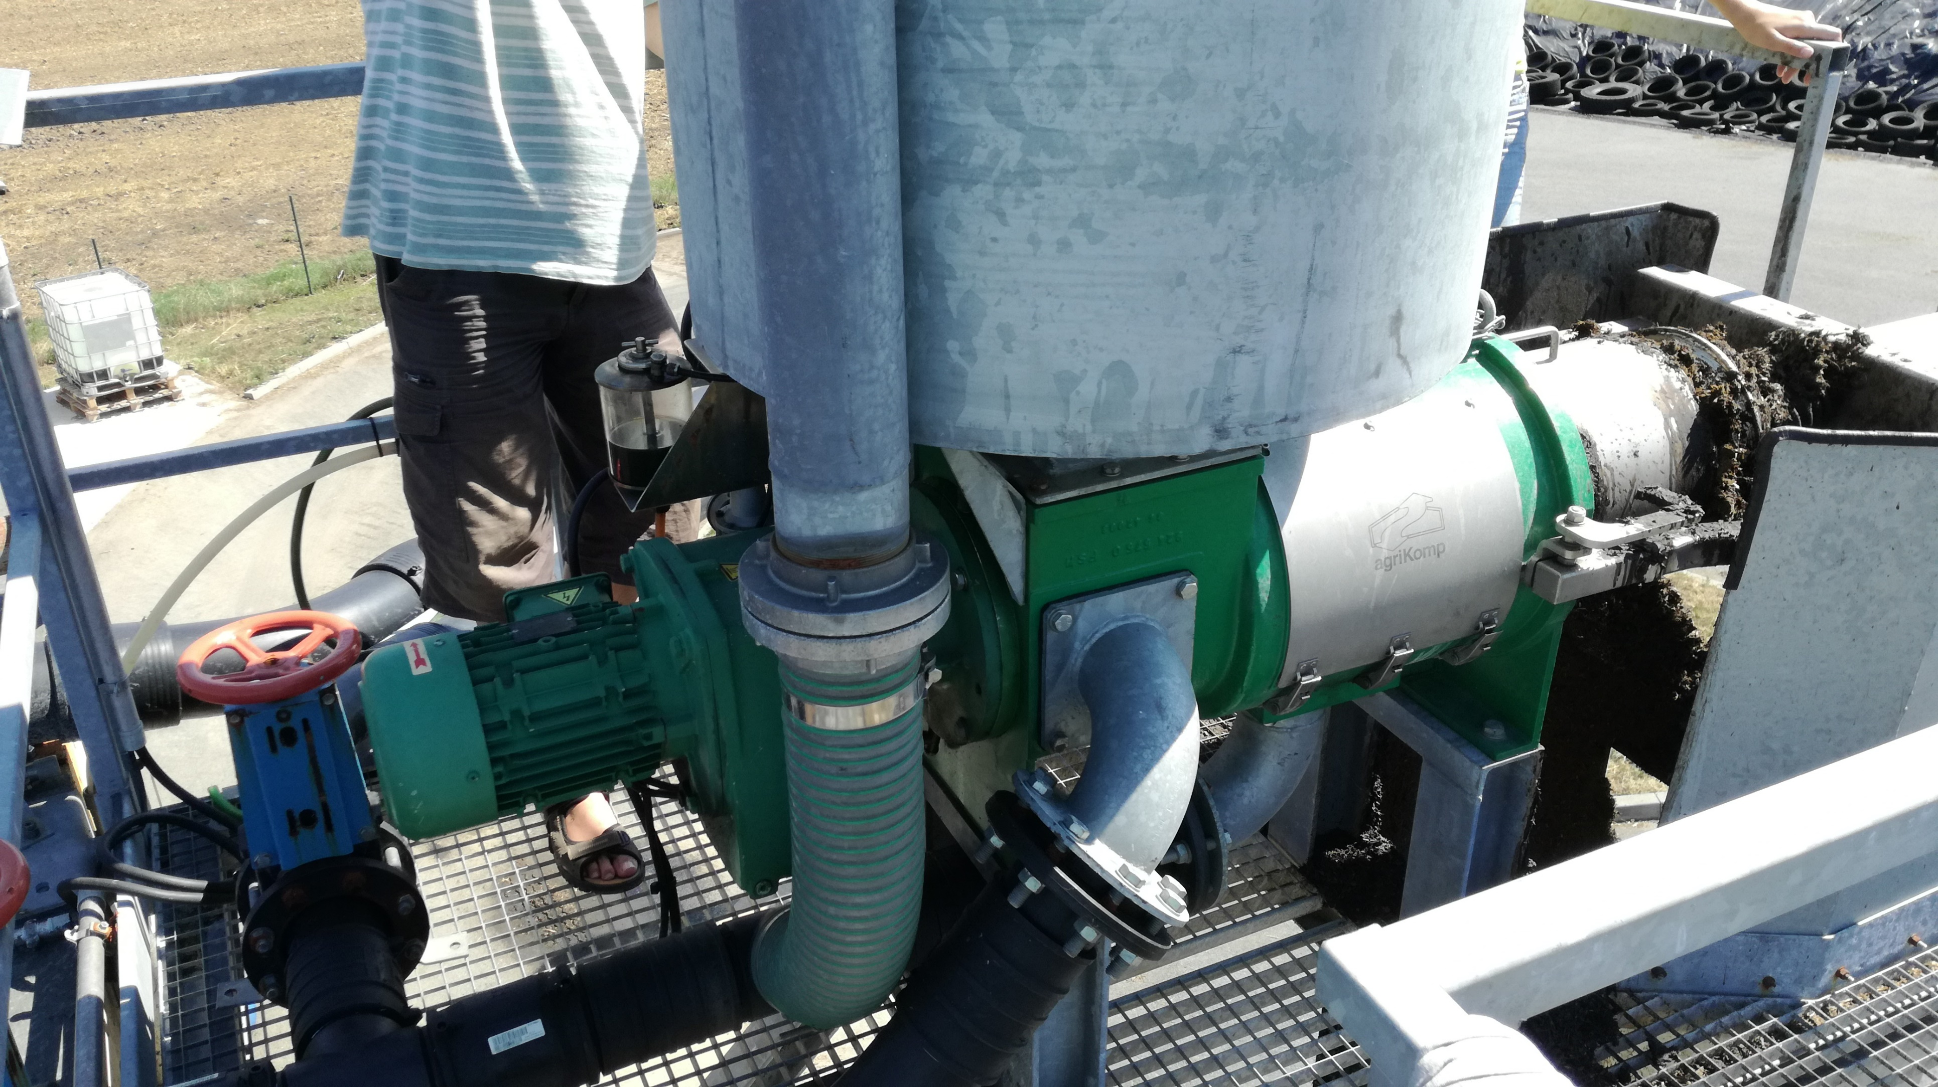
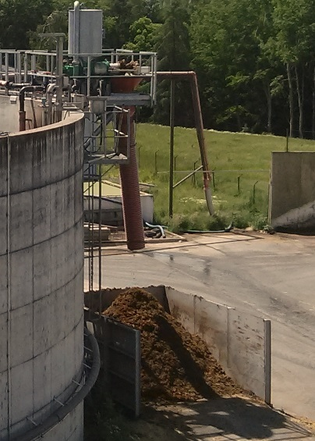
LIQUID
DIGESTATE
Mechanical separation
SOLID
FRACTION
DIGESTATE

Slide 8
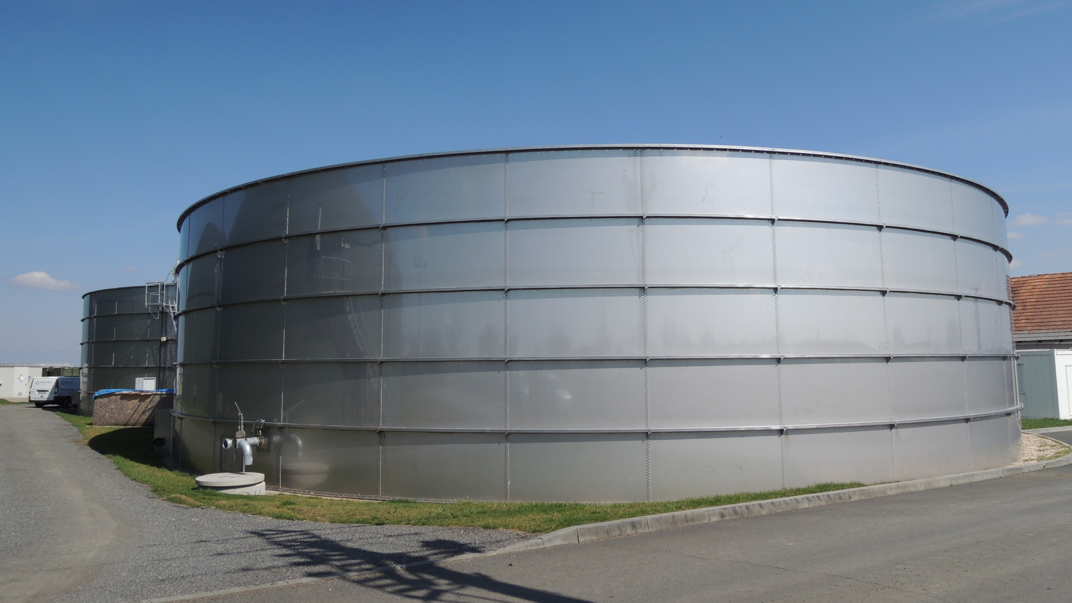

Slide 9
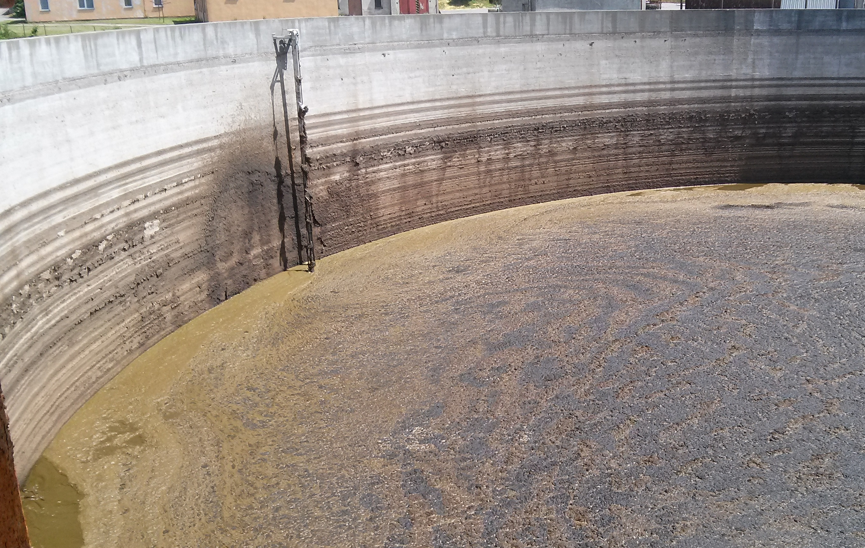
Waste heat production and utilization
Legal requirements for water discharge
Digestate
Parameter | Value | Unit
pH | 7.5 – 8.1 | -
Dry matter | 2 – 12 | % wt.
N-NH4 | 3 000 – 5 000 | mg/l
COD | 30 – 60 | g/l
N-total | 3000 - 7000 | mg/l
P-total | 8 - 42 | g/kg DM
S-total | 2.9 – 14.7 | g/kg DM
Ca | 9 – 65.8 | g/kg DM
K | 28 - 95 | g/kg DM
Separated water
Parameter | Value | Unit
pH | 6.5 – 8.5 | -
TSS | 40 | mg/l
N-NH4 | 40 | mg/l
COD | 200 | mg/l
N-total | 60 | mg/l
P-total | 10 | mg/l

Slide 10
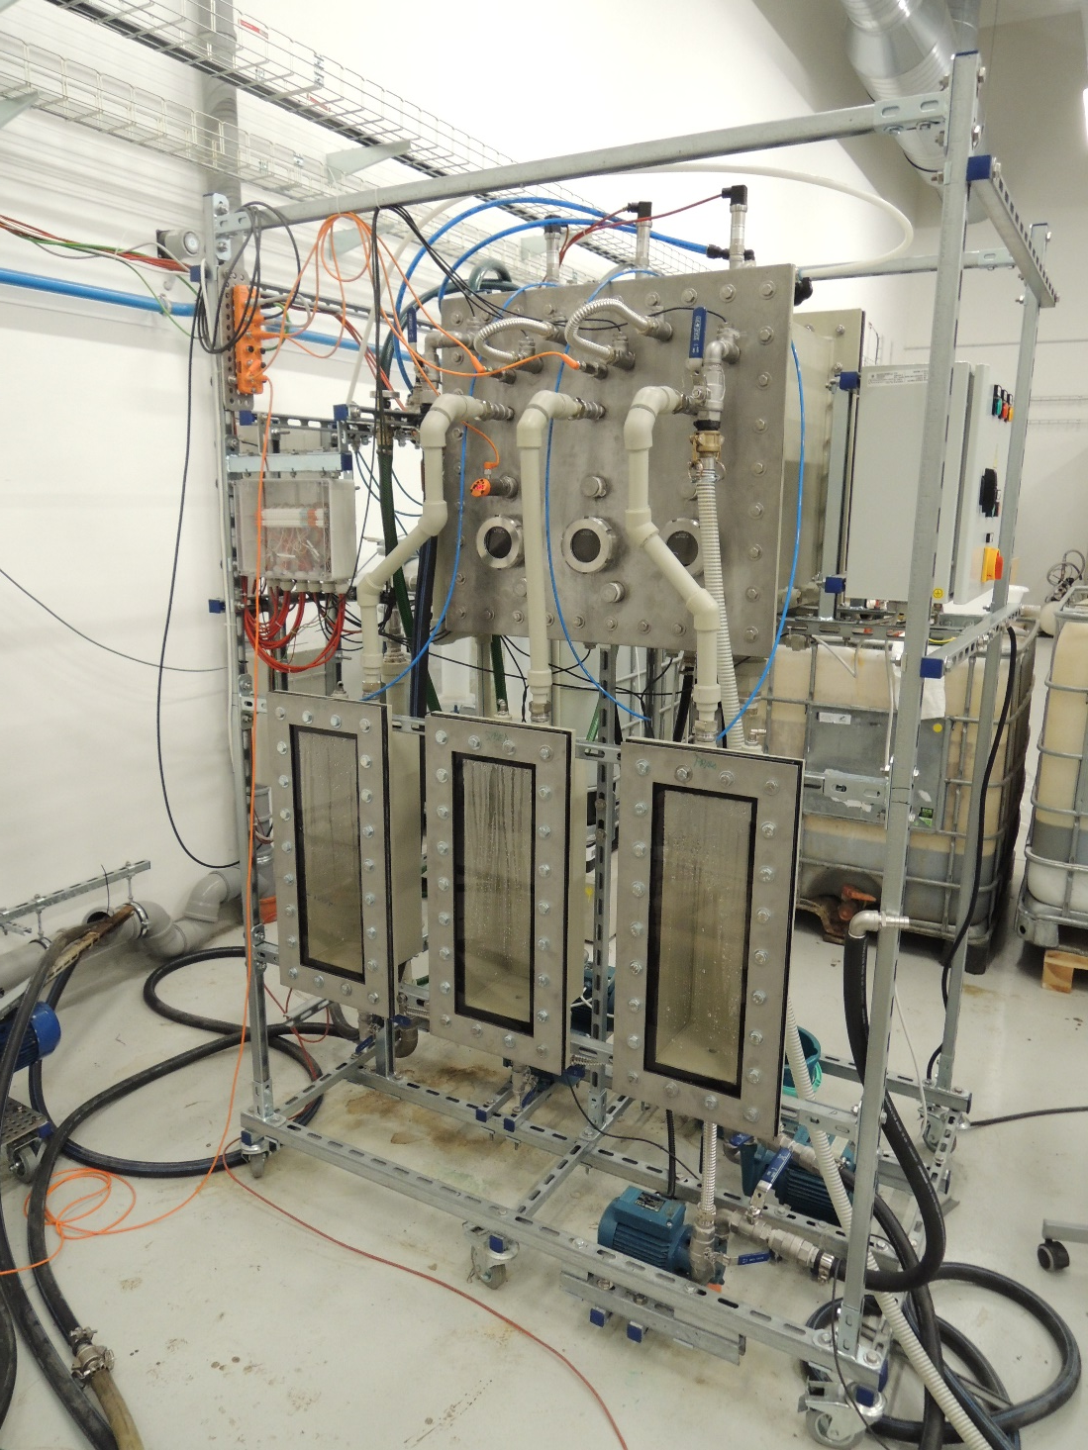
MSF evaporator prototype
Volume reduction up to 80%
Adjusted to LD: foaming, viscosity, high ammonia conc., H₂SO₄ formation
Up to 15 % of DM
Ammonia
in distillate
3000 mg/l
Brno University of Technology

Slide 11
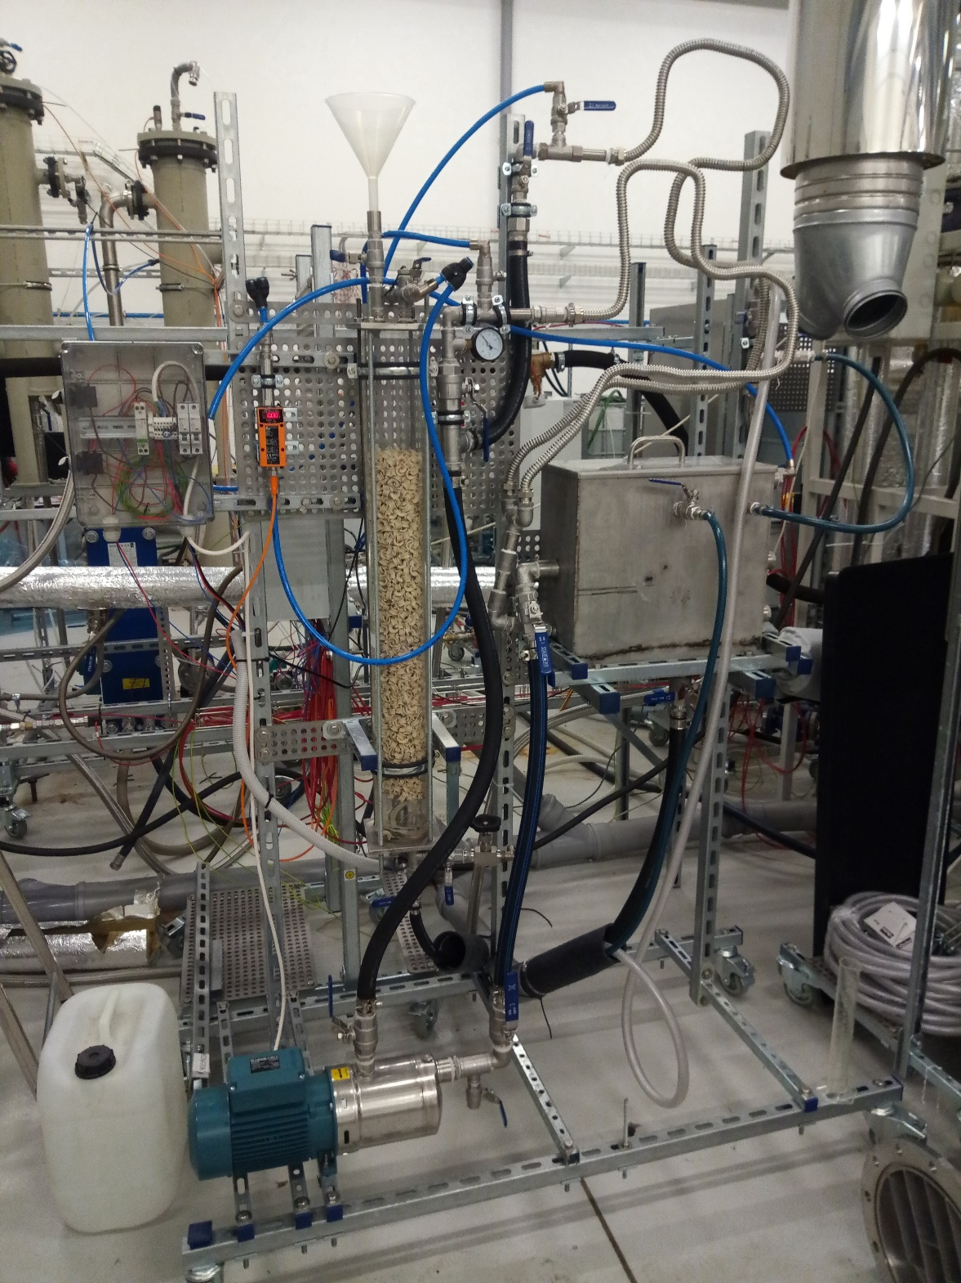
Stripping prototype
Air as a stripping gas
Random packing: ceramic saddles
Up to 95 % ammonia removal
Ammonia
below
40 mg/l
Brno University of Technology

Slide 12




Pilot plant in Dříteč (CZ)
Project starting in 2021
Designed capacity of 32 t/d
Thermal input 250 kW
Cooperation with industrial partners

Slide 13
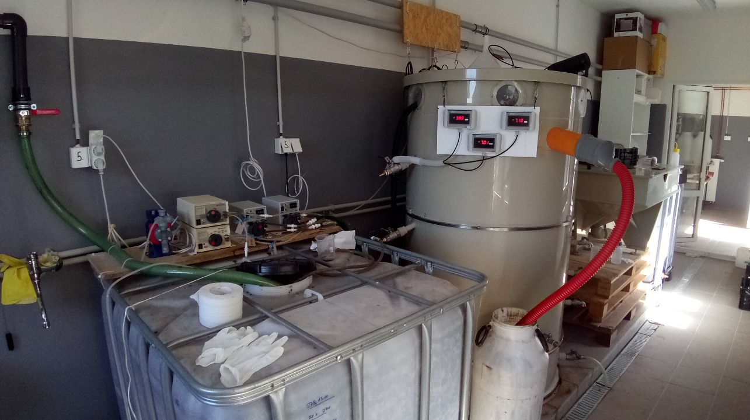
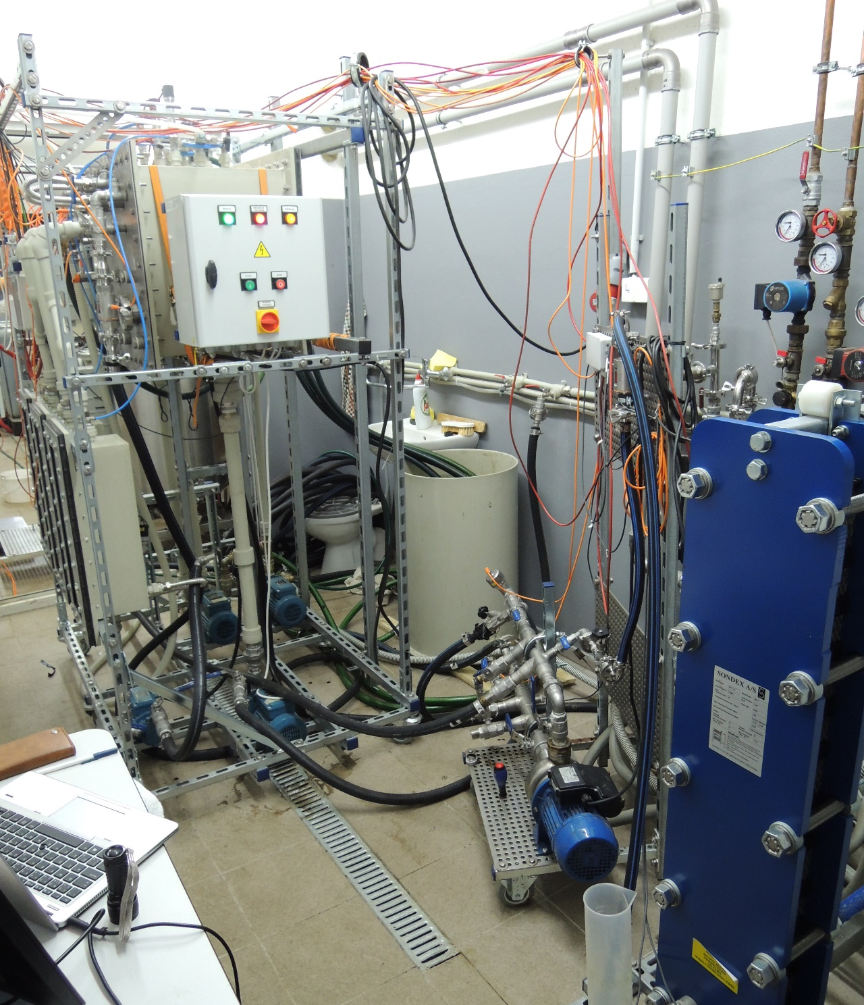
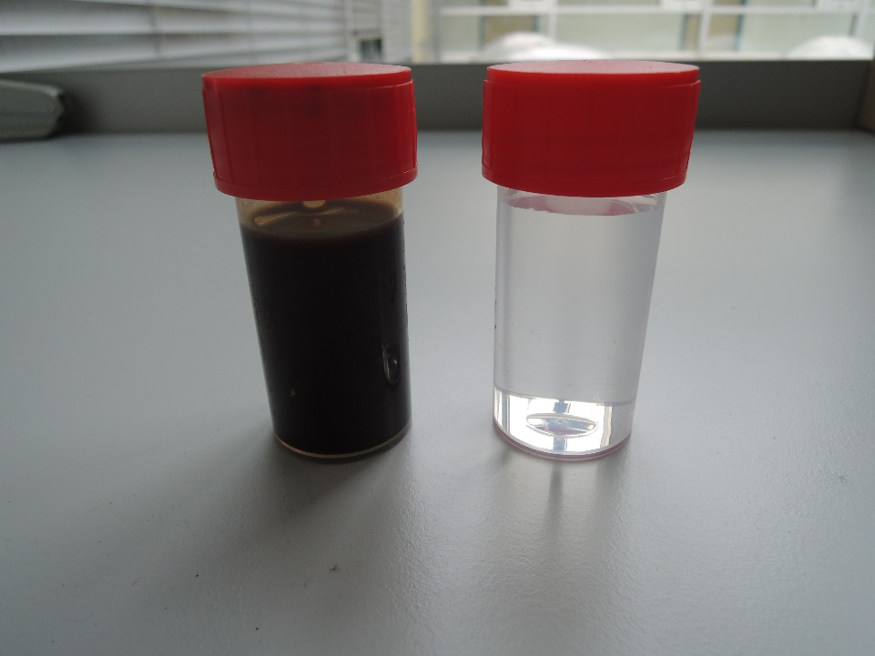
Alternative solution:
Nitrification + Evaporation
Czech University of Life Sciences Prague
 |  | Distillate,A | Distillate,B | Input
N-NH4 | mg/l | 40 | 20 | 16
COD | mg/l | 13 | 16 | 11067
N-total | mg/l | 47.6 | 30.0 | 4540
P-total | mg/l | 0.52 | <0,10 | 79.33
S-total | mg/l | 0.58 | <0,5 | 425
Brno University of Technology

Slide 14
Conclusions & Future work
Digestate thickening brings number of benefits
Proposed technology: evaporation + stripping
Sufficient quality of the separated water
From prototypes to full-scale pilot plant
Development of the thickening system
Reduction of investment costs and elektricity consumption
Pilot plant installation and testing

Slide 15
Acknowledgment
Strategic Partnership for Environmental Technologies and Energy Production
BRNO UNIVERSITY OF TECHNOLOGY
FACULTY OF MECHANICAL ENGINEERING
Project reg. Nr.: CZ.02.1.01/0.0/0.0/16_026/0008413
Pilot plant for digestate reduction in biogas plants
BRNO UNIVERSITY OF TECHNOLOGY
FACULTY OF MECHANICAL ENGINEERING
Project reg. Nr.: FW03010481 (Technology Agency of the Czech Republic)

Slide 16
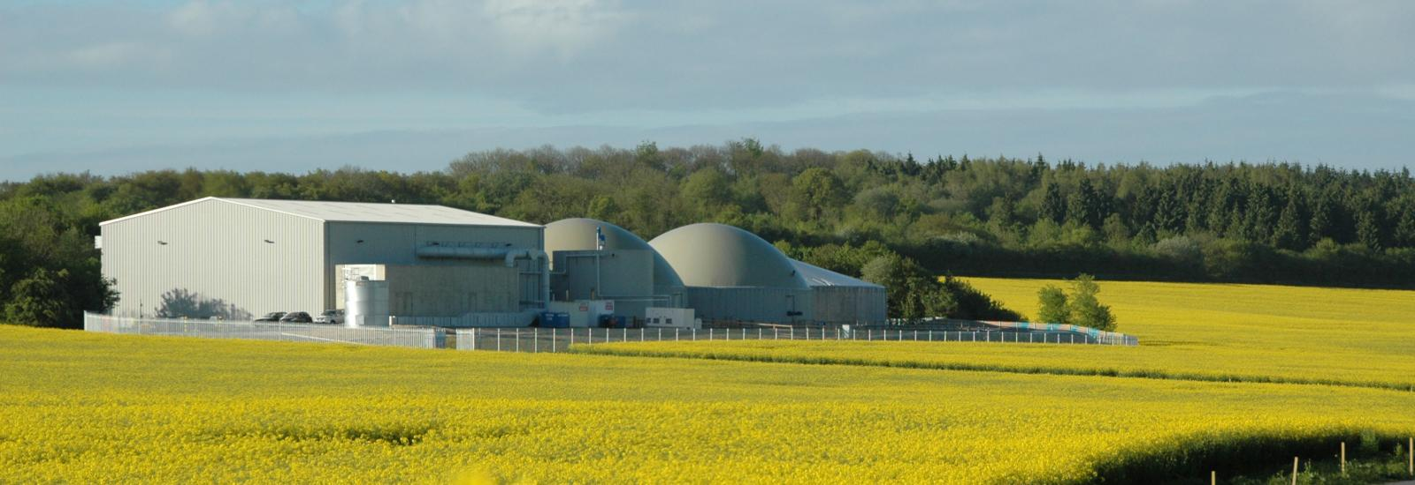
Thank you.
Marek Vondra
m.vondra@vut.cz
Source: www.fli-energy.com

