Slide 1
Phosphorus recovery technologies from ‘waste’ streams
Joana Lapao Rocha
UCT, Prague

Slide 2
Food Security
Phosphorus is irreplaceable and impossible to synthesize
Indispensable to maintain high agricultural yields
Phosphate rock was added to the list of critical raw materials at EU level

Slide 3
Phosphate Rock Reserves

Slide 4
P Resources Governance
Restriction on mineral fertilizers use
Global and local agriculture towards sustainability
Map P stocks and flows to identify bottlenecks and losses
Ensure P recovery and reuse

Slide 5
P recovery technologies
From meat and bone meal
 | P (in % of DM)
Bone meal | 10.5 (5.24-16.5) | Better for the use in acidic soils
Meat meal | 3.42 (0.30-4.74) | High plant P availability
Meat and bone meal | 5.31 (2.21-9.62)
Meat and bone meal ashes | 14.02 (6.07-18.9) | Ashes from monoincineration of MBM- high amounts of Ca and P

Slide 6
Manure
Pros | Cons
P in plant available form (inorganic form) | High transportation costs
Substitution of mineral fertilizers | Difficult to define proper application rate – necessary to separate liq. from solid phase
Cost efficient | Risk of pathogens, odors
To improve transportability and storage is beneficial to perform anaerobic digestion

Slide 7
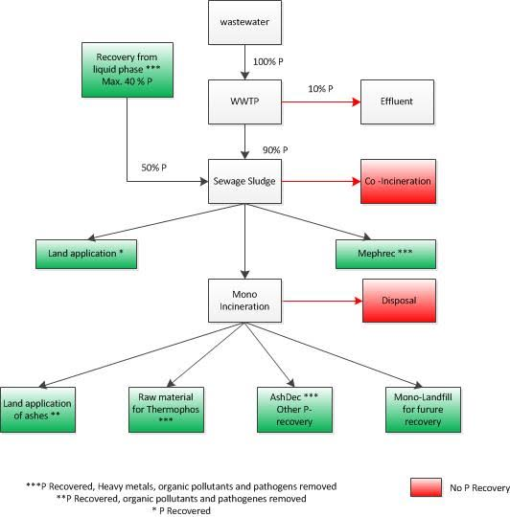
Wastewater

Slide 8
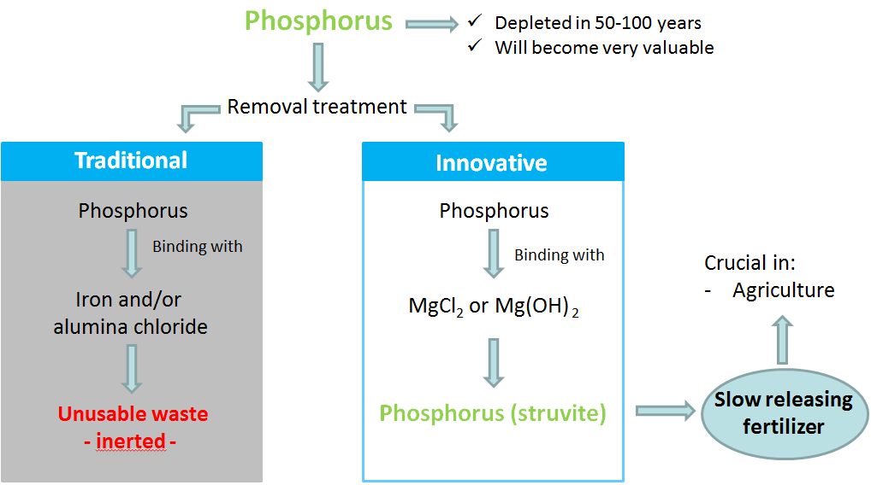
Struvite
Low recovery efficiency 30%
Simple
Cost effective
Chemical precipitation
Ca₁₀(OH)₂(PO₄)₆ or,
MgNH₄PO₄

Slide 9
Sludge

Slide 10
Ash-Dec technology

Slide 11
Product Characterization
40-80% crystalline phases
Plant availability dependent on proton supply and soil characteristics
Presence of heavy metals ( dependent on the initial ash composition) usually in low concentrations

Slide 12
Leachphos technology

Slide 13
Product Characterization
Amorphous
40%protonated Ca-P
60% free ortho-P and P loosely bound to Al
Plant availability 70-100%, not dependent on the soil characteristics
Presence of heavy metals in low concentrations

Slide 14
Conclusions
For a sustainable governance of phosphorus is necessary to involve various stakeholders
Phosphorus recovery can be done at diverse scales: households, farms, megacities
‘wastewater’ is a suitable substitute of PR as a raw material

Slide 15
Thank you for your attention
Rochaj@vscht.cz

