Slide 1

New technologies for energy supply needs in the field humanity and military base
Ing. Libor Baraňák Ph.D

Slide 2
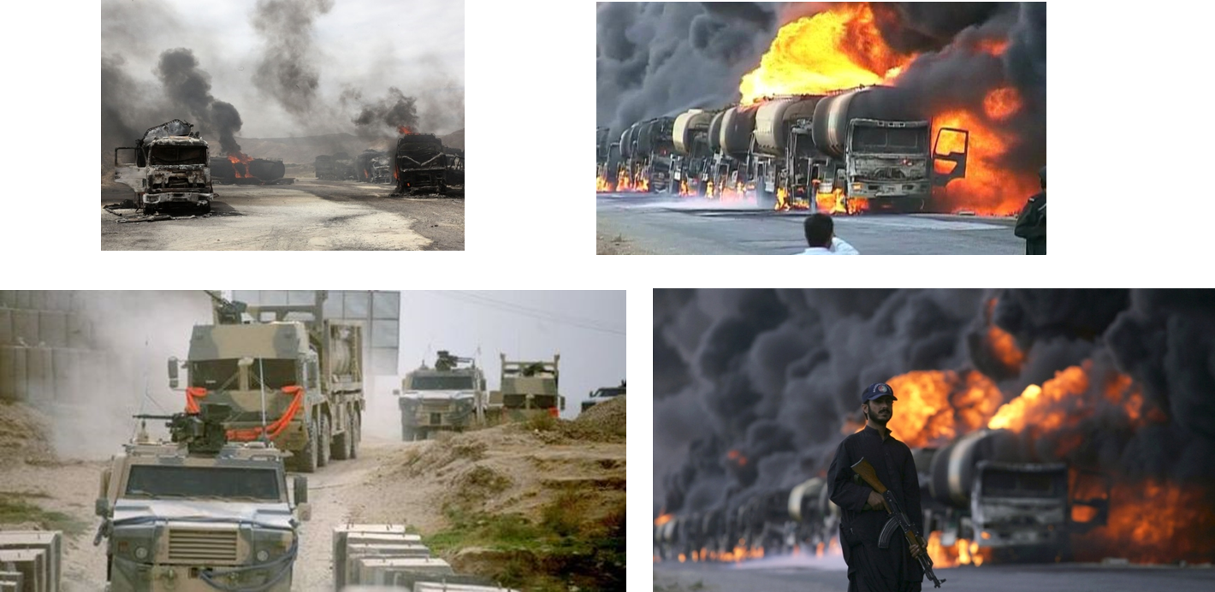
Disposal supply convoys

Slide 3
Analysis

Slide 4
Analysis

Slide 5
New technologies OFWEC III

Slide 6
GEM TRL6

Slide 7
HEDWEC

Slide 8
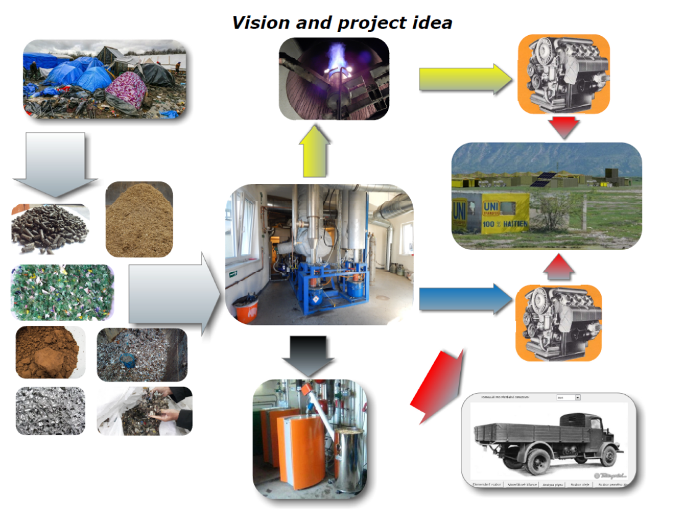
AČR

Slide 9
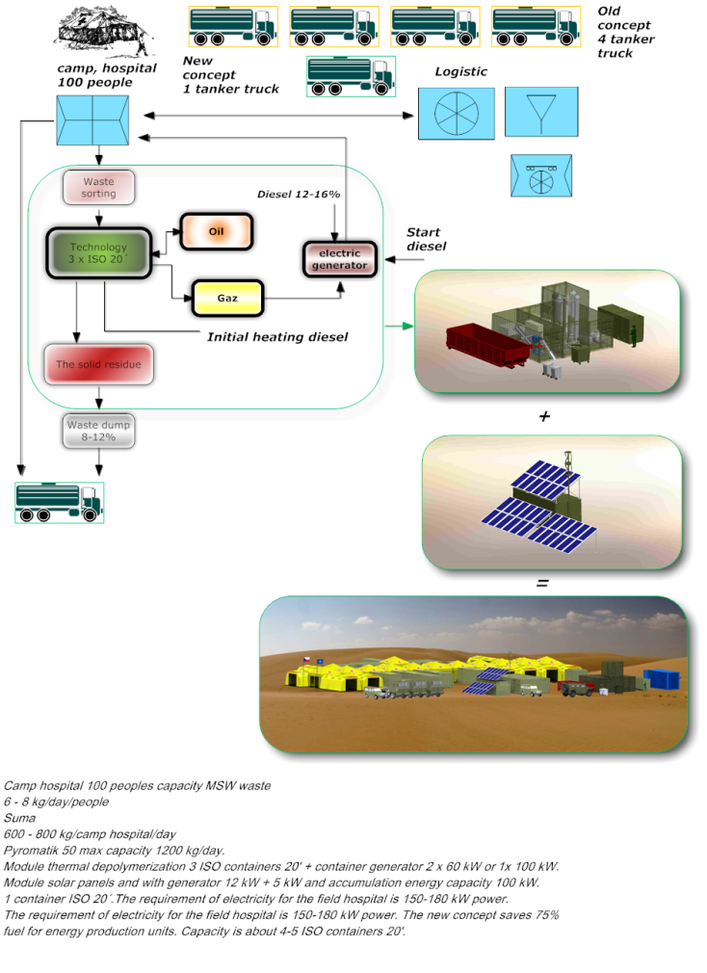
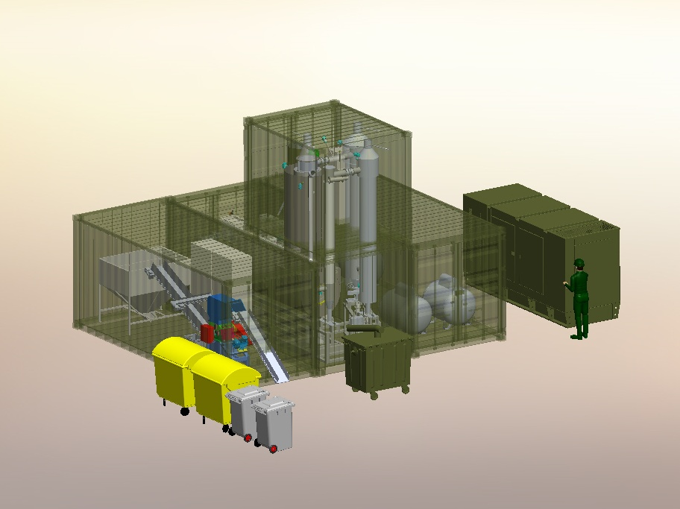
AČR

Slide 10
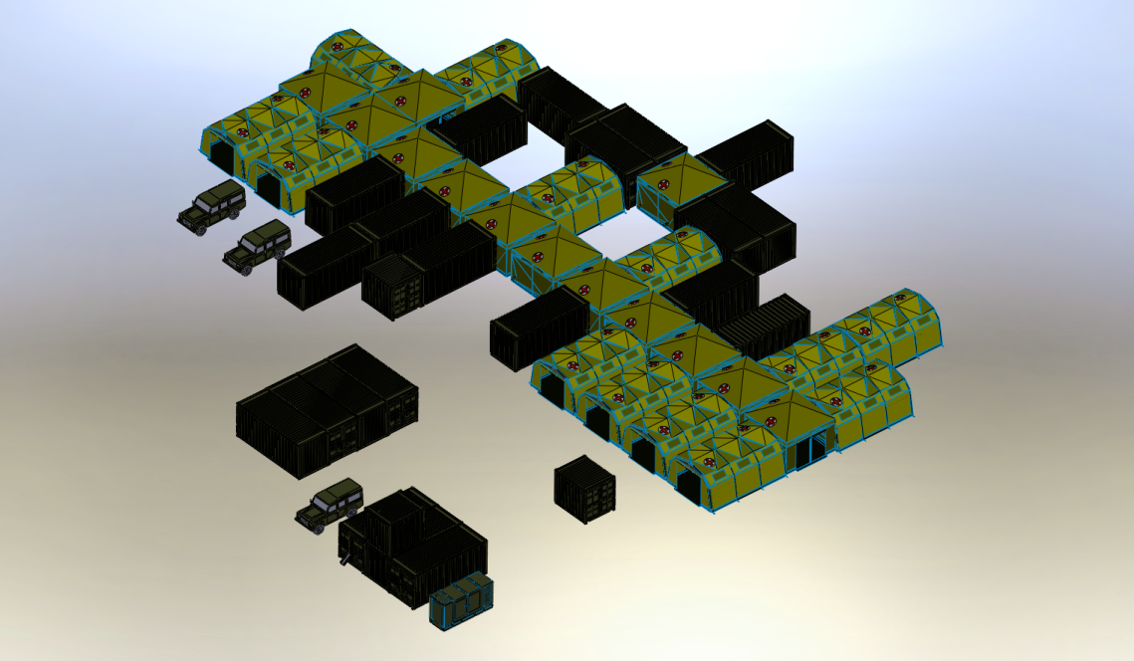
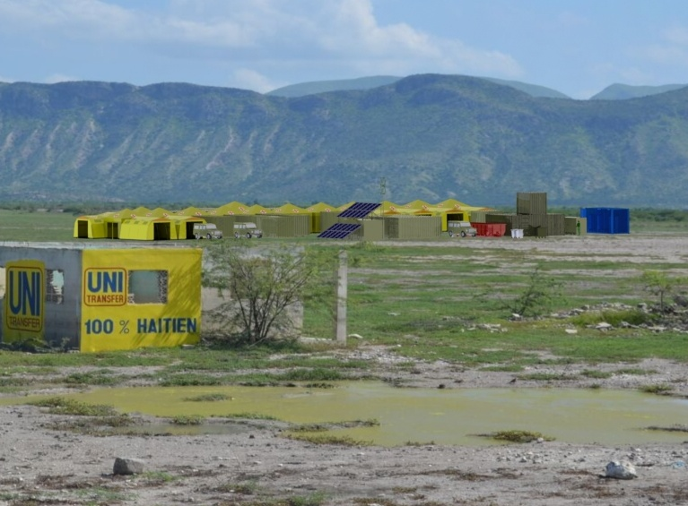

Slide 11
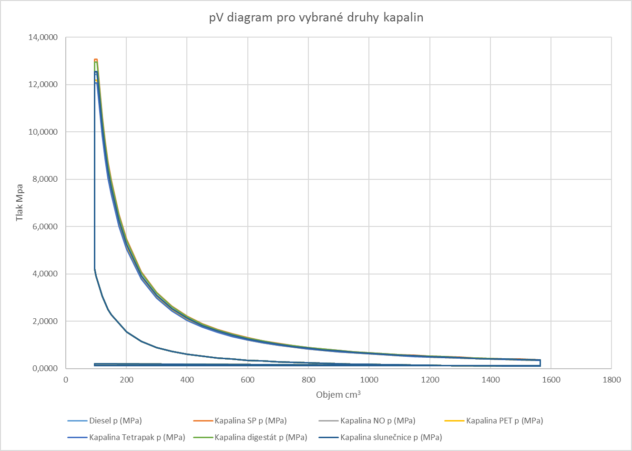
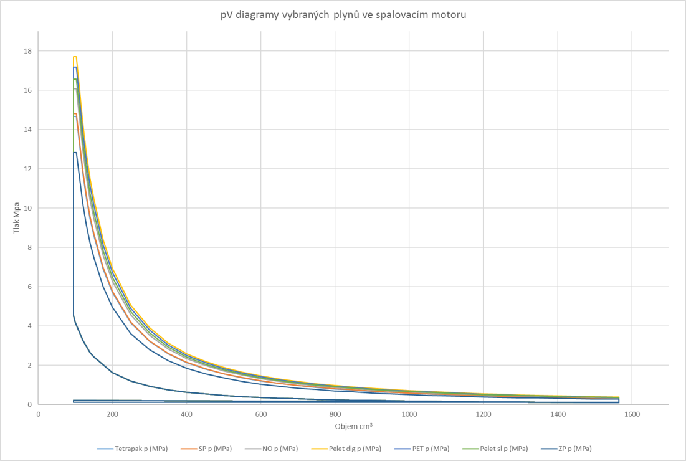
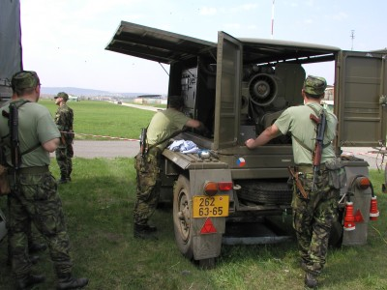
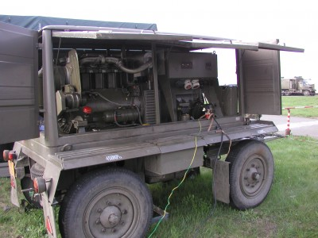
T-924-A53 dual engine

Slide 13
Result

Slide 14
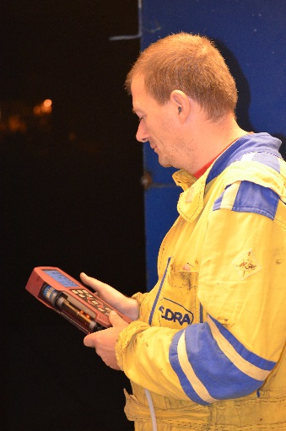
Thanks for your attention

