Slide 1
Applying of LCA methodology on the sludge management operation
Authors:
Ing. Réka Csicsaiová
Prof. Ing. Štefan Stanko, PhD.
Prof. RNDr. Ivona Škultétyová, PhD.
Ing. Jaroslav Hrudka, PhD.

Slide 2
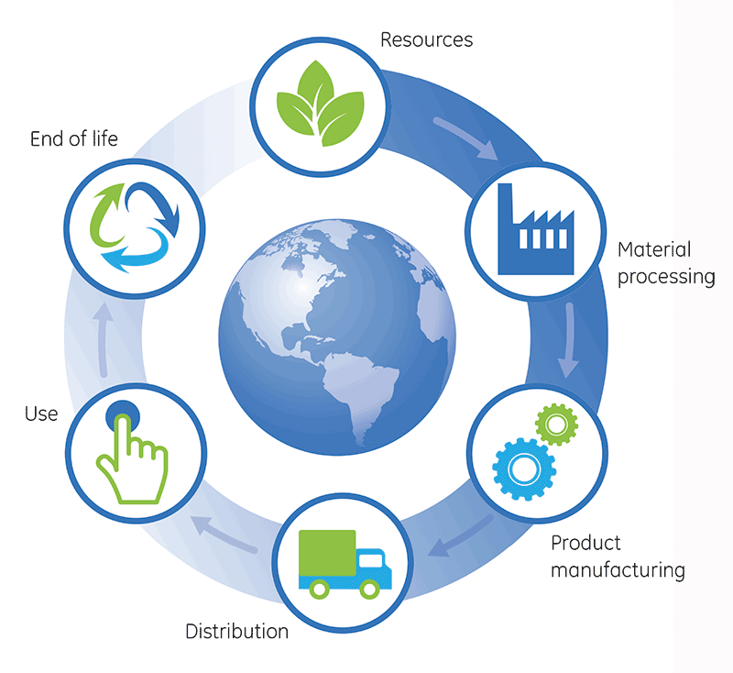
TABLE OF CONTENTS
Introduction - Life Cycle Assessment,
ISO standard 14040,
Methodology of impact assessment
Conclusion.

Slide 3
INTRODUCTION LIFE CYCLE ASSESSMENT
Goal and scope definition
Life Cycle Inventory (LCI)
Interpretation
Life Cycle Impact Assessment
Function
Functional unit
Reference flow
System boundaries
Product system model
Environmental profile of product
Impact categories
Identification of significant findings
Evaluation of the LCA study
Suggestions for product system innovation
Life Cycle Assessment

Slide 4
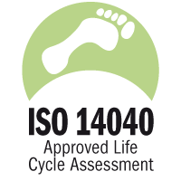
LCA ISO 14044
function of the product system,
functional unit,
system bounderies,
the type and form of assessment,
restrictions,
data requirements and data quality,

Slide 5
MATHERIALS AND METHODS The goal and scope definition
was built in 1944 and in 2013 underwent intensification and extension to a capacity of 22 300 EO,
The wastewater treatment process is a low-pressure activation process that operates on the principle of sequential nitrification and denitrification to remove nitrogen contaminants with simultaneous aerobic sludge stabilization.
The sludge management consists of a thickening and storage tank. Both tanks are equipped with aeration with drainage of sludge water and a hinging hose for draining water from the surface.
The aim of this analysis is to assess the benefits and disadvantages of running the sludge management of the municipal waste water treatment plant to the environment.

Slide 6
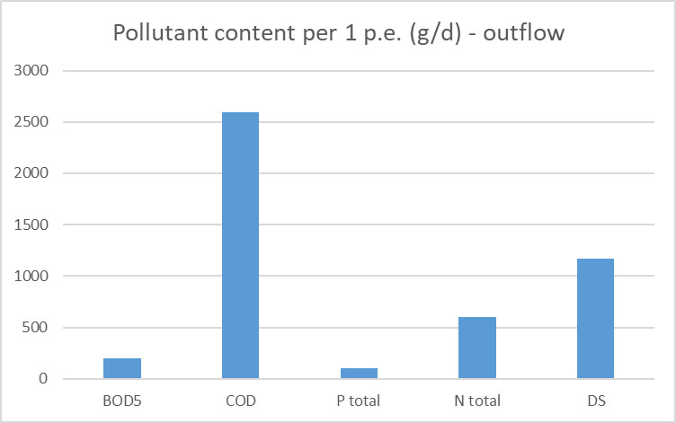
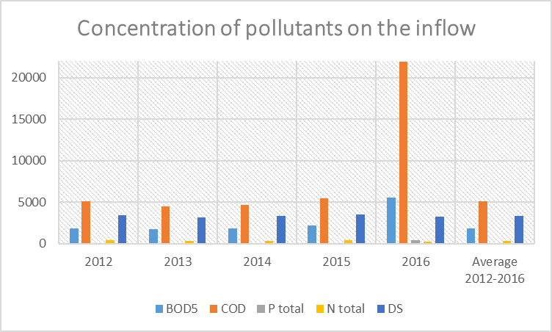
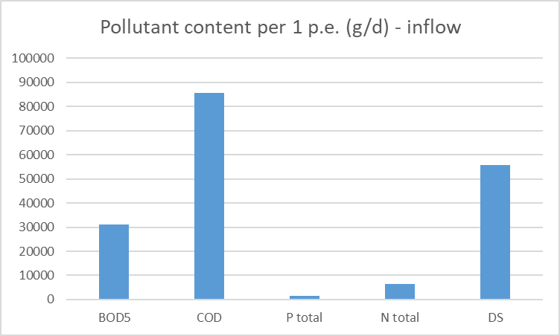
MATHERIALS AND METHODS Inventory analysis and Life cycle impact assessment

Slide 7
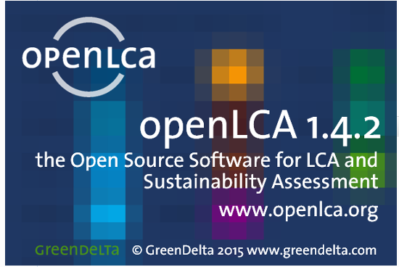
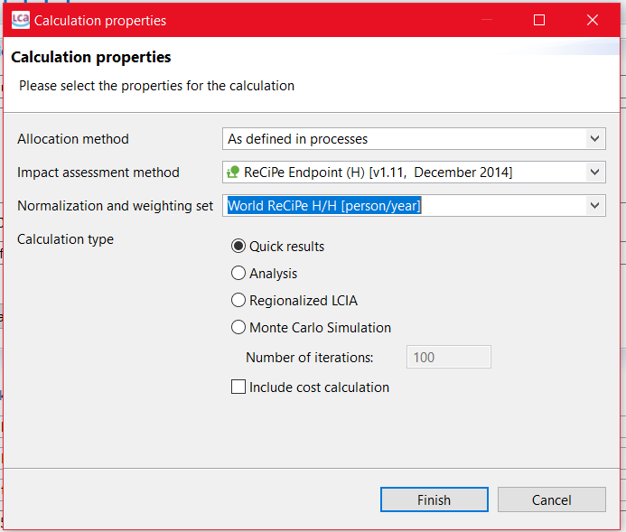
MATHERIALS AND METHODS Inventory analysis and Life cycle impact assessment
OpenLCA,
Free databases,
several impact methods,
ReCiPe midpoint.

Slide 8
RESULTS
Environmental impacts on ecosystem quality

Slide 9
RESULTS
Impacts of WWTP on human health

Slide 10
Conclusion
The aim of the paper was to intorduce the LCA methodology and its use for assessing the environmental impacts of the sludge management. The LCA analysis identified possible adverse impacts of the wastewater treatment process on the environment.
Impact assessment of the plant life cycle is based on the correct determination of the function, the functional unit of the system under consideration, system boundaries and the reference unit.
A significant part of the assessment is based on the legislative limits of individual indicators.
The characterization profile was created in OpenLCA. This program is a tool for converting impact indicators into impact categories and displays the results of the analysis. During the LCIA, it was found that the sludge management has the following environmental impacts: climate change, exhaustion of fossil resources, freshwater ecotoxicity, human toxicity, ionization radiation, formation of solid particles and photochemical oxidation.

Slide 11
Thank you for your attention

