Slide 1
Removal of ions of
harmful metals from
water with help of
original composite sorbent
DUŠAN BEREK, IVAN NOVÁK,
POLYMER INSTITUTE, SLOVAK ACADEMY OF SCIENCES
84541 BRATISLAVA, SLOVAKIA
DAVID HUNKELER, AQUATECH-WATER, GENEVA, SWITZERLAND
HLUBOČEPY 2019

Slide 2
THE PRIMARY TASK – PREPARATION
INEXPENSIVE
POROUS CARBON FIBERS
WITH ADJUSTABLE PROPERTIES
AND BROAD APPLICABILITY - BY
CARBONIZATION OF CELLULOSE

Slide 3
CELLULOSE 
CARBONIZATION 
PYROLYTIC CARBON 
 POROUS CARBON FIBERS

Slide 4
WHY FIBERS?
BECAUSE
 CELLULOSE USUALLY
APPEARS IN FORM OF FIBERS OR FIBER-LIKE STRUCTURE
 COMPARED TO PARTICULATE MATERIALS - FIBERS ARE EASIER TO MANIPULATE AND THEIR BED EXHIBITS DECREASED RESISTANCE TO FLOW OF GASES AND LIQUIDS

Slide 5
MACROSCOPIC PROPERTIES OF C-FIBERS
BOTH LENGTH AND DIAMETER ARE DETERMINED BY STARTING MATERIAL:
 INDUSTRIAL RAW CELLULOSE
 INDUSTRIAL DELIGNIFIED CELLULOSE –
PULP, COTTON WOOL
 NATIVE RAW CELLULOSIC MATERIALS –
YUTA, SISAL, (CRUSHED) BAMBOO,
OIL- AND COCO-PALMS, SAW-DUST....
 CRUSHED WASTE PAPER
 CELLULOSE NANOFIBERS SOON COME UNDER STUDY

Slide 6
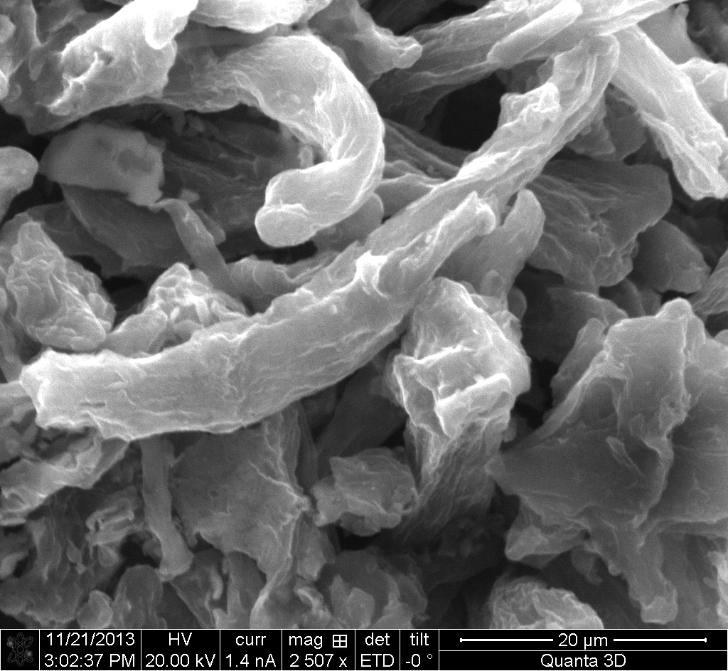
INDUSTRIAL DELIGNIFIED CELLULOSE
„GREENCEL“, HUNCOVCE, SLOVAKIA

Slide 7
GENERATION OF PORES
ACTION OF ACTIVATORS, POROGENS
 MAINLY Zn SALTS, P AND B SUBSTANCES
 ALTERNATIVES: Si, Ti, etc.
PROBLEMS: PRICE AND ECOLOGY
CHALLENGE  CARBONIZATION
WITHOUT POROGENS
HLUBOČEPY 2019

Slide 8
CARBONIZATION UNDER NITROGEN
EXPENSIVE
SOPHISTICATED REACTORS
SIMPLE APPROACH IS NEEDED FOR
PRACTICAL APPLICATION
CLOSED VESSELS WITH
PROTECTIVE ATMOSPHERE
OF CO₂
HLUBOČEPY 2019

Slide 9
BASIC PHYSICAL PROPERTIES OF
SO FAR PREPARED MICROPOROUS
CARBON FIBERS:
-- LENGTH FROM 20 µm TO SEVERAL cm
-- DIAMETER FROM 1 to 100 µm
B.E.T. SURFACE AREA FROM FEW m².g⁻¹ to ALMOST 2,500 (!) m².g⁻¹
HLUBOČEPY 2019

Slide 10
PORE STRUCTURE OF MICRO-POROUS CARBON FIBERS
positron annihilation lifetime spectroscopy
b.e.t. argon adsorption isothermS and gel permeation chromatography -- indicate presence of
narrow pores with similar size in the range of 0.6 nm

Slide 11
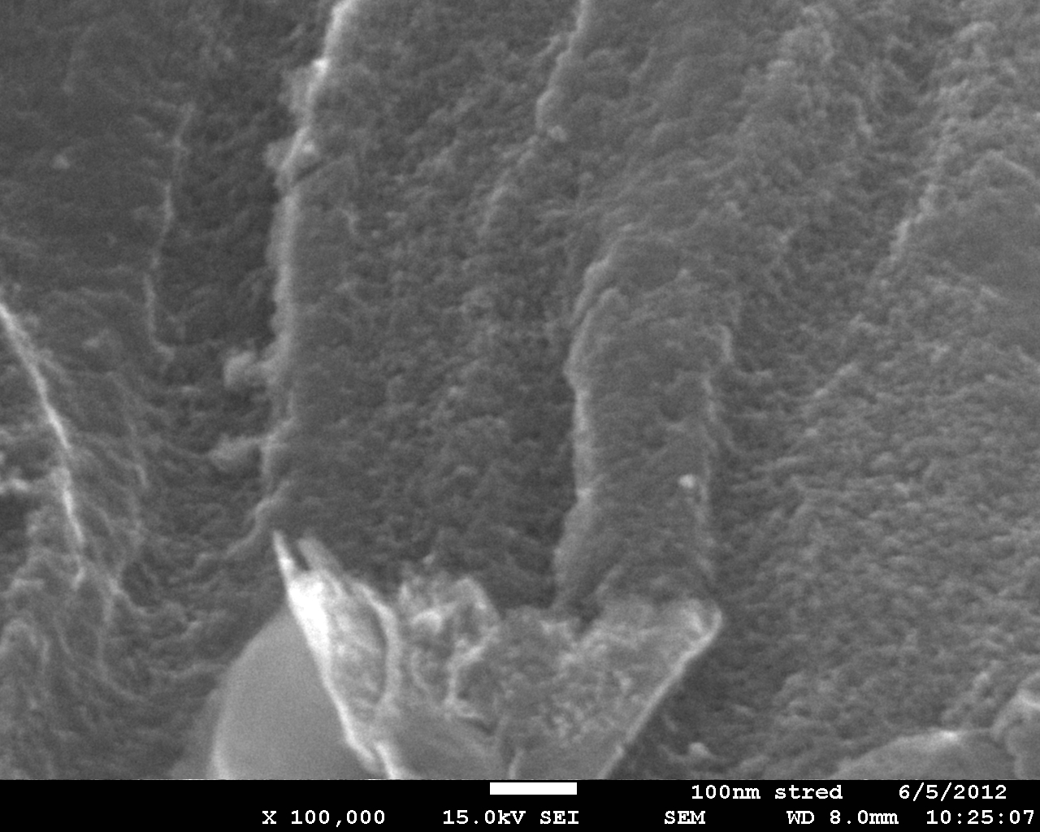

Slide 12
CURRENT ASSUMPTION -
 RATHER UNIFORM, DEEP NANO-PORES
WITH ORIFICES OF DIFFERENT SIZE,
SHAPE AND VOLUME
HLUBOČEPY 2019

Slide 13
FORMATION OF COMPOSITES
 DEPOSITION OF NANO- AND MICROPARTICLES OF ACTIVE SUBSTANCE EXCLUSIVELY ON THE SURFACE OF MICROPOROUS CARBON FIBERS
 ORIGINALLY STRUCTURED COMPOSITE MATERIALS
HLUBOČEPY 2019

Slide 14
PRINCIPLE --
PORES OF SUBSTRATE MUST BE SMALL ENOUGH TO PREVENT PENETRATION OF PRECURORS OF ACTIVE SUBSTANCE, FeCl₃, Ag(NO₃), ZnCl₂, etc.
THE ACTIVE SUBSTANCE GENERATED FROM PRECURSOR BY PRECIPITATION IS DEPOSITED EXCLUSIVELY ON THE SURFACE OF CARRIER SUBSTRATE –
---- MICROPOROUS CARBON FIBERS

Slide 15
FEATURES OF COMPOSITES
 LARGE AND EASILY
ACCESSIBLE SURFACE
OF ACTIVE SUBSTANCE
 LOW FLOW RESISTANCE

Slide 16
HYDRATED FERRIC HYDROXIDE
IS KNOWN FOR ITS HIGH AFFINITY
TO NUMEROUS METAL IONS, incl.
HARMFUL As, Sb, Cr, Pb, Se, ...
NANO- AND MICROPARTICLES OF
Fe(OH)₃.n(H₂O) WERE DEPOSITED
ON THE MICROPOROUS CARBON
FIBER SURFACE – „CF-Fe“

Slide 18
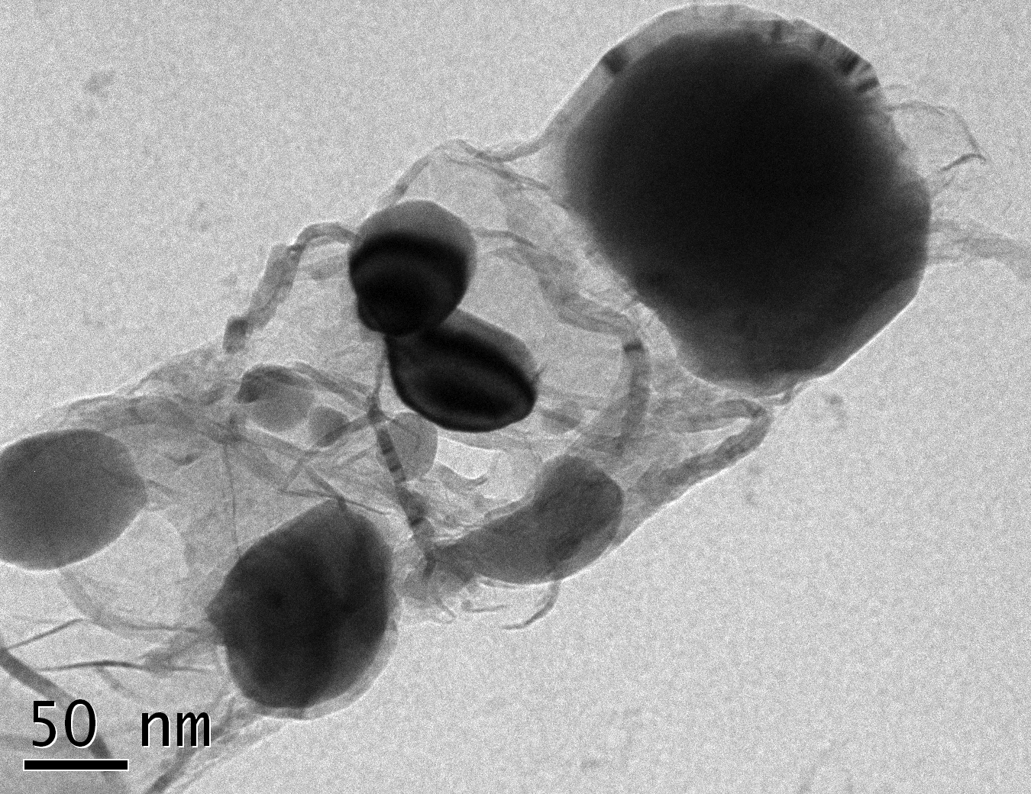
C-FIBER WITH DEPOSITED
HYDRATED FERRIC HYDROXIDE

Slide 19
BOTH EFFICIENCY & CAPACITY OF
CF-Fe COMPOSITE ADSORBENTS
FOR REMOVAL OF HARMFUL
METALS FROM WATER WERE
TESTED UNDER STATIC AND ALSO
DYNAMIC (FLOW-THROUGH)
CONDITIONS
HUSTOPEČE 2019

Slide 21
SAMPLE NUMBER GEH
145 146 148 151 153 157

Slide 22
CONCLUSION 
COMPOSITES CF-Fe EXHIBIT HIGH
ADSORPTION EFFICIENCY AND CAPACITY
FOR As, Sb, Pb, Cd, Se, Cr and Ni, as well
as natural and synthetic RADIONUCLIDES
SUITABILITY FOR WATER TREATMENT
AND PURIFICATION

Slide 23
A SPECIFIC FEATURE OF
COMPOSITE SORBENT WITH A
CARBON CARRIER
TWO DISTINCT KINDS OF SURFACES
ARE PRESENT
 SURFACE OF NANOPARTICLES
 SURFACE OF ORIGINAL CARBON

Slide 24
NUMEROUS ORGANIC IMPURITIES FROM
WATER AND GASES CAN BE REMOVED
WITH HELP OF COMPOSITE MATERIALS
 WASTE OF BOTH SYNTHESES AND
INDUSTRIAL PRODUCTION INCLUDING
COLORANTS, etc.
 MUNICIPAL AND AGRICULTURAL
SEWAGE INVOLVING DETERGENTS,
NITRATES, PRODUCTS OF DIGESTION,
etc., etc.

Slide 25
FURTHER POSSIBLE APPLICATIONS OF
COMPOSITES BASED ON CARBON FIBERS:
 SORBENTS
-- FOR PURIFICATION OF GASES AND LIQUIDS -- PRODUCTS OF INDUSTRIAL CHEMICAL SYNTHESES
-- FOR SELECTIVE ENTRAPMENT AND SEQUESTRATION OF GASES
 CATALYSTS

Slide 26
NUMEROUS OTHER APPLICATIONS
OF MICROPOROUS CARBON FIBERS
ARE AT HAND
A ROOM FOR COOPERATION WITH
MANY PARTNERS IS AVAILABLE
 EVERYONE IS WELCOME
CONTACT:
dusan.berek@savba.sk
HLUBOČEPY 2019

