Slide 1

MiscanValue – Miscanthus waste utilization
Barbora Grycová

Slide 2
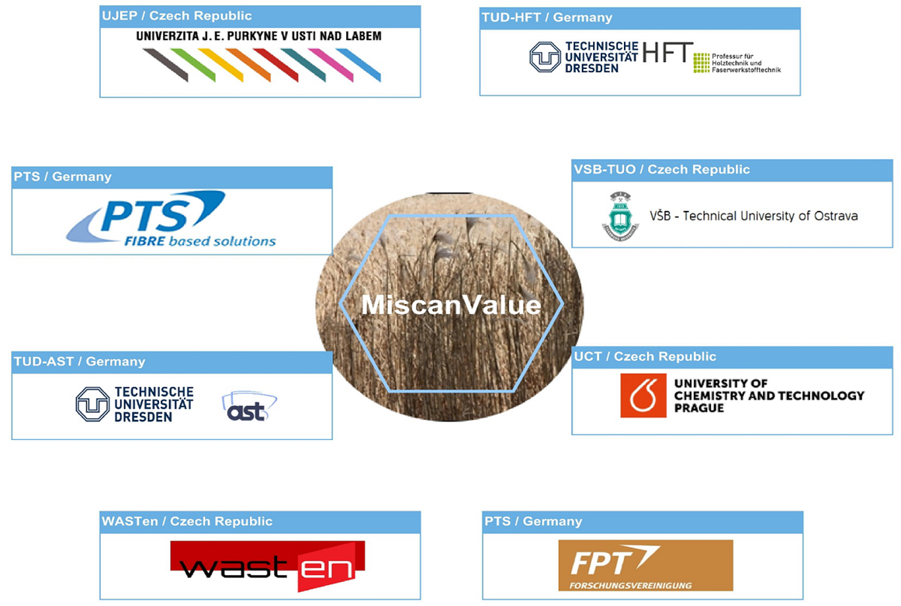
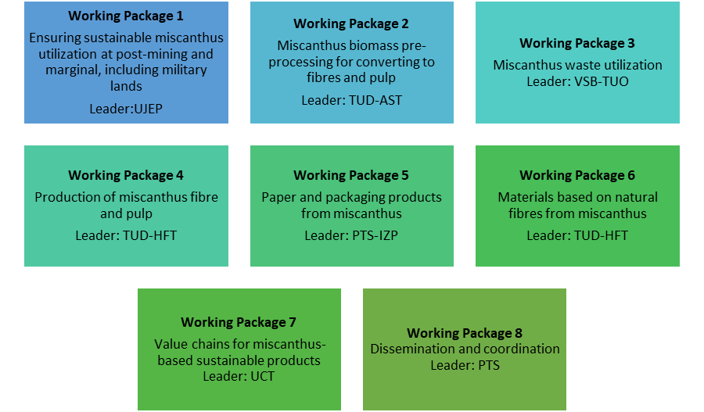
MiscanValue - Cornet project No. CZ.01.1.02/0.0/0.0/19_263/0018837
Creating value chains for utilization of miscanthus fibres from sustainably managed marginal and post-mining areas
The main goal of the proposed project is to ensure a complete miscanthus value chain from sustainable land management at different marginal lands through cultivation, harvest, storage, to biomass processing to fibres, pulp, fibrous materials and packaging paper. The developed value chain will be relevant to the circular economy and imply a “zero waste” approach. Overall, the proposed project will contribute to the EU Bioeconomy Strategy and strengthen transboundary cooperation between Saxony province and Czech Republic.

Slide 3

MISCANTHUS GIGANTEUS
Soil preparation
Seeding
Plant growth
Harvest
It is a perennial plant, does not require any special care.
Under favorable conditions, the plant reaches a height of 4 m.
It is resistant to freezing, diseases and pests.
Planting takes place from March to early May.
Harvesting can be done with self-propelled forage harvesters.
Harvesting takes place after winter (February, March).
The plant does not grow deep into the soil, so the final liquidation of the vegetation is simple.
Taken from company SWHG Valašské Meziříčí.

Slide 4
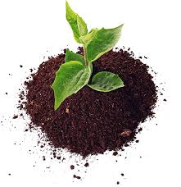
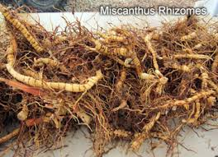
Time schedule – IET Ostrava – 2020/2021
Paper
+
Textile fiber
Production
residues
Miscanthus
Miscanthus
Rhizome
Pyrolysis
400-700 °C
Biochar
Proximate and Ultimate analysis
Physisorption (BET)
Analysis of PAHs (extraction by toluen)
Study of phytotoxicity
and ecotoxicity of biochar
Analysis of Heavy Metals (leaching)

Slide 5
Cleaning
Particle size adjustment
Pyrolysis experiments
Proximate and ultimate analysis
Final products evaluation
Drying
High pressure water cleaning
Drying under air for several days.
Material delivery
Uncleaned
Undried
Inhomogeneous particle size
Particle size adjustment with the use of knife mill LMC up to 3 mm.
Determination of moisture, volatile matter, fixed carbon, ash, elemental composition and heating values.
Process conditions: 600 °C with heating rate 5 °C/min and 2h residence time
In terms of physical, chemical and fuel properties

Slide 6
CHANGES IN MATERIAL FORM
Raw material
Milled material
Cleaned and dried material
Pyrolyzed material

Slide 7
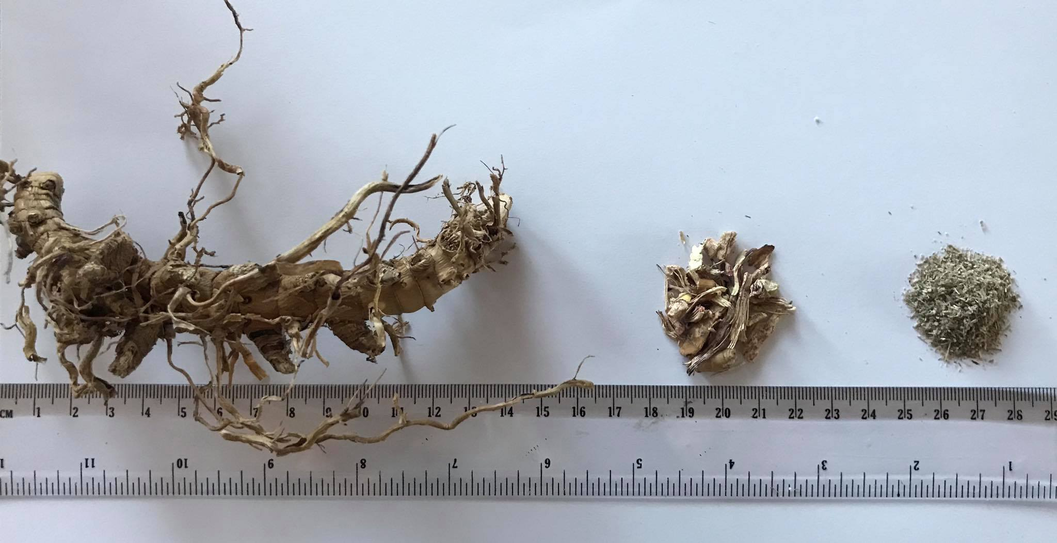

Slide 8


Slide 9
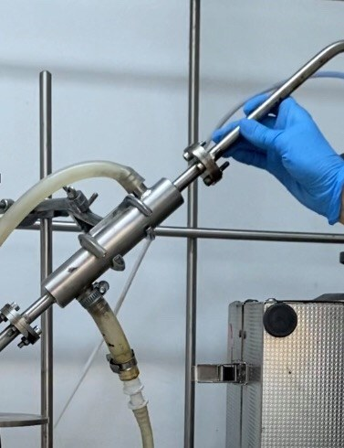
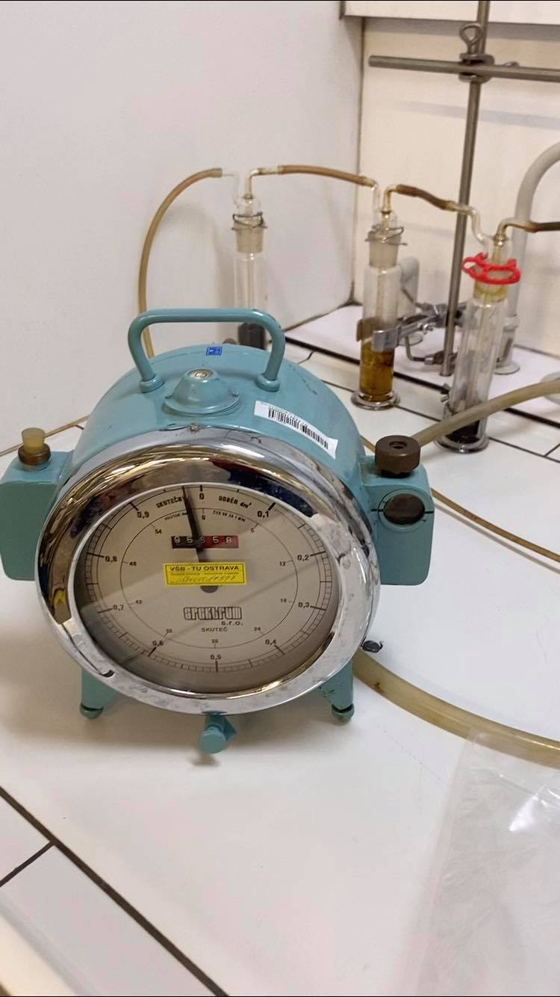
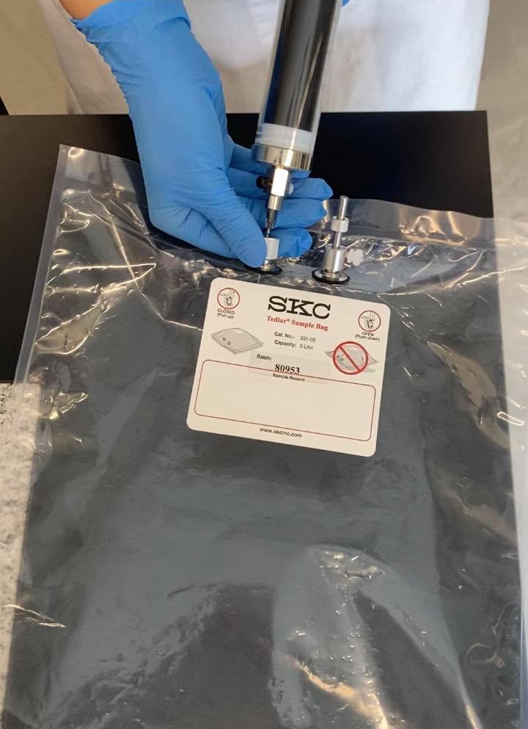
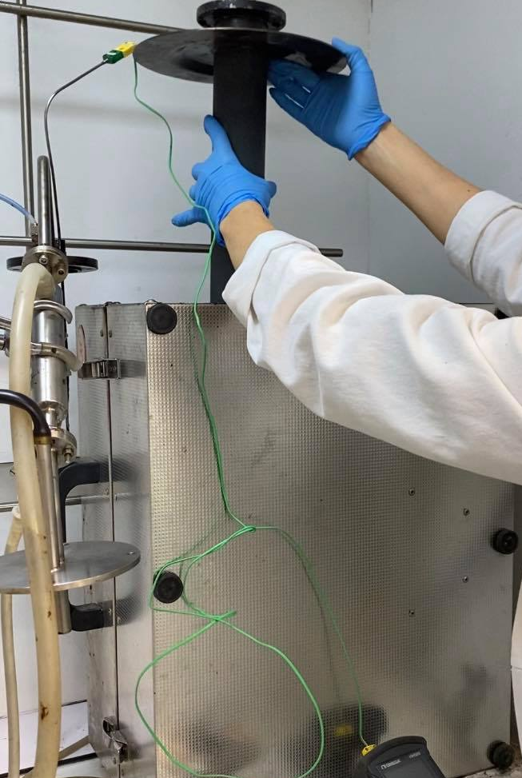
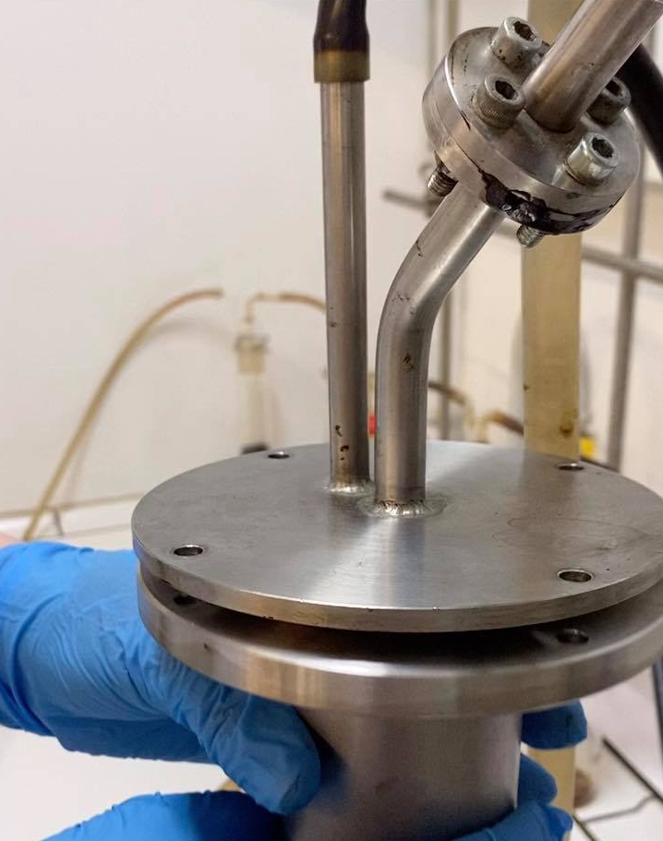
LABORATORY UNIT

Slide 11
FINAL PRODUCTS EVALUATION
Experiment
Solid product
Fuel properties:
TGA, EA, CA
Sorption properties:
S_{BET}
Liquid product
GS-MS
Karl fischer titration
Gas product
GC
+ advanced analyses according to the IBI Biochar Standards

Slide 12
Thank you for your attention
Ing. Barbora Grycová, Ph.D.
+420 597 327 331
barbora.grycova@vsb.cz
www.iet.vsb.cz
https://miscanvalue.wasten.cz/

