Slide 1
Life cycle assessment of biowaste management: comparison of various alternatives in Prague
ODPADOVÉ FÓRUM
21st, September 2022 - Hustopeče
Aurore Guillaume
Supervisor: prof. Ing. Vladimír Kočí, Ph.D., MBA

Slide 2
Introduction
Non valuable
Biowaste: garden waste + kitchen waste
EU objectives:
2023: container for biowaste
2030: reduce part of biodegradable waste going to landfill
➔ evaluate environmental impacts of current biowaste management situation in Prague
25%
25%
6%
40%
Autopsy of mixed waste in Prague

Slide 3
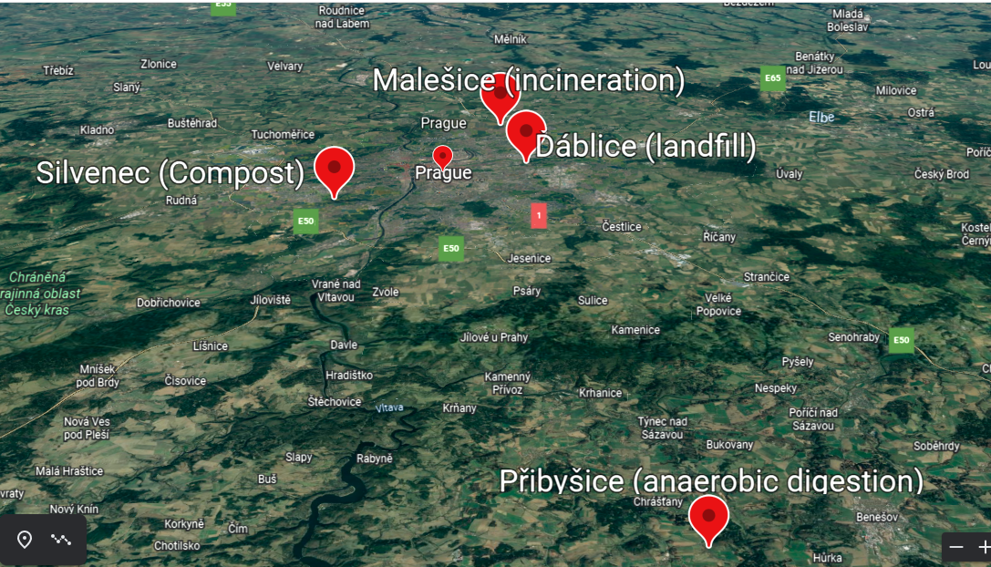
Introduction
Part of mixed waste
81% incineration
7% landfill
12% compost
0,03% anaerobic digestion
Collected separately
➔ 88.3 kg/capita/year biowaste in Prague

Slide 4
Method
Landfill
Life Cycle Assessment (LCA)
Biowaste collection (88.3 kg/capita/yr)
Incineration
Transport
Avoided burden (energy + mineral fertilizer)
Compost
Anaerobic digestion

Slide 5
Method
Source: Prague municipality, CENIA (Czech Environmental Agency), Pražské služby, literature
Impact assessment method: Environmental Footprint 3.0 (EF 3.0) and IPCC
Impact categories:
Climate change
Resource use (fossils)
Ecotoxicity to freshwater
Water use

Slide 6
Results - Current situation in Prague
EF 3.0 normalized and weighted

Slide 7
Results – Different energy mix
Electricity from power wind mix & Steam from biomass
EF 3.0 normalized and weighted

Slide 8
Results - Separate collection of biowaste
BUT doesn’t include biogenic carbon in EF 3.0!
EF 3.0 normalized and weighted

Slide 9
Results – Climate change

Slide 10
Results – Climate change - biowaste separation

Slide 11
Discussion
Difficult to draw conclusion:
Biogenic carbon emissions?
Avoided burden: energy grid mix ?
Do we want to focus on avoided emissions or avoid direct emissions?
If we include biogenic emissions and we have a grid mix with more renewable energy, there are environmental benefits to separate biowaste
If we don’t consider biogenic emissions and with current energy sources, environmental benefits due to avoided burdens

Slide 12
Conclusion
Climate change and resource use most important impact categories
Significant influence of energy grid mix
Different point of view: biogenic emissions ? Avoided burden ?
Locally dependent (improvement in technologies, transport, energy mix)
Future:
Production of biomethane from fermentation?
Anaerobic digestion more efficient and injection of steam to grid mix?

Slide 13
References
Thank you for your attention. Questions?
Ekora. Oznámení záměru podle přílohy č. 3 zákona 100/2001 Sb. - Zpracování biologických odpadů v zařízení anaerobní digesce - Přibyšice; Prague, 2006.
Forbes, H.; Quested, T.; O'Connor, C. Generation, recovery and disposal of waste for the period 2020; Czech Statistical Office, 2021. https://www.czso.cz/documents/10180/143330119/28002021.pdf/41f799e9-3ffb-4702-a517-0c2dc1525144?version=1.3.
Petra Strouhalová. PILOTNÍ PROJEKT SBĚRU GASTROODPADŮ ŽIVOČIŠNÉHO A ROSTLINNÉHO PŮVODU Z DOMÁCNOSTÍ NA ÚZEMÍ HL.M. PRAHY; oddělení odpadů OCP MHMP,, 2021.
This project is supported by specific university research grant A2_FTOP_2022_009.

Slide 14
Comparison between technologies
EF 3.0 normalized and weighted

Slide 15
Results - Current situation in Prague
EF 3.0 normalized and weighted

