Slide 1

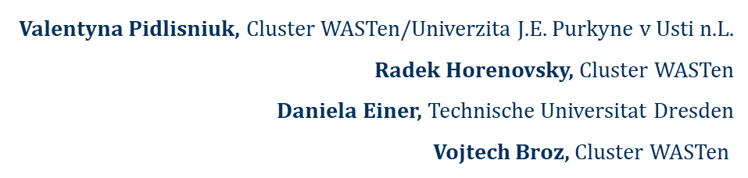
MiscanValue Final Conference
Hustopeče, the Czech Republic
September 21, 2022

Slide 2

MiscanValue - Creating value chains for utilization of miscanthus fibres from sustainably managed marginal and post-mining areas

Slide 3









07/2020 – 12/2022
End User Committees: Germany and the Czech Republic
Notes:
Introduction
Introduce project as a joint Czech-German research project
Institutions, universities and businesses from both countries including user committee from all relevant sectors

Slide 4
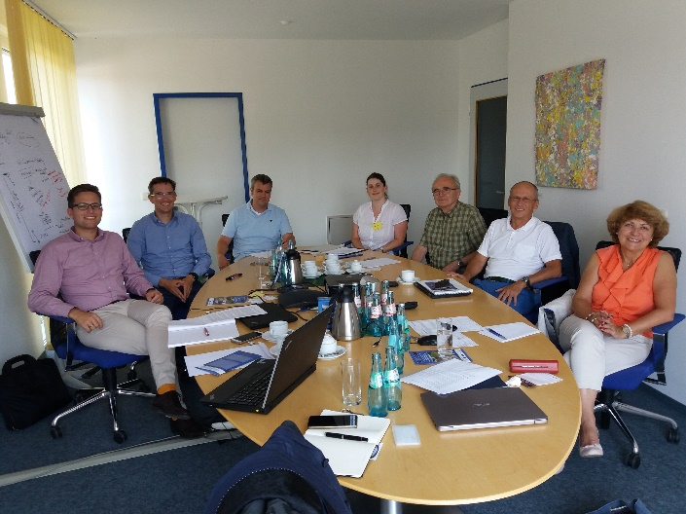
Working packages:
The main goal is to ensure a complete Miscanthus value chain from sustainable land management at different marginal lands through cultivation, harvest, storage, to biomass processing to fibres, pulp, fibrous materials and packaging paper. Simultaneously, Miscanthus waste produced during processing and from contaminated plant tissues from the field is utilized by pyrolysis to energy and biochar used at the fields again.
WP 1: Ensuring sustainable miscanthus utilization at post-mining and marginal, including military lands: UJEP
WP 2: Miscanthus biomass pre-processing for converting to fibres and pulp: TUD-AST
WP 3: Miscanthus Waste Utilization: VSB-TUO
WP 4: Production of Miscanthus fibre and pulp: TUD-HFT
WP 5: Paper and packaging products from Miscanthus: PTS-IZP
WP 6: Materials based on natural fibres from Miscanthus: TUD-HFT
WP 7: Value chains for Miscanthus-based sustainable products: UCT
WP 8: Dissemination and coordination: PTS and WASTen

Slide 5
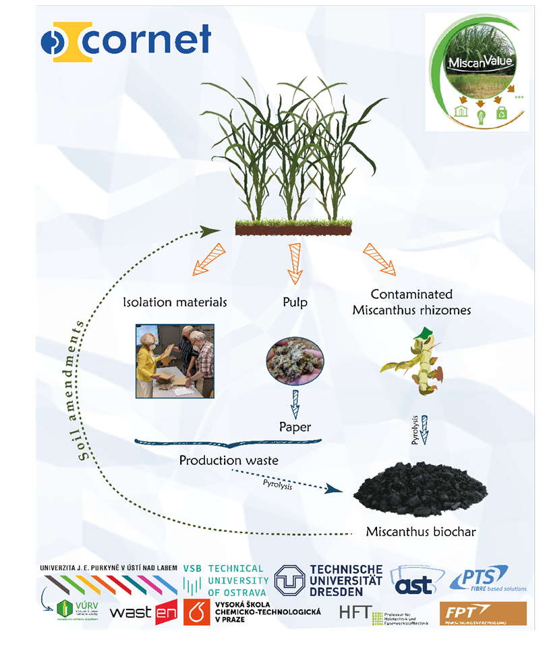
End-Users Committee
Germany
User committee consists of companies working in the following areas:
Agriculture and bioenergy
Mechanical engineering
Paper production
Wood-based material
Czech Republic
Bioimpro s.r.o.
Lipská 4705, 430 03 Chomutov
Wekus spol. s.r.o.
Lipská 4705, 430 03 Chomutov
AGMECO LT s.r.o.
Türkova 828, 149 00 Praha 4, Chodov
ENRESS s.r.o.
V zářezu 902/4, 158 00 Praha 5, Jinonice
VIA ALTA a.s
Nádražní 377, 675 21 Okříšk
Euroforum Group a.s.
K Roztokům 220/47, 165 00 Praha 6, Suchdol
E&H services a.s.
Žitná 1633/47, 110 00 Praha 1, Nové Město
SAPRIL s.r.o.
Skyřická 221, 434 01 Most, Vteln

Slide 6
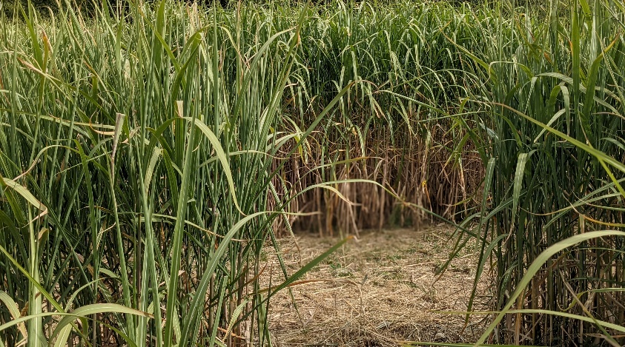

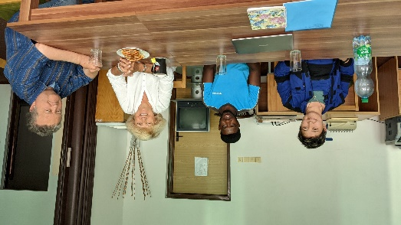
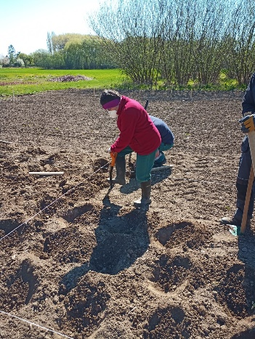
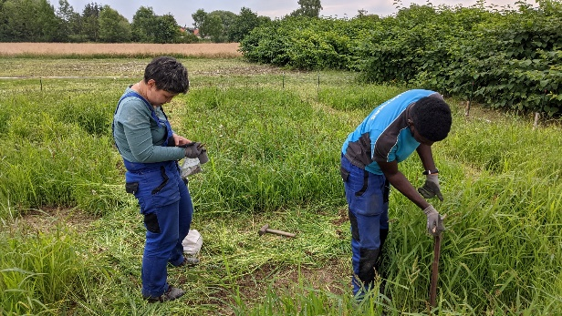
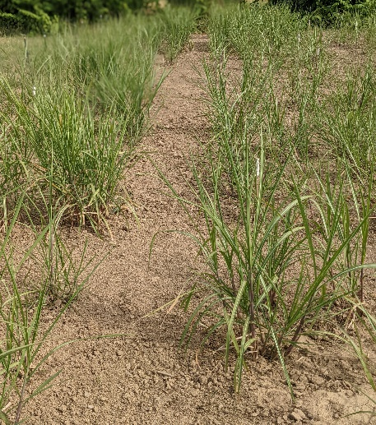
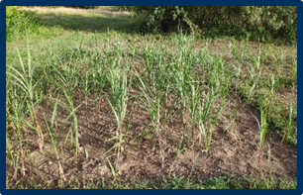

WP 1: Ensuring sustainable miscanthus utilization at post-mining and marginal lands: UJEP
Field 2020
Two research fields were established in Chomutov at the marginal land (2020 and 2021)
Sub-contractor of UJEP
Field 2021

Slide 7

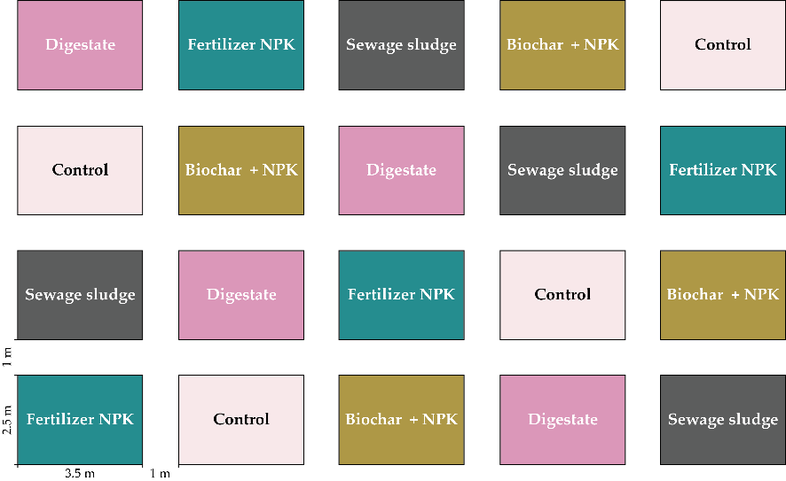
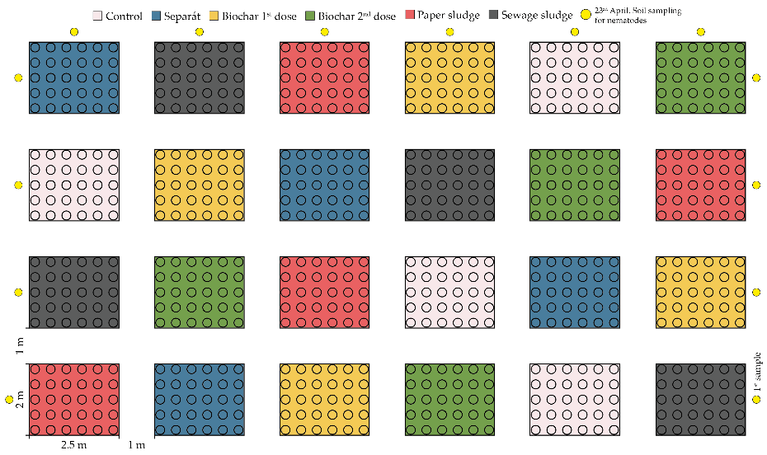

Field experiment (Chomutov, the Czech Republic), impact of soil amendments
WP 1: Ensuring sustainable miscanthus utilization at post-mining and marginal, including military lands: UJEP
Control
Fertilizer NPK
Biochar + NPK
Digestate
Sewage sludge
5 treatments × 4 plots = 20 plots
Date of establishing: 24th April, 2020
Control
Biochar (1st dose)
Biochar (2nd dose)
Paper sludge
Digestate
Sewage sludge
6 treatments × 4 plots = 24 plots
Each plot contains 30 rhizomes.
Field consists of 720 Miscanthus × giganteus rhizomes.
Date of establishing: 27th April, 2021

Slide 8
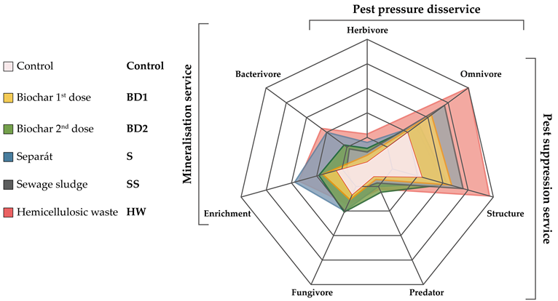
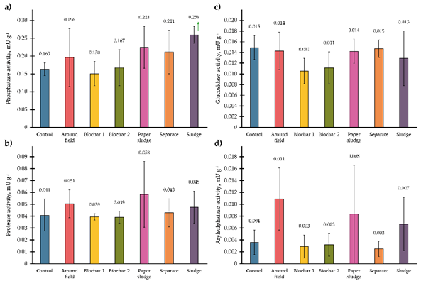
Changing in the soil microbial communities during Miscanthus growth at the amended soils (Field 2021, Chomutov), in cooperation with NULES, Ukraine and Research Institute, Poland
BD2 10% positively impacted to the harvest value.
The soil nematode community associated with the cultivation of crops was sensitive to the type of applied organic amendments.
SS favoured a more stable maturity status of nematode community compared to the application of S, providing a snapshot of soil health.

Slide 9
Guide for end-users:
Outcome: Verified Technology
More on WP1: Report #124

Slide 10
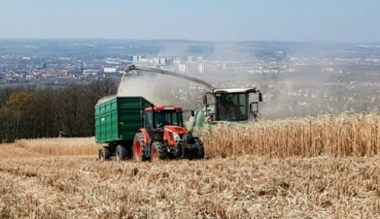
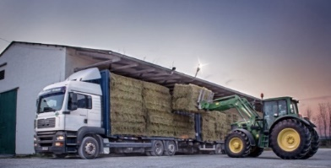
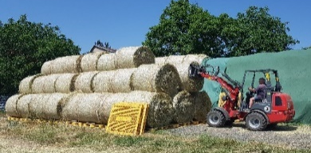

WP 2: Miscanthus biomass pre-processing for converting to fibres and pulp: TUD-AST
Agricultural Systems and Technology
Technische Universität Dresden
Harvesting
Chipped material, forage harvester
cheap, available on standard farms
high output power
easy to transport
low bulk density (120 kg/m³)
standard cutting length: 1-10 cm
high dust load
Big bales, baler
higher costs, additional equipment necessary
lower output
Less dust during handling
higher bulk density (240 kg/m³, ideal cutting length for baling: 10-20 cm)
Transportation
Tractor & trailer < 10 km (max. 20 km)
Truck < 50 km (max. 150 km)
Handling
Losses per loop 1-5%
Fleece cover
(short term, mostly bales)
Under-roof storage
(long term)
Storaging
Losses per year 5-10%
Moisture > 20%,
technical drying necessary
Notes:
Long-term storage requires a water content less than 20% to minimize fungal and bacterial activity. For the harvest, it turned out that the material does not fall below this water content until April at the earliest and the harvest should therefore take place as late as possible. If the water content is higher, technical drying is also required. Standard drying systems are suitable for most agricultural Goods (e.g. push and turn dryers). a tech. Drying should be avoided if possible, as it Costs are incurred and further abrasion and thus additional dust is caused by movement/manipulation of the material.
The material must be protected from rewetting due to the weather and must therefore be stored under a roof. For storage under the open sky for a year, the debris can also be protected with a cheaper fleece cover. Contact with the ground usually degrades the quality of the material.

Slide 11



Test for utilization of Miscanthus biomass to bio-products
Test is proposed for biomass verification depending of the aimed bioproduct: fiber, pulp, insulation material, paper, and biochar
The test includes:
  Stages of biomass utilization at the marginal land
  Stages of harvesting, transportation and storing
  Requirements for:
    Biomass to fibers
    Fibers to fibrous and insulation materials
    Biomass to pulp
    Miscanthus and industrial wastes to biochar
    Test is presented as a Guide for End-users
More about WP2 and Test: report #123
Notes:
Test for utilization of Miscanthus biomass to bio-products

Slide 12
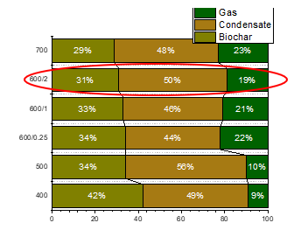
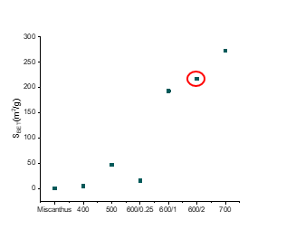
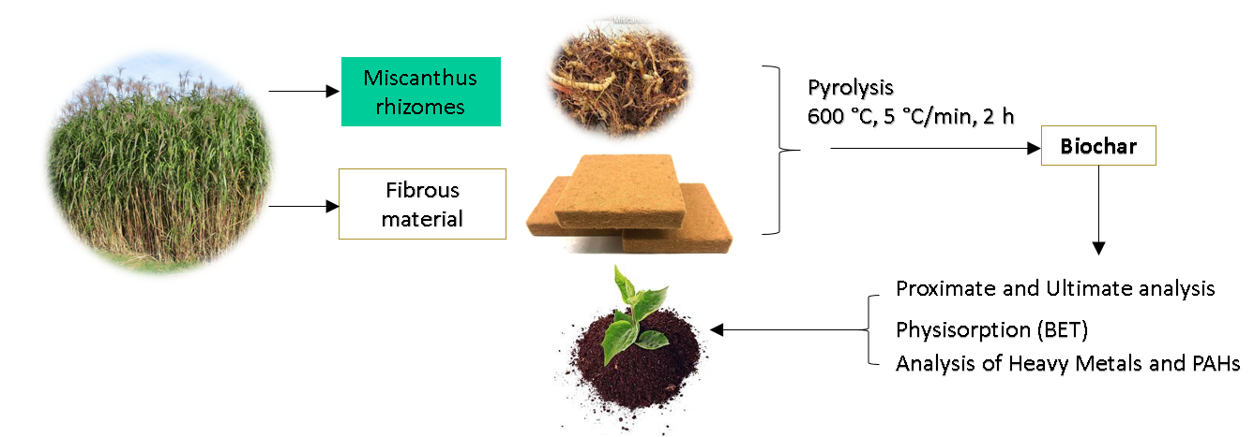
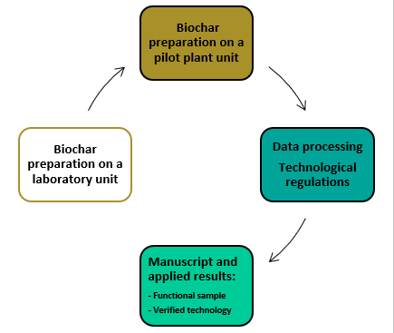
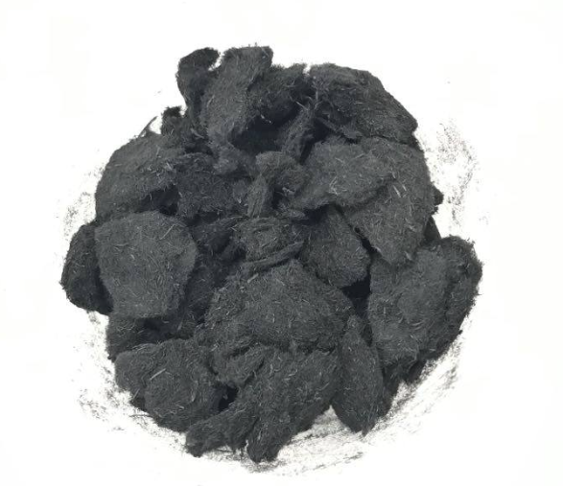
WP 3: Miscanthus waste utilization: VSB-TUO
Setting of process conditions was done from the following conditions:
400, 500, 600, 700 – final temperature (°C); 0.25, 1, 2 – residence time (hour)
 | Raw Miscanthus | Biochar 400 | Biochar 500 | Biochar 600 | Biochar 700 | Biochar 600/1 | Biochar 600/0.25
Proximate analysis (wt.%)
W | 8.53 | 2.05 | 1.84 | 1.55 | 1.53 | 1.74 | 1.85
VM^{d} | 76.00 | 22.82 | 15.78 | 9.92 | 7.30 | 11.07 | 13.13
FC^{d} | 20.58 | 67.33 | 74.04 | 77.82 | 78.71 | 76.79 | 76.50
A^{d} | 3.42 | 9.86 | 10.17 | 12.26 | 13.98 | 12.14 | 10.38
Higher heating value (MJ/kg)
HHV^{d} | 19.84 | 30.00 | 31.17 | 30.37 | 29.32 | 30.70 | 31.18
PAHs (Criteria IBI 6-300 mg/kg dry wt.)
PAHs | nd | 6.80 | 17.40 | 5.60 | 4.10 | 5.80 | 5.00
Notes:
The resulting products were evaluated. The basic parameter was the content of polycyclic aromatic hydrocarbons. At 700 ◦C, PAH content was slightly less, while other parameters were comparable—i.e., carbon content, biogenic element content as well as specific surface area. Conversely, 500 ◦C led to the formation of biochar with a high PAH content. A temperature of 600 ◦C was chosen as a compromise between the achieved properties of biochar and its yield with respect to the economics of the process. Experiments in the laboratory and pilot plant units followed, based on which technical regulations, manuscript and applied results were made.

Slide 13

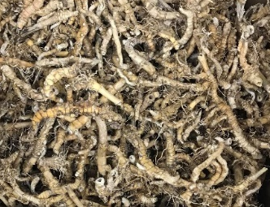
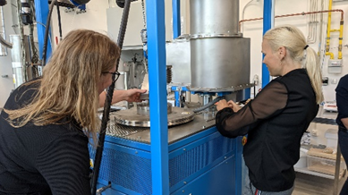
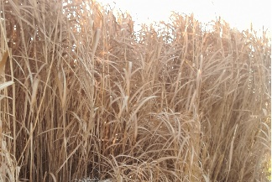
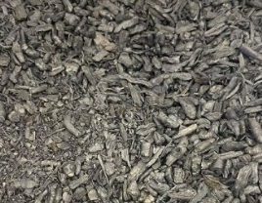
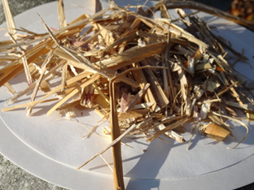
Miscanthus contaminated
rhizomes
Influence of t/time on biochar quality
Condensate
Miscanthus biomass
from landfill
Biochar
Testing in plant’s production
Pyrolysis
Miscanthus
fibrous waste
Gas
Outcome: verified technology
Outcome: functional sample
More about WP3: report #129

Slide 14
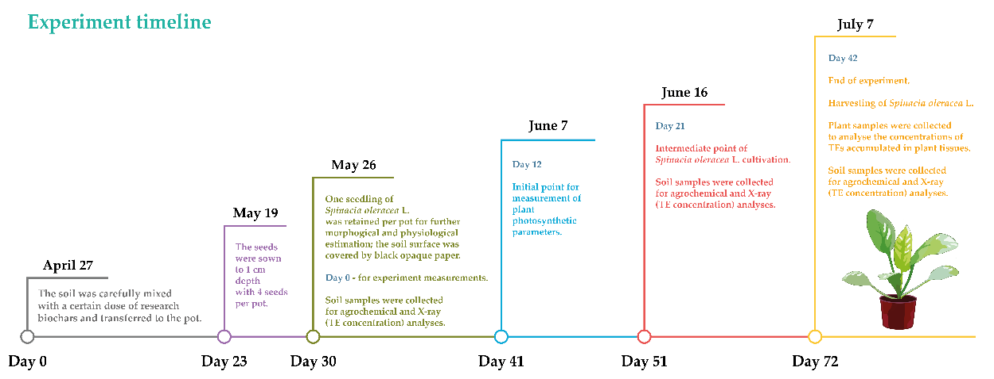
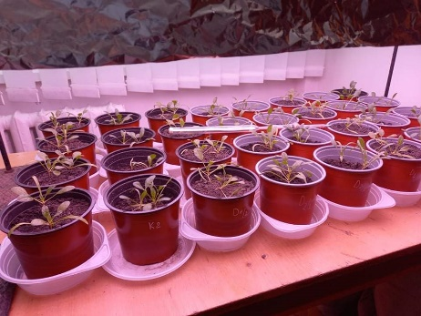
Testing of Biochar from Miscanthus contaminated rhizomes/biomass during Spinacia oleracea L.’s growing
(UJEP+VSB-TUO in cooperation with TNPU, Ukraine)
Physiological parameters of S. oleracea at the end of the experiment: a) biomass DW and b) plant leaf total area.
Dynamic of the soil parameters
Testing biochars produced from contaminated rhizomes grown in Všebořice TEs-contaminated soil (Biochar 1), and biochar received from the aboveground biomass produced at the Chomutov field (Biochar 2), in the latter case three doses (1, 3, and 5%) were tested.
The highest biomass yield of S. oleracea was recorded for 3% B2.
More about testing: report #124

Slide 15



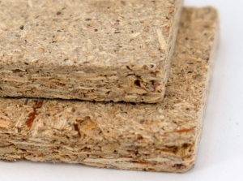
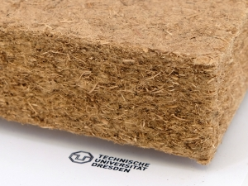
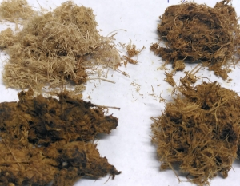
WP4: Production of Miscanthus fiber and pulp: TUD-HFT
WP6: Products based on natural fibers from Miscanthus: TUD-HFT
Processing of raw material
Particle board
Thermo-mechanical pulping (TMP)
Insulating materials
Chemical thermo-mechanical pulping (CTMP)
Fibres for paper
Biochar
Outcome: functional samples
of pulp/insulating material
More about WP4 and WP6: report #127

Slide 16
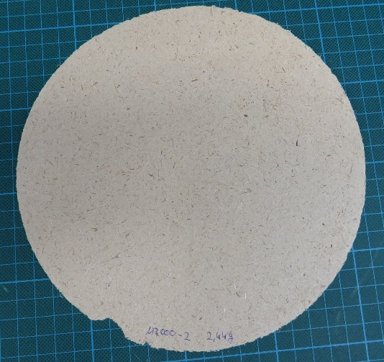
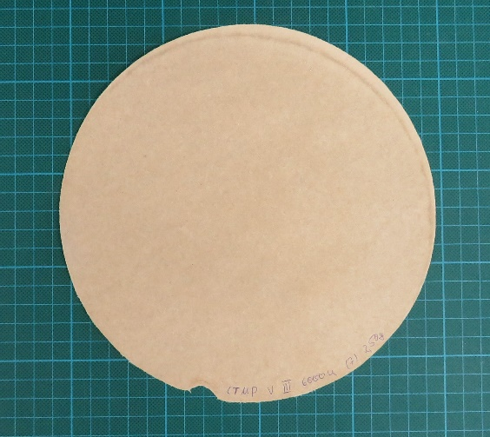
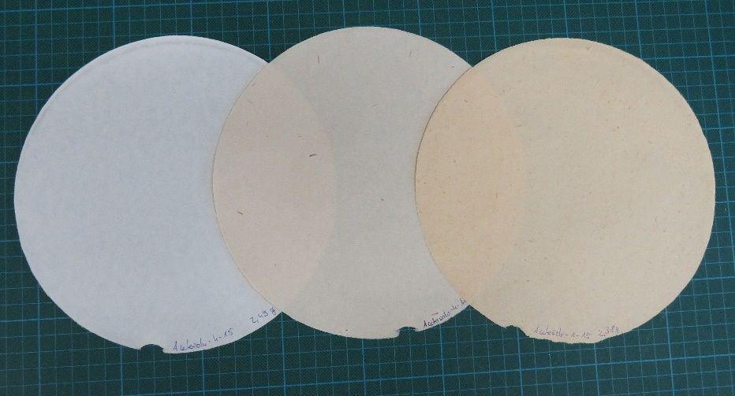
WP5: Processing of Miscanthus Pulp to Paper: PTS
Miscanthus fibres were not bleached -> higher lignin content
Miscanthus Acetosolv pulps achieve significantly higher strength (Tensile Index) than pulps produced after sulphate digestion without refining. Fibrillation occurs within the pulping process
Mechanical Pulping
CTMP
Acetosolv-Pulping
Outcome: verified technology
Outcome: functional sample
More about WP5: report #128

Slide 17


WP 7: Value chain for Miscanthus based sustainable products: UCT
LCA and LCC models were created for cultivation, waste processing, paper production and insulation production phases in Miscanthus life-cycle
Four scenarios of cultivation were compared (Farmland vs. Marginal land; No biochar use vs. Biochar use)
Heavy metal extraction from soil proven to have substantial environmental benefits (Toxicity impact categories)
Cultivation practice on marginal land is currently more economically feasible
Evaluated price of biochar is currently too big to consider it a feasible option as an amendment to soil during Miscanthus cultivation
The impacts and costs of Miscanthus waste pilot-plant pyrolysis process were analyzed:
  Pilot-plant costs (especially inert gas) do not cover for revenues
The impacts and costs of paper production and insulation production from wood were analyzed
  Comparison to Miscanthus products was only estimated as detailed data were not acquired
More about WP7: reports # 126 and #125

Slide 18
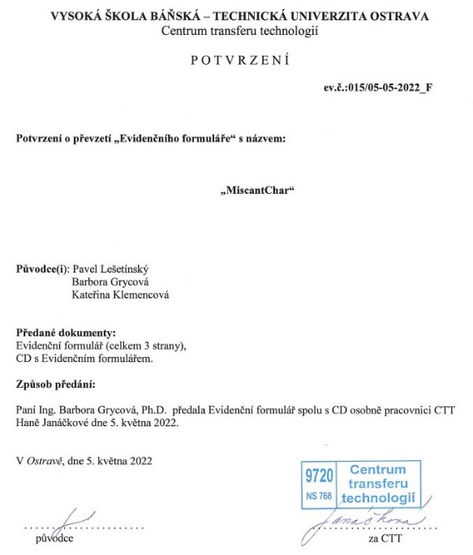
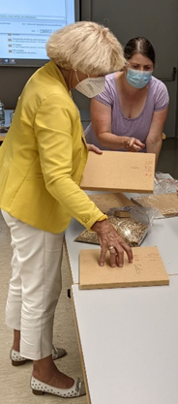
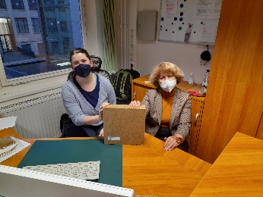
Main products (outcomes) of the CORNET MiscanValue:
Verified technology for growing M×g at the post-mining soil with processing of raw materials to bioproducts (under evaluation at UJEP)
Verified technology for production of biochar (under evaluation at VSB-TUO)
Functional Sample of biochar (approved by VSB-TUO)
Functional Samples of insulation materials and pulp (TUD-HFT)
Verified technology for production of paper (PTS)
Functional Sample of Paper (PTS)

Slide 19
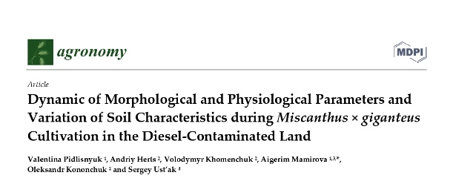
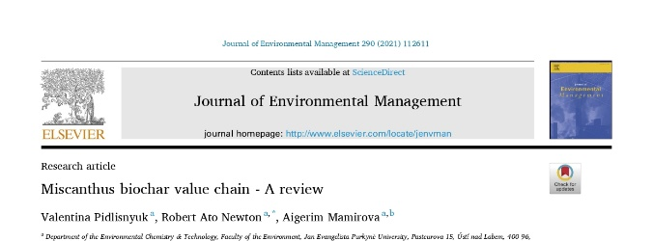
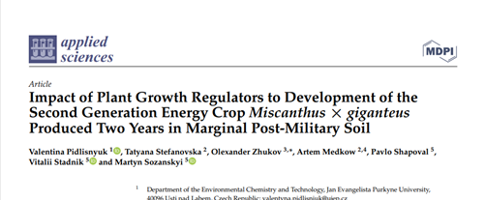
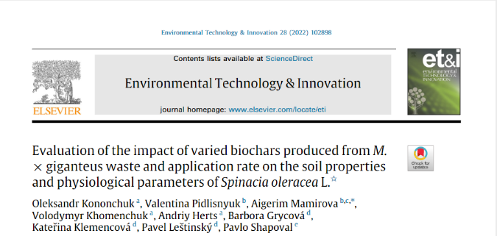
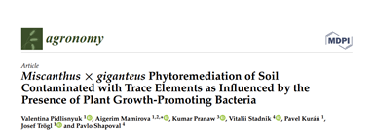
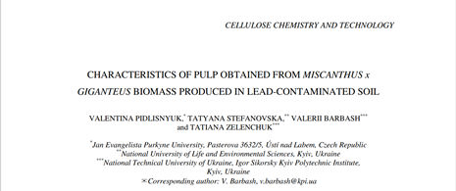
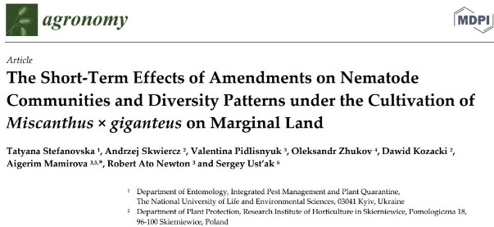
WP 8: Dissemination and coordination: PTS and WASTen
Publications:
7 IF papers published
1 under reviewing
2 under preparation

Slide 20
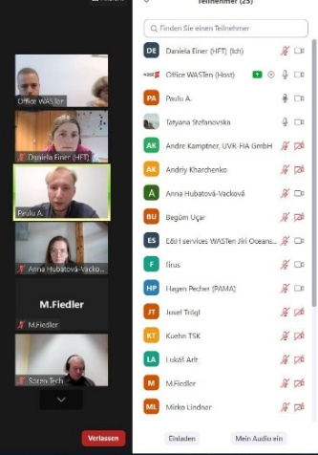
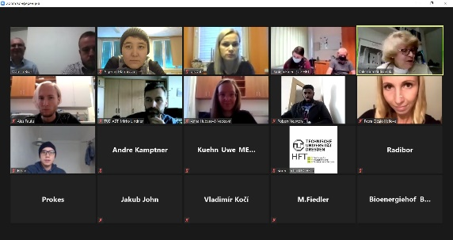
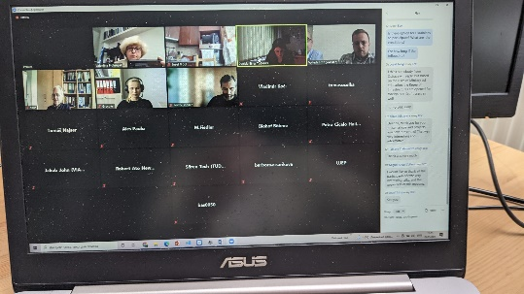
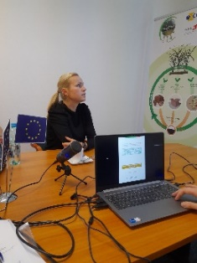
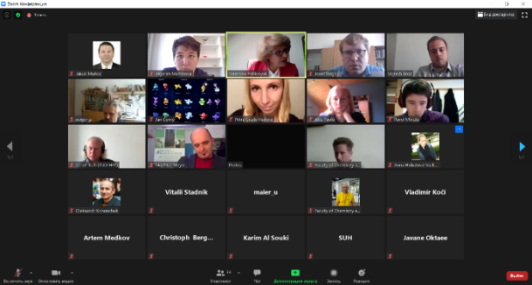
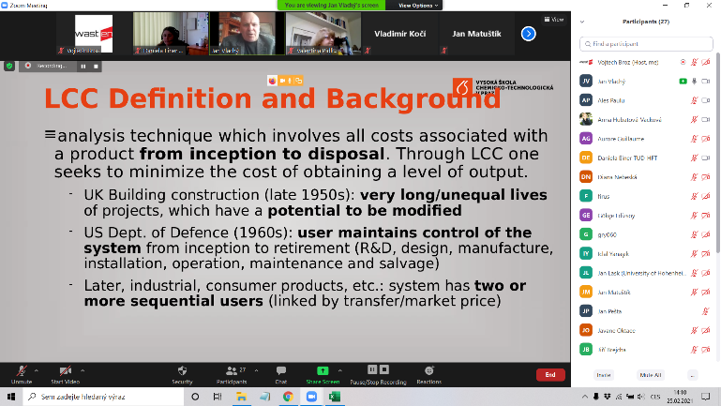

WP 8: Dissemination and coordination: PTS and WASTen
3 MiscanValue End-Users Committee & Consortium meetings (December 17, 2020; May 26, 2021; January 25, 2022)
Workshop for end-users, “Best available practice for Miscanthus utilization”, WASTen, November 5, 2020
Training: Miscanthus Waste Convention, VSB-TUO, May 26, 2021
International workshop
at CTU, February 25, 2021
3 Consortium&EndUsers Meetings: December 2020; May 2021; January 2022
Future Training at PTS on October 19, 2022
Draft title: “Production of Paper from Miscanthus Biomass”

Slide 21










Conferences and meetings
International Conference on Green Technology,
Prague, September 2-3, 2021
TVIP 2021, Hustopece
Reco-Mine, Freiberg, April 7, 2022
International seminar, Kyiv, Ukraine, October 11, 2021 (online)
Conference “Energy from Biomass XXI, Lednice, September 14-16, 2021
9th International Conference on Chemical Technology, Mikulov, April 25-27, 2022
Innovation Day, Berlin, June 23, 2022
Vyshegrad 4+ workshop, Lutsk, Ukraine, October 6, 2021 (online)
IFAT, München, June 1, 2022
ATNA solution, August 26, 2022
RemTech Europe, Ferrara, Italy, September 21, 2021 (online)

Slide 22












