Slide 1
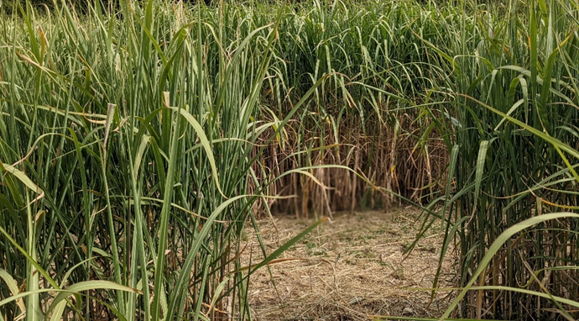
Phytotechnology with Miscanthus embedded in post-mining land
Professor Valentyna Pidlisniuk, Dr.Sc.
Dr. Aigerim Mamirova, PhD
Mgr. Robert Ato Newton, PhD student
Dr. Josef Trogl, PhD
Univerzita J.E. Purkyně v Ústí n.L.
CORNET MiscanValue Final Conference,
Hustopece, the Czech Republic, September 21, 2022

Slide 2
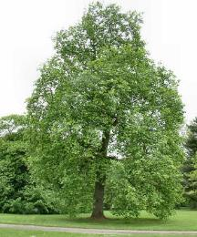
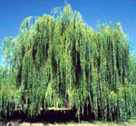
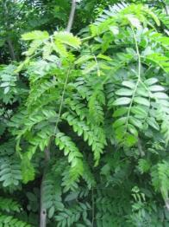
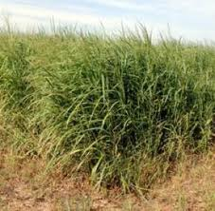
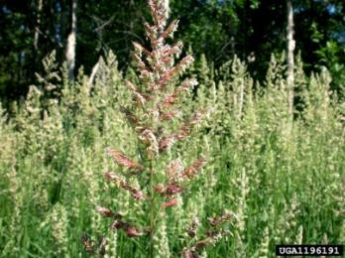
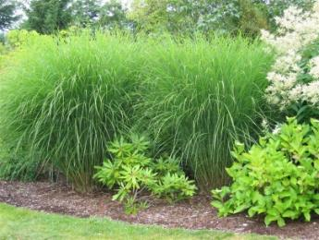
Biofuel crops for biotechnology
Second generation biofuel crops represent not-food crops and are less directly in conflict with food crops
Crops for second generation biofuels can be divided into two main categories:
short rotation
canopy species
perennial/
annual grasses
Poplar
(Populus spp.)
Willow
(Salix spp.)
Locust (Robinia spp.)
Switchgrass (Panicum virgatum L.)
Reed canary grass (Phalaris arundinacea L.)
Miscanthus
(M. sinensis And., M. sacchariflorus M., M. × giganteus Greef et Deu)

Slide 3
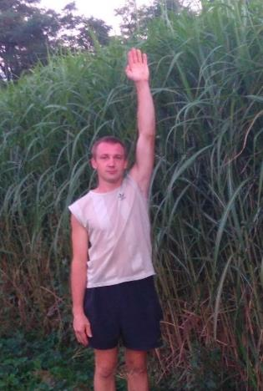
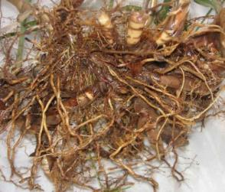
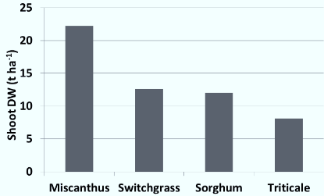
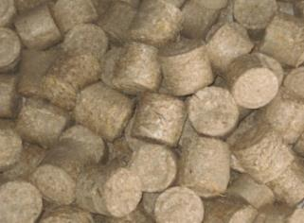
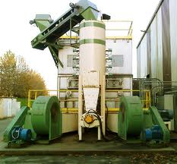

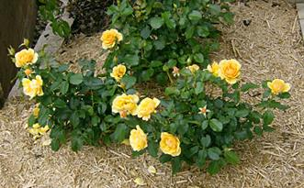

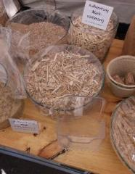
Miscanthus × giganteus
Perennial grass: growth up to 25 years
Stem height: 3 - 4 m
High shoot productivity: 15 - 30 t DW ha⁻¹
Low production inputs
Soil stabilization
C0₂ sequestration
Non invasive species
Biomass with multiple uses
Cadoux et al, 2013
Ivanivka, Ukraine
Heat
Biofuel
Mulch
Animal
bedding
Building
materials
Packaging

Slide 4
In case of insignificant pollution & damaging after post-mining or post-military operations it is more profitable to apply the Phytotechnology with biomass production
Interest of phytotechnology
Phytoremediation
Bioremediation
Physico-chemical
remediations
Dig & dump
Time
Environmental friendliness
Cost
Social acceptability
Notes:
4
4

Slide 5
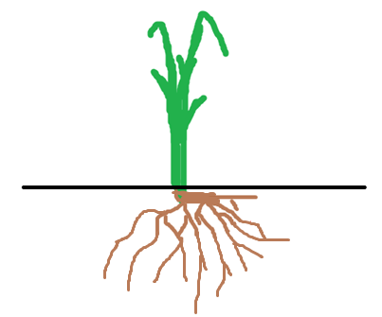
Phytoextraction
Uptaken of contaminants to the plant

Slide 6
Phytovolatilization
Uptaken by plant with further transpiration through above biomass

Slide 7
Phytostabilization
Changing the biological available form, uptaken mainly to roots

Slide 8
Exploitation of M. × giganteus in Phytoremediation of TEs-contaminated soil
TE | Type of Phytoremediation | Reference
Cd | Rhizoextraction Excluder Phytostabilization | (Arduini et al., 2006) (Fernando & Oliveira, 2004) (Nsanganwimana et al., 2015)
Cr | Rhizoextration Excluder | (Arduini et al., 2006) (Fernando & Oliveira, 2004)
Cu | Excluder | (Fernando & Oliveira, 2004)
Hg | Excluder | (Fernando & Oliveira, 2004)
Ni | Excluder | (Fernando & Oliveira, 2004)
Pb | Excluder Excluder Phytostabilization | (Pavel et al., 2014) (Fernando & Oliveira, 2004) (Nsanganwimana et al., 2015)
Zn | Accumulation Excluder Phytostabilization | (Pogrzeba et al., 2013) (Fernando & Oliveira, 2004) (Nsanganwimana et al., 2015)
L. Erickson and V. Pidlisnyuk, CRC Press, Taylor and Francis Group, 2021

Slide 9

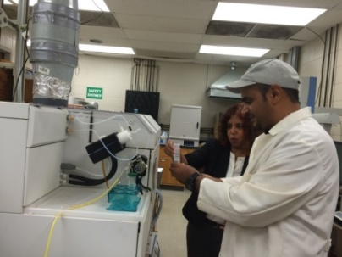
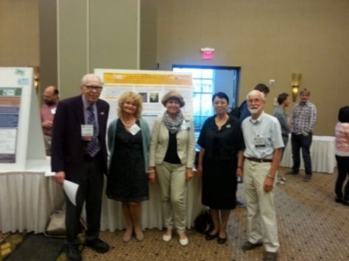
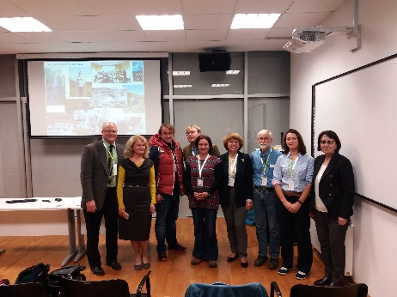
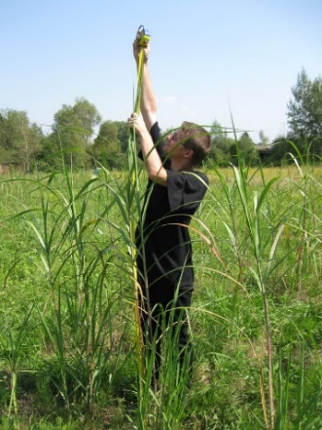
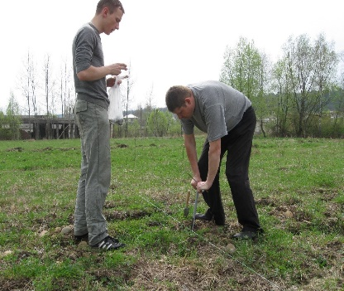
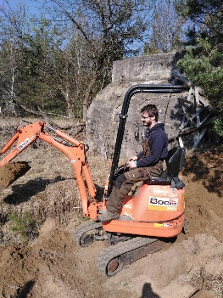
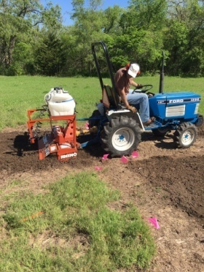
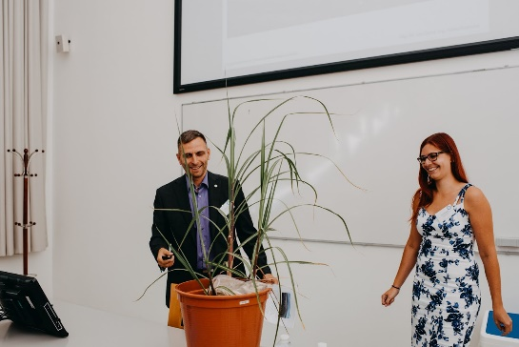
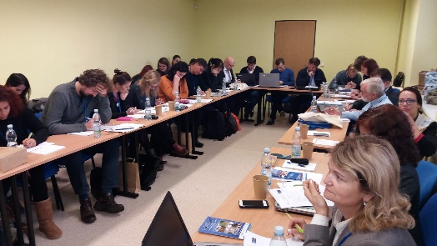
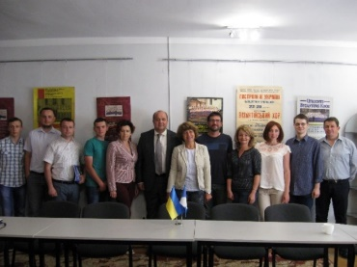
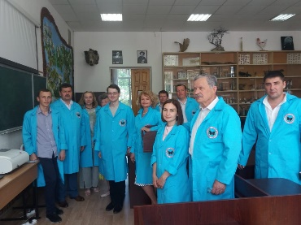
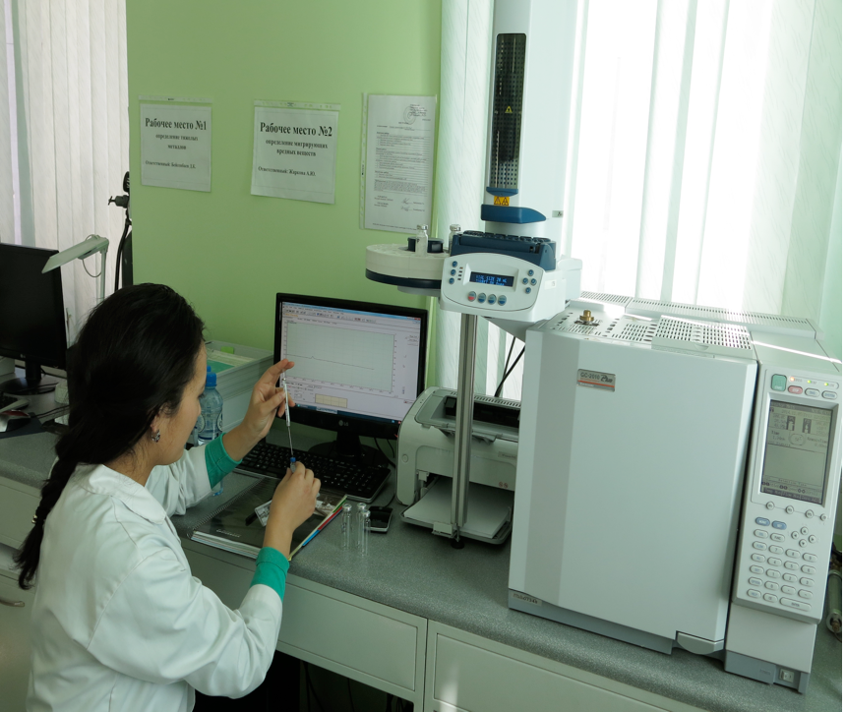
Main partners:
Jan Evangelista Purkyne University, Czech Republic
National University of Life and the Environment, Ukraine
Kansas State University and Kansas Agricultural Research Station, USA
Institute of Plant Biology and Biotechnology, IPBB, Kazakhstan
National University “Lvivska Polytechnika”, Ukraine
Science for Peace Programmer, Multiyears project
“New phytotechnology for cleaning military polluted sites”
2016-2021
End-users:
State Committee of Energy Saving, Ukraine
Slovakian Environmental Agency, Slovakia
Dolyna city council, Ukraine
Environmental Division, Fort-Riley, USA
“Ecology Engineering”, Kazakhstan
Project goal:
to enhance environmental security of military sites by developing phytotechnology to produce biomass in large quantities on contaminated lands
Liasoning institutions:
University of Zagreb, Croatia
Warminsko-Mazursky University, Poland
Wroclaw University of Life Science
and the Environment, Poland

Slide 10
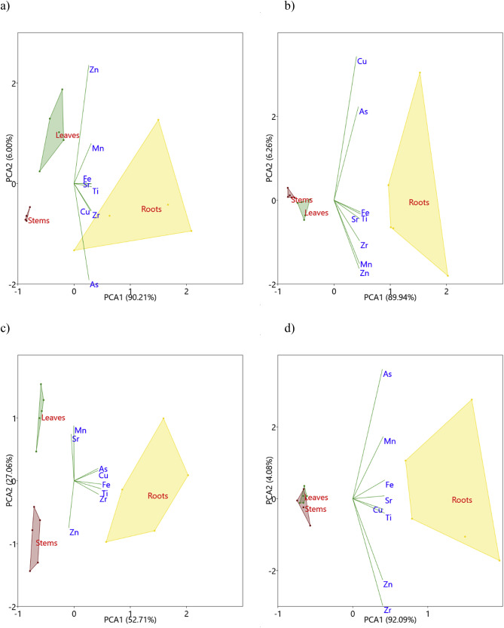
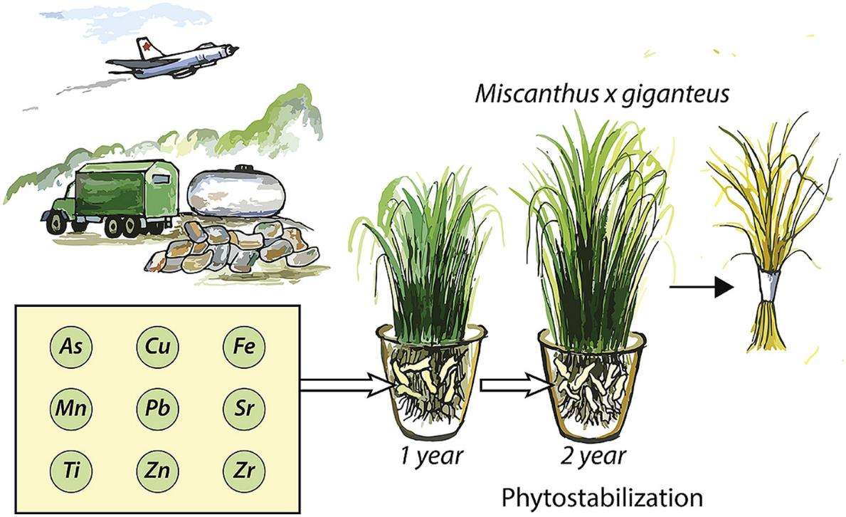
Phytoremediation of M×g in the post-military TEs-contaminated soils
(Kamenetz, Ukraine and Sliac, Slovakia)
Background: project NATO SPS MYP
Pidlisnyuk et al., Environmental Pollution, 2019

Slide 11

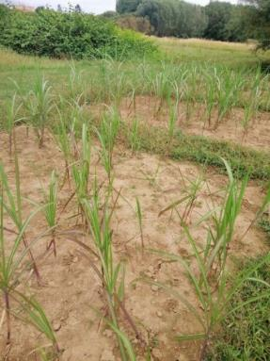
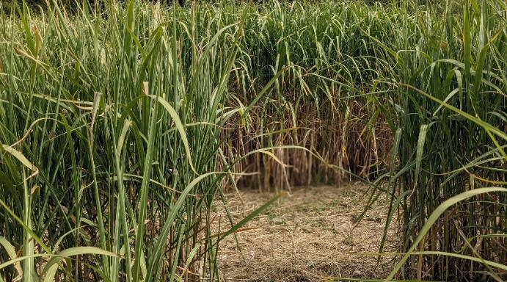

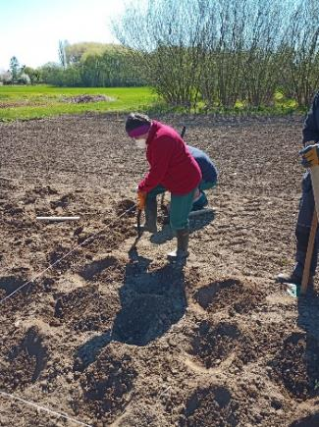

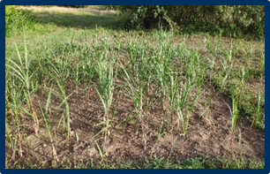
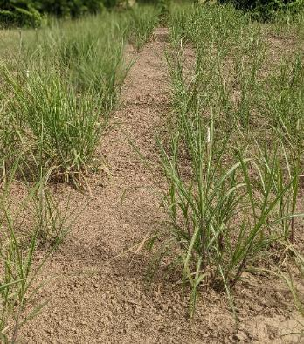


WP 1: Ensuring sustainable miscanthus utilization at post-mining and marginal lands: UJEP
Field 2020
Sub-contractor of UJEP
Two research fields were established in Chomutov at the marginal land (2020 and 2021)
Field 2021
2022 - Survival rate 74%

Slide 12
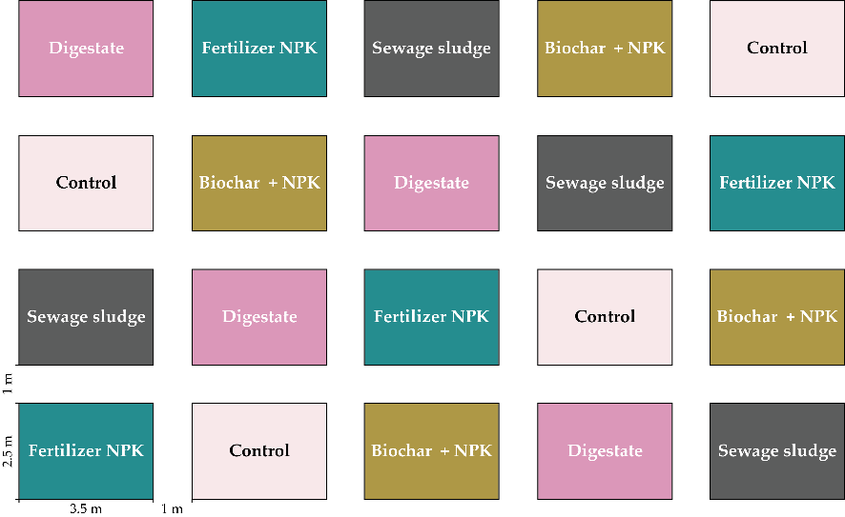
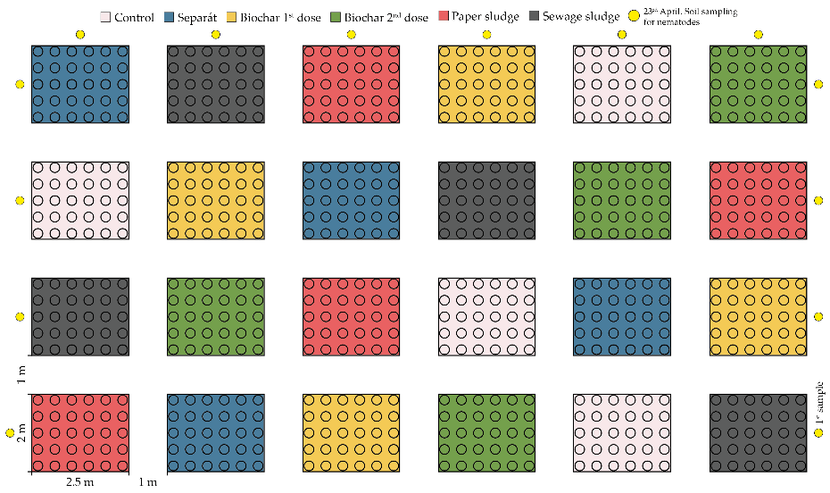

Field experiment (Chomutov, the Czech Republic), impact of soil amendments
WP 1: Ensuring sustainable miscanthus utilization at post-mining and marginal lands: UJEP
Control
Fertilizer NPK
Biochar + NPK
Digestate
Sewage sludge
5 treatments × 4 plots = 20 plots
Date of establishing: 24th April, 2020
Control
Biochar (1st dose)
Biochar (2nd dose)
Paper sludge
Digestate
Sewage sludge
6 treatments × 4 plots = 24 plots
Each plot contains 30 rhizomes.
Field consists of 720 Miscanthus × giganteus rhizomes.
Date of establishing: 27th April, 2021

Slide 13
Soil microbial activities in Chomutov soil, field 2021
Soil microbes are key components of soil ecosystem services.
Respiration
Extracellular enzyme activities representing biogeochemical cycles
Biomass
Not many differences after 1st season

Slide 14
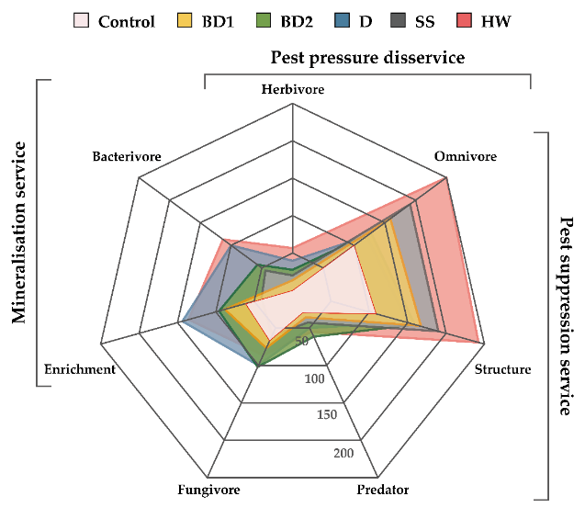
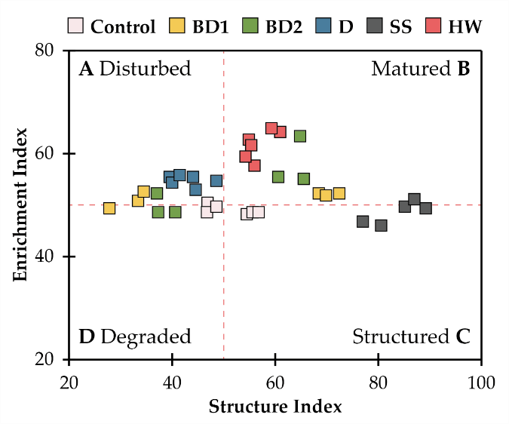
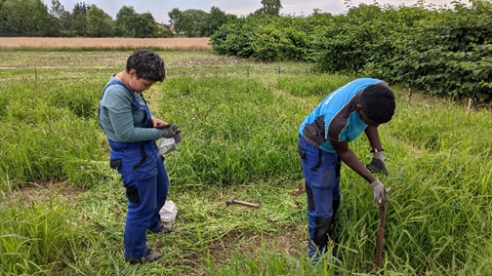
Impact of soil amendments to the nematodes communities (in cooperation with NULES, Ukraine and Research Institute of Horticulture, Poland)
Radar chart of the metabolic footprint of each nematode trophic group in the different treatments and ecosystem services delivered.
Nematode faunal analysis indicating the food web status (A-D) in different amendments type:
BD1, BD2, D, SS, and HW.
Stefanovska T., Skwiercz A., Pidlisnyuk V. et al., Agronomy 2022, 12, 2063.

Slide 15
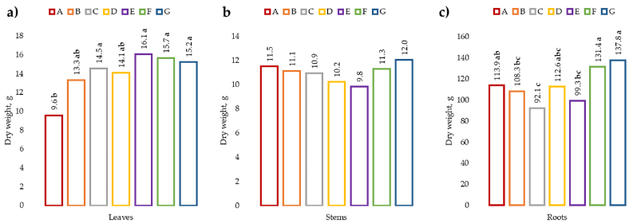
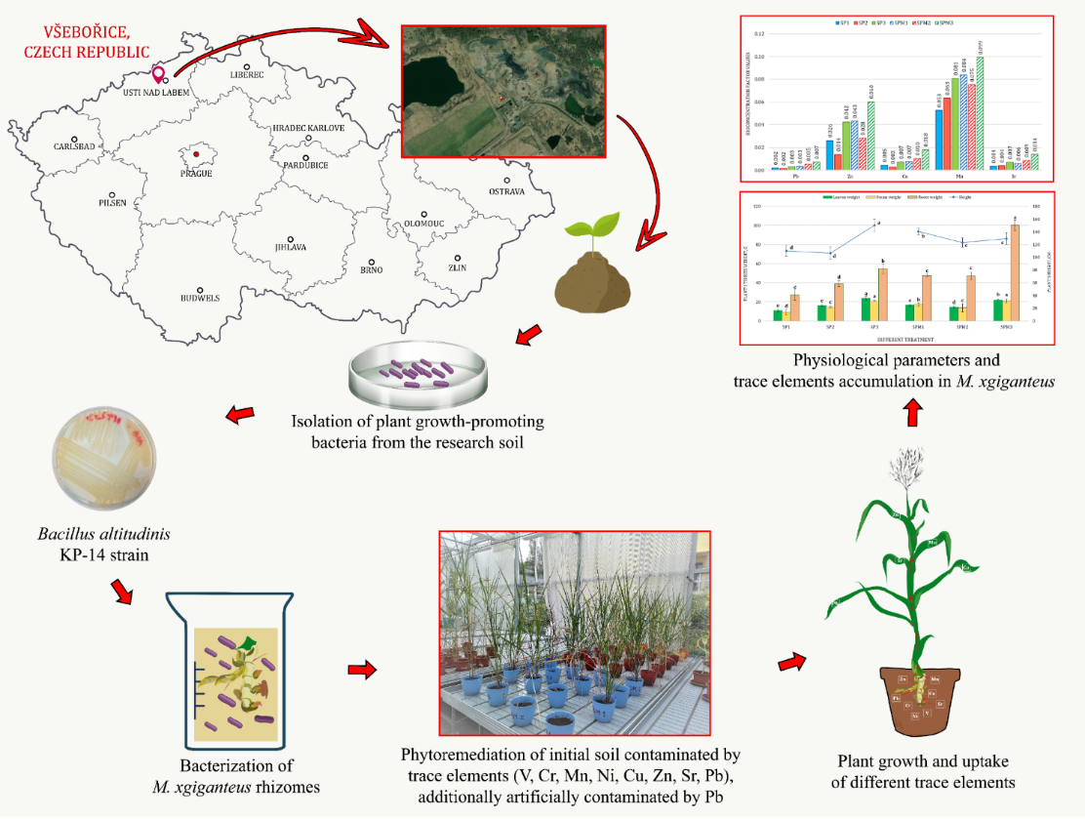
Soil from Všeborice, Ústí n.L., former lignite post-mining site
5
Biomass productivity of M×g produced in the TEs-contaminated soil in the presence of PGPB strains: a) leaves; b) stems; c) roots.
Using of PGPB isolated from the contaminated soil, assisted in increasing of M×g biomass
TE | MPC, mg kg⁻¹ | Treatments
 | ЧР | Pb < MPC | Pb = 4.6 × MPC | Pb = 33.9 × MPC
V | 43 | 502.9 ± 161.1 | 460.2 ± 157.3 | 488.3 ± 160.0
Cr | 90 | 201.4 ± 68.3 | 208.3 ± 66.4 | 243.2 ± 67.2
Mn | 1500 | 492.4 ± 45.8 | 449.7 ± 44.7 | 440.1 ± 45.9
Ni | 50 | 99.6 ± 17.4 | 104.9 ± 16.8 | 102.1 ± 17.2
Cu | 60 | 73.5 ± 10.5 | 70.5 ± 9.9 | 68.9 ± 10.3
Zn | 120 | 204.2 ± 7.1 | 206.3 ± 8.5 | 195.9 ± 8.4
Sr | 7 | 418.5 ± 3.9 | 407.4 ± 3.9 | 400.7 ± 4.1
Pb | 60 | 44.2 ± 3.7 | 293.4 ± 7.0 | 1969.8 ± 15.8
Pidlisnyuk et al., Agronomy, 2022, 12, 771; Pranaw et al., Biology, 2021, 9, 305; Pidlisnyuk et al., International Biodeterioration & Biodegradation, 2020, 155, 105103.

Slide 16
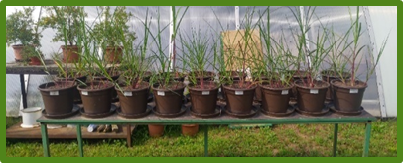
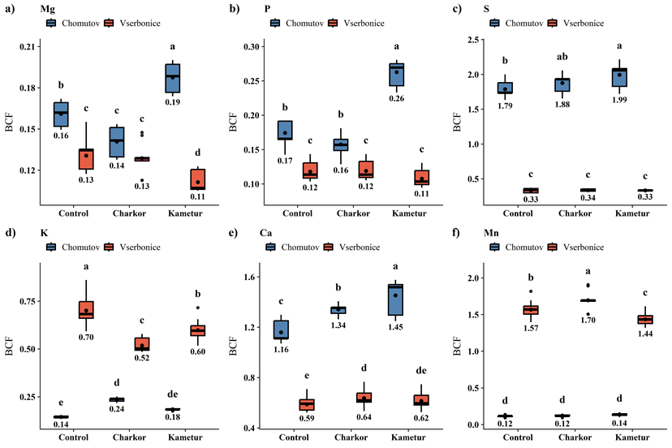
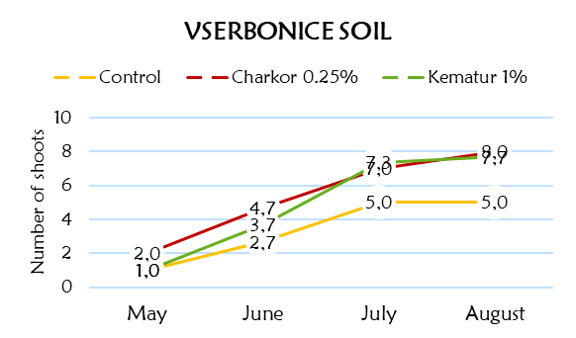
Impact of PGRs
The impact of PGRs (Charkor and Kametur) on Miscanthus growing in soil from post-mining land in Všebořice and marginal land in Chomutov was evaluated: Charkor was more effective than Kametur for Mn and Zn in Chomutov soils, while Kametur was more effective for Sr and Zn in Všebořice soil.

Slide 17
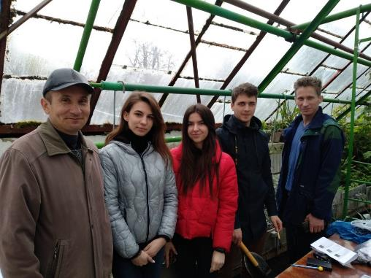
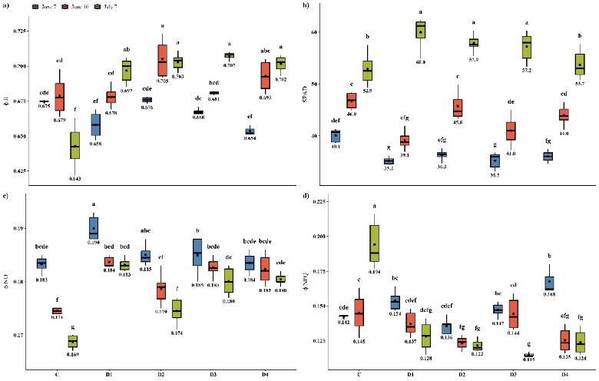
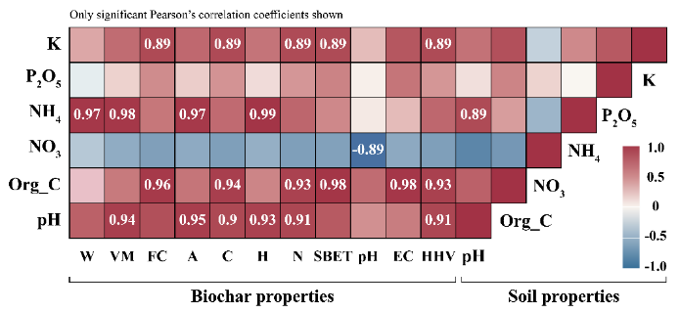
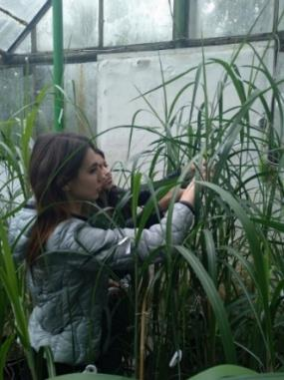
Biochar supported M×g phytotechnology applied to the petroleum-contaminated soil (in cooperation with Ternopil National Pedagogical University, Ukraine)
Concentration of oil-products, mg kg⁻¹ | No amendments | Biochar from sludge, 5% | Biochar from wood and biohumus, 5%
A:0 | A1 | A2 | 3
B:250 | B1 | B2 | B3
C: 1000 | C1 | C2 | C3
D:3000 | D1 | D2 | D3
E:5000 | E1 | E2 | E3
Changes in the photosynthesis parameters of S. oleracea during the experiment: a) ɸII; b) SPAD; c) ɸNO; and d) ɸNPQ. Different letters on the boxplots within one stress parameter indicate a significant difference between the values of the different treatments at (at least) p <0.05.
Heatmap of the Pearson correlation between biochar properties and soil agrochemical characteristics. Abbreviations: A—ash, EC—electrical conductivity, FC—fixed carbon, Org_C—organic carbon, VM—volatile matter, and W—moisture.
Pidlisnyuk V. et al., Agronomy, 2021, 111, 4, 798.

Slide 18
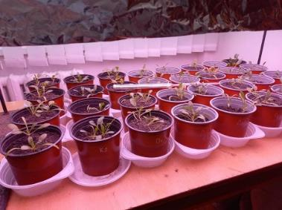
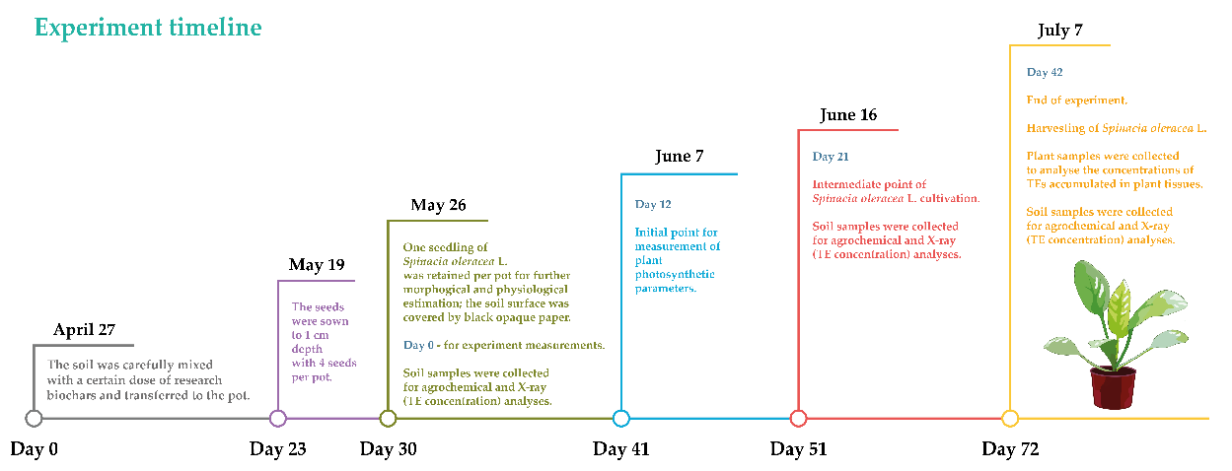

Testing of Biochar from Miscanthus contaminated rhizomes/biomass during Spinacia oleracea L.’s growing (UJEP + VSB-TUO in cooperation with TNPU, Ukraine)
Testing biochars produced from contaminated rhizomes grown in Všebořice TEs-contaminated soil (Biochar 1), and biochar received from the aboveground biomass produced at the Chomutov field (Biochar 2), in the latter case three doses (1, 3, and 5%) were tested.
The highest biomass yield of S. oleracea was recorded for 3% B2. The photosynthetic parameters indicated that 3 and 5% B2 doses resulted in the dissociation of light-harvesting complexes. Increasing the biochar dose did not necessarily increase biomass yield or improve photosynthetic parameters.
Physiological parameters of S. oleracea at the end of the experiment: a) biomass DW and b) plant leaf total area.
Kononchuk O.,Pidlisnyuk V., Mamirova A. et al, Environmental Technology & Innovation, 2022, https://doi.org/10.1016/j.eti.2022.102898

Slide 19

The Best Available Practice of Miscanthus utilization was created and presented to end-users at the workshop on November 5, 2020
Workshop, November 5, 2020 (on-line, 36 participants)

Slide 20




Further progress
Response of M×g yield to the soil type and agronomic treatment (from multivariate GLMs). a) Leaves DW; b) Stems DW. Mean and 95% confidence intervals.
Evaluation results of the impact of PGR Kametur and Charkor to Miscanthus production in post-mining soil
Testing impact of doses and varieties of
biochar received from Miscanthus to the phytoremediation of Miscanthus in:
a)oil-contaminated soil
b)Cu and Zn contaminated soil
Testing By-products of Miscanthus gasification process, from with University of Applied Science, Zittau

