Slide 1
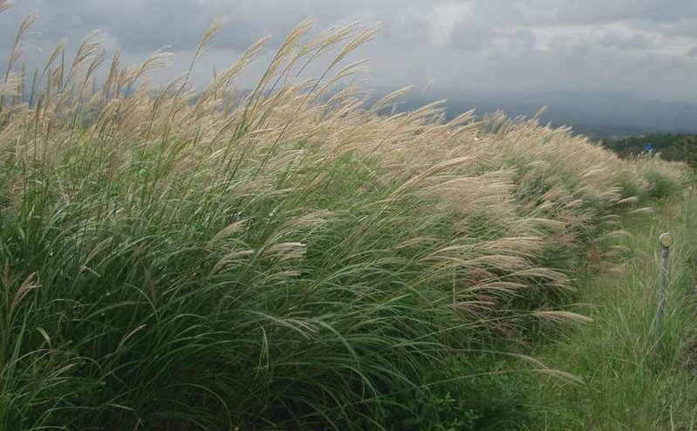

Miscanthus based products value chain:
economic perspective
Ing. Aleš Paulu
Notes:
Good evening everyone. I would like to follow on Anna´s presentation by talking about Miscanthus based products value chain, but now looking at it from an economic perspective.

Slide 2
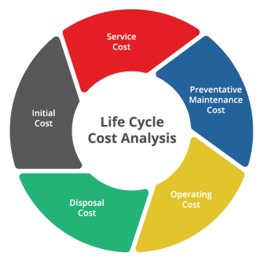
Economic analysis
Comparisons
  Four MxG cultivation scenarios - Farmland/Marginal land; biochar/no biochar
  MxG waste pyrolysis - pilot plant inputs/outputs
  Pulp from wood - semi-mechanical process inputs/outputs
  Paper from wood - inputs/outputs
  Particleboard from wood - inputs/outputs
Tools
  Life cycle costing (LCC) for MxG scenarios
  7 % interest rate
  Analysis based on market prices for wood products
Notes:
And to get right to it, I would like to set the specificts of the economic analysis performed. There were several cost comparisons done.
As described in Anna´s presenation, we look at foor MxG cultivation scenarios, these were based on the type of land, where Miscanthus is cultivated (farmland/marginal land) and based on the fact if biochar was used as a soil amendment.
Then, Miscanthus waste pyrolysis was analysed – this was an input/output analysis of the pilot plant process.
And this input/output analysis was also made for pulp, paper and particleboard products, however since we have no data on utilizing Miscanthus for these processes, established production processes from wood were analysed, as a reference.
Then I would like to specifiy what tools were used for the economic analysis. For the MxG scenarios of cultivation and pyrolysis, life-cycle costing was used, which looks at all the costs associated with a producted throughout its life-cycle, even factoring in future costs recalculated to present value based on interest rate. The interest rate used in this study was 7%.
And for the production of wood based materials, basic economic analysis was conducted that was based on current market prices of the individual inputs to production.

Slide 3
Cultivation
17-year cultivation
Phases: Rhizome planting, biochar application, field maintenance and closing, harvest, storage
Land differences: land rent, subsidies
Biochar differences: price of biochar, yield
European conditions
Data received by UJEP or drawn from relevant literature
Notes:
So now, lets get to cultivation phase.
A 17-year span of average Miscanthus cultivation was modelled. The phases included wee rhizome planting, biochar application (if applicable), field maintenance and closing, and ofcourse harvest and storage.
As was already described, 4 scenarios were asssessed, based on land differences or biochar application differences. For land, the difference was lower land rent and introduction of subsidies when cultivating Miscanthus on marginal land
And for biochar, ofcourse the price of biochar needed to be accounted for, and also 16% biomass yield increase was considered for biochar application.
The whole cultivation was based on central european conditions, which influenced the data that were required for the analyses.
The data were partly received by our colleagues from UJEP and also partly drawn from relevant literaure dealing with Miscanthus cultivaiton.

Slide 4
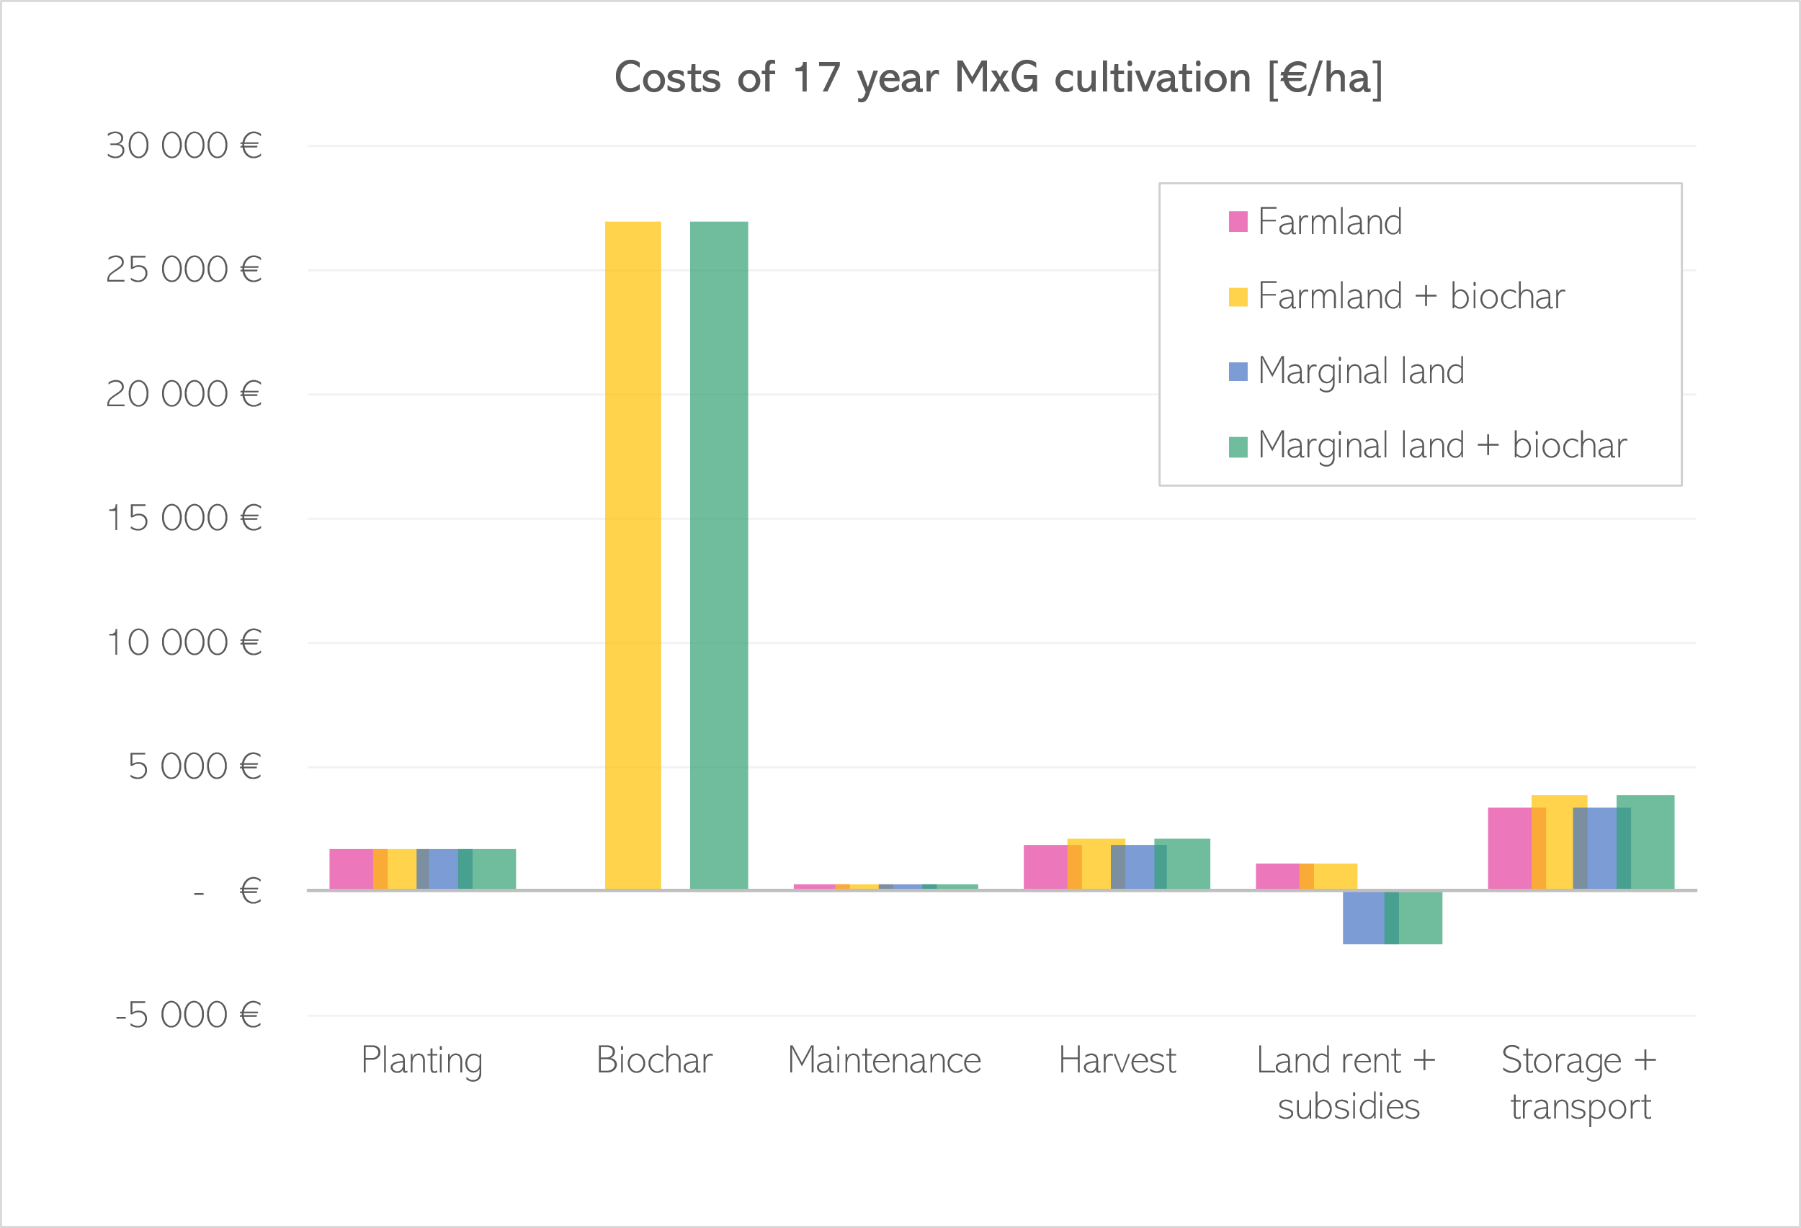
Cultivation: results
Biochar:
1 % application rate
30 t/ha
0,86 eur/kg
Notes:
You can see the results for the four analysed scenarios in the graph, divided into individual phases and expressed in euros per hectare. At first glance, you can notice that the price of biochar is signifacant compared to other processes. This is when counting in the 1 % application rate of biochar, which according to literature corresponds to roughly 30 t/ha. With the price of 0.86 euro per kilogram, it yields this great cost of biochar application.

Slide 5
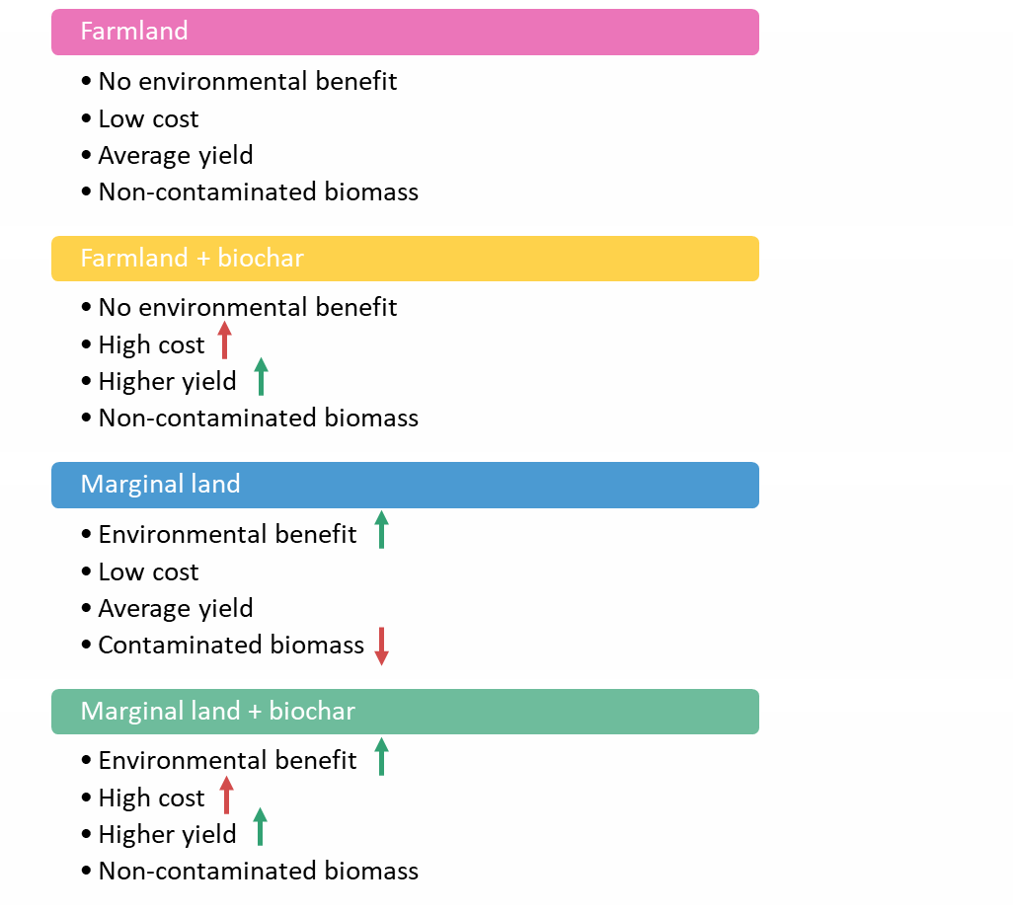
Cultivation: results
Notes:
So in summary with the environmental results, the four cultivation scenario comparison looks like this. Each practice has certain ups a downs. Farmland cultivation may produce non-contaminated biomass, but there is no great environmental benefit attributed to the cultivation. On marginal land, great environmental benefit comes from phytoextraction, however the biomass produded in this case may be contaminated by heavy metals. This could be dealth with by using biochar as an soil amendent to stabilize pollutants in the soil, the biomass produced is non-contaminated and produced with greater yields. However this comes with additional costs as 1 % application of biochar is quite expensive.

Slide 6
Pyrolysis
Pilot plant scale - continuous process
Data received by VŠB-TUO
MxG leaves and rhizome waste as input
  1,5 kg/hour
Yields of 30 % biochar, 51 % oil and 19 % gas
Biochar sold, oil and gas burned for energy yield
Notes:
So now lets get to the next phase, which is pyrolysis of miscanthus waste. The process was based on pilot plant scale continous process which of VŠB-TUO, which also provided us with all necessary data for analysis.
The process counted with inputs of miscanthus leaves waste each year and rhizome waste at the end of the 17 year cultivation. And the process itself processed about 1,5 kg of materials per hour.
This yielded 3 products, 30 % of input mass was solid biochar, 51 % was pyrolysis oil and 19 % was pyrolysis gas.
The end of life considered for the economic analysis was considered as sold biochar for market price and pyrolysis oul and gas that was burned for energy yield.

Slide 7
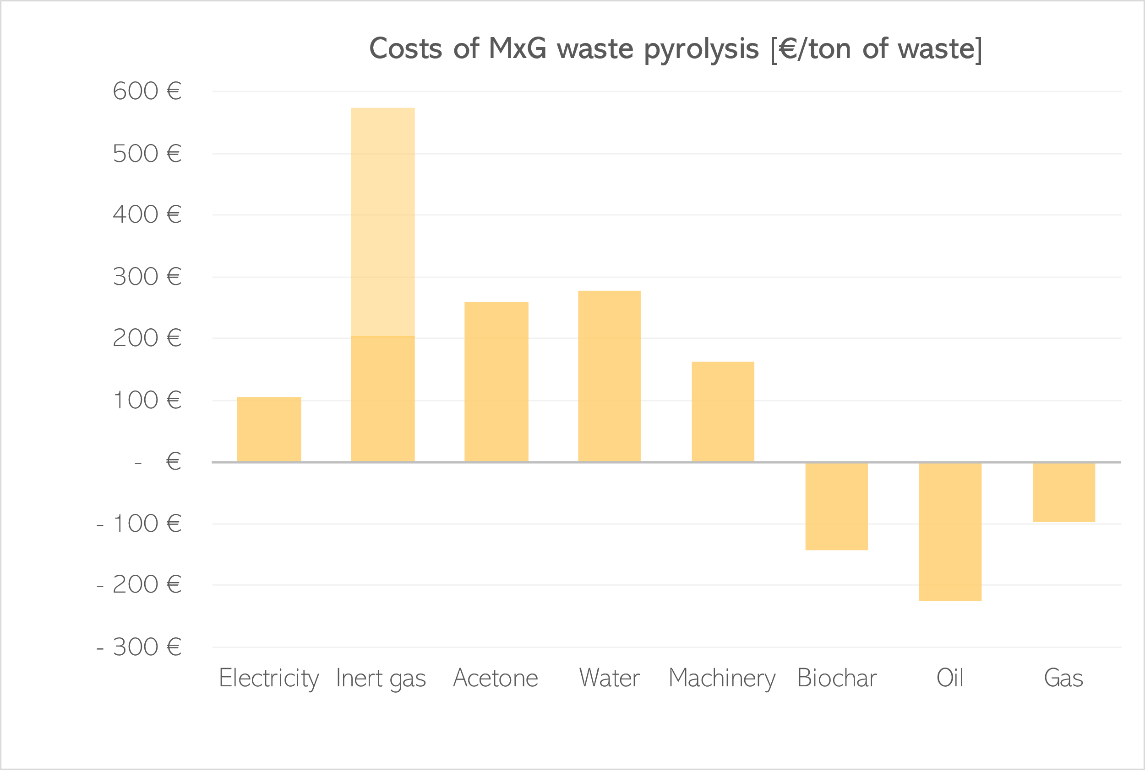
Pyrolysis:
results
Argon
Nitrogen
  Acetone not used in full scale
  Decreased machinery cost
  Decreased consumption
Notes:
And now to look at the results, this time divided into individual inputs and outputs and expressed in euros per ton of waste processed.
Currently, for this pilot plant scale, the revenues of biochar, oil and gas do not cover for the expenses of the process. The highest cost is associated with the inert gas, in this case Argon, that is used to create the oxygen-free environment in pyrolysis plant. However, this cost could be reduced by using cheaper inert gas such as Nitrogen.
Overall, the costs of pyrolysis are expected to be lower in a full scale operation. This would be attributed to the fact, that acetone is usually not used in full scale, also machinery cost and overall consumption would be expected to decrease, when allocated to 1 ton of processed waste.

Slide 8
Pulping process
Data from BAT documents by EC
Chemi-thermo-mechanical pulping (CTMP) of wood
Based on Finnish CTMP mill
Main inputs
  Spruce (logs)
  Sodium sulphite used for wood softening
  Oxidative bleaching using hydrogen peroxide
  DTPA used as chelating agent
Notes:
And now I would like to continue with the phases of biomass processing. First is processing miscanthus biomass to pulp.
As mentioned before, we have looked into wood-based processes for comparisons. Therefore, I have used data from BAT documents, provided by European Commision.
In this document, chemi-thermo-mechanical pulping of wood (in this caser spruce) is desribed. The inventory analysis of this process is based on actual Finnish CTMP mill.
The actual process describes using Sodium sulphite for wood presoftening. Hydrogen peroxide used for oxidative bleaching and DTPA used as a cheltaing agent.
70 ºC to 170 ºC, 15 minutes and a couple of hours
DTPA used as chelating agent – complexing and sequestering metal ions (Fe, Mn, Cu)

Slide 9
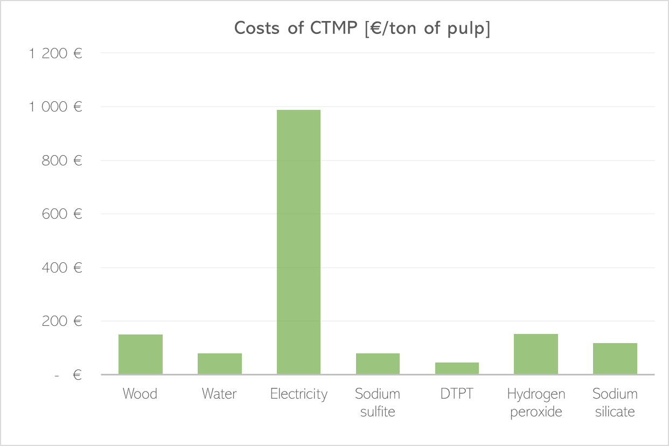
Pulping process
Notes:
When looking at the costs of CTMP process, expressed in euros per ton of pulp, it can be seen that the highest costs area attributed to elektricity consumption.
Therefore, to effectively decrease the costs of CTMP process, it would be needed to decrease the costs of elektricity, for example by decreasing consumption.
Hypothetically, the costs could be also lower for processing of MxG either be lower price of input material, compared to wood, or by reduction of energy needed to preprocess the material, as grinding of wood is quite energy intensive.

Slide 10
Paper production
Data from BAT documents by EC
Fine paper produced from chemical bleached pulp
Based on average European fine paper mill conditions
Main inputs
  55 % chemical pulp
  37 % kaolin filler
  8 % starch binder
Notes:
Now lets move to paper production, from the pulp that was processed.
For this, again data were drawn from BAT documents by EC and the process described was fine paper produced from chemically bleached pulp-
The inventory data presented in BAT were based on average European fine paper mill conditions
And these were the inputs to the process: 55 % chemical pulp, 37 % of kaolin used as filler and 8 % of starch used as a binder

Slide 11
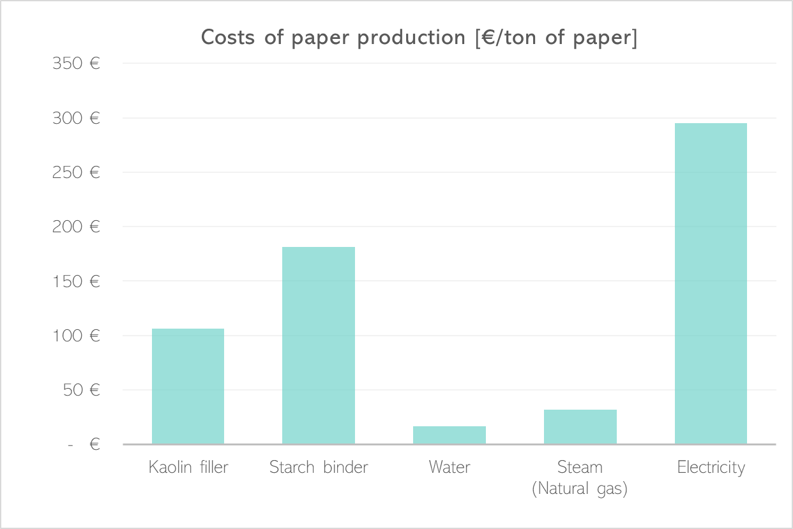
Paper production
Notes:
Looking at the results, now expressed in euros per ton of paper, again the highest costs are tied with electricity consumption required to run the process.
So again, to efectively reduce these costs, more energy-effective process management would be ne appropriate.
Relatively high costs are also attributed to chemicals used during the process the improve the properties of the final product. Reducing their consumption in mxg paper production could therefore make a difference.

Slide 12
Insulation production
Data from literature
Particleboard produced from wood waste
Based on Spanish state of the art particleboard production factory
Wood preparation (debarking, shaving, chipping, drying)
Board shaping (Resin mixing, mat forming a pressing)
Including process waste combustion and cogeneration
Main inputs
  Wood waste (forest slash, sawdust)
  UF-Resin binder; Paraffin wax, (NH₄)₂SO₄ hardener
Notes:
And now to move on to insulation material production. This time data were drawn from literature that was describing particleboards produced from wood waste.
The process was based on spanish state of the art particleboard production factory.
The phases included in the process were: ……..
Also, the process included wood waste combustion and cogeneration to create energy that helps to run the processes, thus decreasing elektricity consumption.
And the inputs into the process were:
wax – water resitance
(NH₄)₂SO₄ – ammonium sulphate

Slide 13
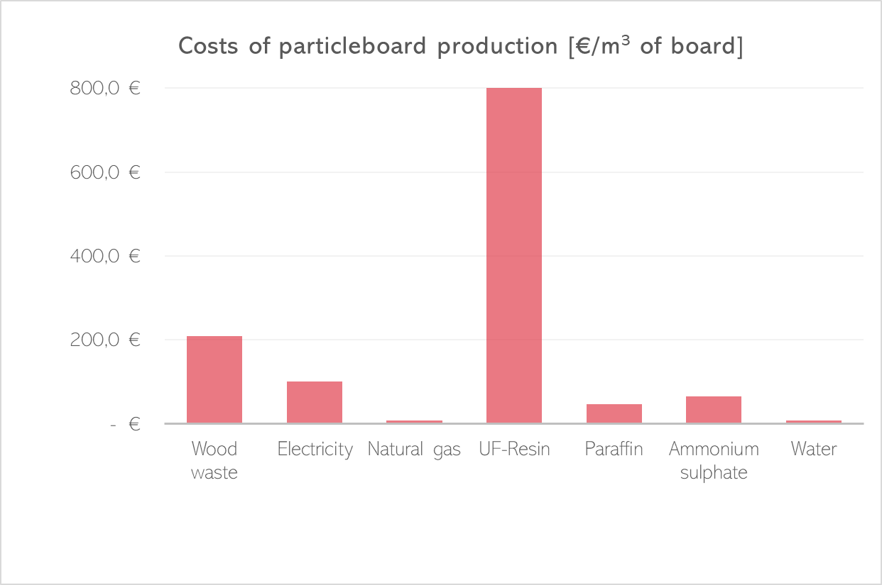
Insulation production
Notes:
And now lets look at the costs of particleboard production, expressed in euros per square meter of board.
The situation is now a bit different compared to paper and pulp, as electricity is not the highest cost in the process, mainly due to production of own energy by process waste combustion and cogeneration.
This mean, that the highest costs are atributed to Urea-Formaldehyde resin, used as a binder to hold the board together.
Therefore, if it was possible to utilize lower amoutns of binder for particleboards made from miscanthus, it would effectively influence the overal costs of the process.
Further the costs of input material of miscanthus biomass could also be lower compared to wood products.

Slide 14
Summary
Marginal land cultivation brings substantial cost reductions
Costs of biochar (1 % application rate) greatly exceed all other costs tied to cultivation phase
Pyrolysis costs could be lowered by using nitrogen and by scaling the process
Pulping and paper production very energy-intensive
Highest costs of particleboard production associated with UF resin
Notes:
So finally i would like to give a summary to the results that have been reported in this presentation.
….
And to give some outlook for future. Ofcourse we would like to make an actual comparison of the shown wood products with miscanthus based products. But to make these, we would need to obtain a lot of production specifics and data about miscanthus based products processing. So we would need some help and cooperation fom you, our project collagues, which are experts in their specific fields. Therefore I would like to kind of a start discussion, what data is it possible to find and obtain, or maybe what assumptions can be made for the production.
Thank you

