Slide 1


Exploring the value chain of
Miscanthus based products from LCA perspective
Anna El Barky Hubatová-Vacková
hubatova@vscht.cz
September 21st, 2022

Slide 2
OUTLINE
Environmental assessment of MxG cultivation and pyrolysis and Miscanthus-based products
  Life Cycle Assessment using Gabi software
  Sphera and ecoinvent 3.8 databases, EF 3.0 methodology
Cultivation phase (4 scenarios)
Pyrolysis
Bio-based products
  Environmental impacts of wood-based reference products

Slide 3
CULTIVATION PHASE SCENARIOS
Model of Miscanthus cultivation on 1 ha of soil throughout plantation lifespan (17 yrs)
In total, four scenarios of cultivation phase were modelled at this stage:
  Farmland cultivation (1a)
  Farmland cultivation using biochar (1b)
  Marginal land cultivation (2a)
  Marginal land cultivation using biochar (2b)

Slide 4
Cultivation phase
The biomass yield per 17-year plantation lifespan considered was 279.3 tons per ha
1 % biochar application rate (30 t/ha applied in the beginning of plantation lifespan)
A yield increase of 16.5 % associated with biochar use
Assumptions
  Leaves waste was collected every year, rhizome waste only at the end of the plantation
  Biochar heavy metal phytostabilization did not increase Miscanthus phytoextraction values
  Leaves:stems ratio 31.7 % according to literature

Slide 5
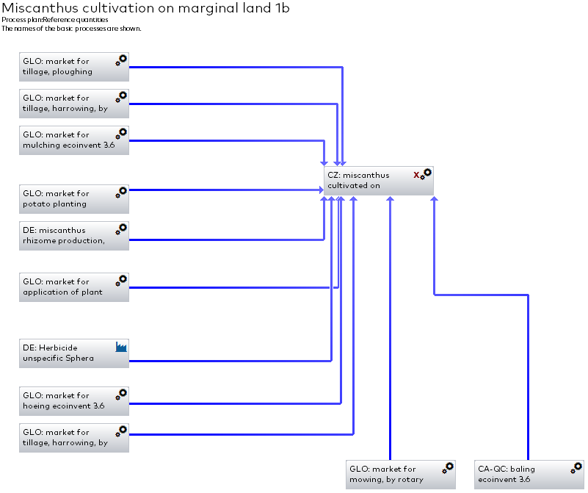
Cultivation phase
The LCA model considers environmental impacts of:
  Rhizome production
  All agricultural operations such as soil preparation, rhizome planting etc.
  Production of herbicide
  Harvesting
  For marginal land cultivation – heavy metal uptake via phytoextraction
Modelled in GaBi software

Slide 6
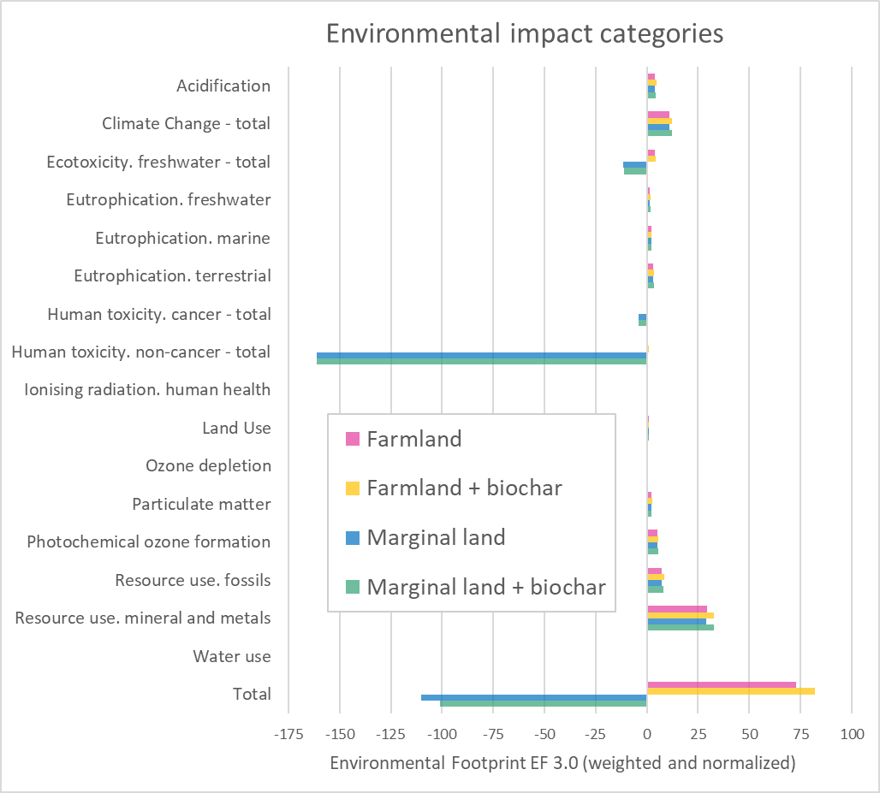
Cultivation phase - results
Significant environmental benefits of planting Miscanthus on marginal land
  Due to the heavy metal phytoextraction from soil
  Outweighs the environmental impacts of Miscanthus cultivation
  Especially in the impact categories of human toxicity, non-cancer (uptake of Zn and As) and freshwater ecotoxicity (Cu, Zn and Fe)

Slide 7
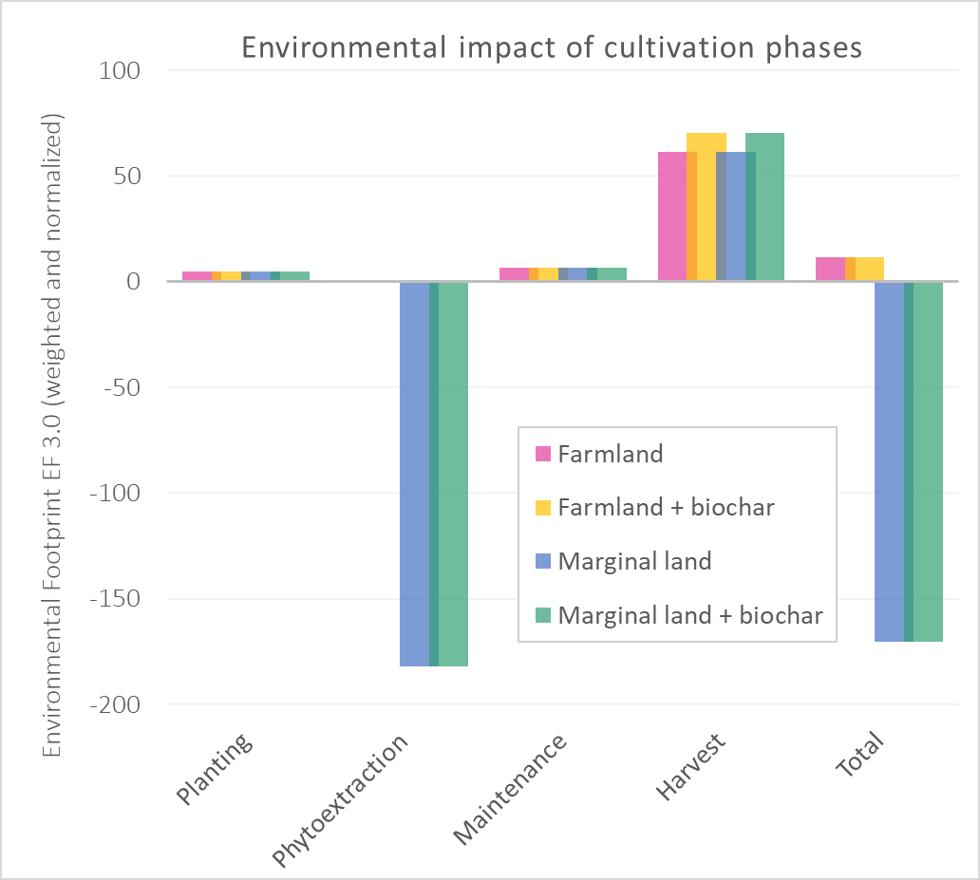
Cultivation phase - results
Environmental impacts of various stages of cultivation phase
Phytoextraction shows the most significant environmental benefits
Biomass harvesting results in the highest environmental impacts for all of the four scenarios

Slide 8
pyrolysis
LCA of a continuous pyrolysis of Miscanthus waste
Normalised and weighed results in order to show the most impactful categories
  Climate change – mostly due to CO₂ emissions and electricity consumption
  Resource use, fossils and freshwater ecotoxicity – both largely due to electricity consumption and acetone use

Slide 9
BIO-BASED products
One of the main goals of this project is to perform LCA on Miscanthus-based products
  Here, environmental impacts of bio-based products made from wood are presented
    These can be used as a reference for comparison once final data about Miscanthus-based products are acquired
Wood pulp (1 t)
Kraft paper from softwood (1 t)
Particle board (1 m³)

Slide 10
Reference wood-based products
 | Wood pulp production (1 t) | Kraftpaper production (1 t) | Particle board (1 m³)
EF 3.0 Acidification [Mole of H+ eq.] | 0.216 | 0.147 | 0.172
EF 3.0 Climate Change - total [kg CO2 eq.] | 76.7 | 88.4 | 89
EF 3.0 Ecotoxicity, freshwater - total [CTUe] | 282 | 51.1 | 279
EF 3.0 Eutrophication, freshwater [kg P eq.] | 0.00437 | 0.000506 | 0.00335
EF 3.0 Eutrophication, marine [kg N eq.] | 0.0328 | 0.0301 | 0.021
EF 3.0 Eutrophication, terrestrial [Mole of N eq.] | 0.404 | 0.36 | 0.283
EF 3.0 Human toxicity, cancer - total [CTUh] | 1.51E-08 | 2.74E-09 | 9.97E-08
EF 3.0 Human toxicity, non-cancer - total [CTUh] | 1.27E-07 | 1.27E-07 | 1.65E-07
EF 3.0 Ionising radiation, human health [kBq U235 eq.] | 3.24 | 2.53 | 1.05
EF 3.0 Land Use [Pt] | 1.98E+04 | 1.62E+04 | 2.92E+03
EF 3.0 Ozone depletion [kg CFC-11 eq.] | 4.04E-06 | 7.68E-10 | 2.20E-06
EF 3.0 Particulate matter [Disease incidences] | 9.43E-06 | 2.86E-06 | 3.71E-06
EF 3.0 Photochemical ozone formation, human health [kg NMVOC eq.] | 0.144 | 0.131 | 0.122
EF 3.0 Resource use, fossils [MJ] | 505 | 479 | 613
EF 3.0 Resource use, mineral and metals [kg Sb eq.] | 0.000749 | 1.22E-05 | 0.00031
EF 3.0 Water use [m³ world equiv.] | 164 | 7.52 | 33.8

Slide 11
Conclusions
LCA models of four cultivation phase scenarios and pyrolysis process were performed and analysed step by step
As for the cultivation, the highest environmental impacts are linked to harvesting, while phytoextraction shows the biggest environmental benefits
Pyrolysis shows the highest environmental impacts in the categories of climate change and resource use (fossils)
Wood-based pulp, paper and particleboard were analysed and ready to serve as a reference for Miscanthus-based products

Slide 12
Anna El Barky Hubatová-Vacková
hubatova@vscht.cz
September 21st, 2022

