Slide 1
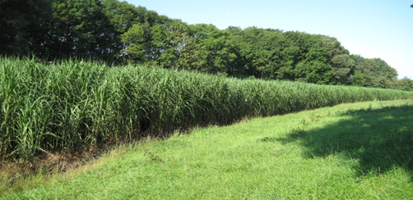


MiscanValue - Creating value chains for utilization of miscanthus fibres from sustainably managed marginal and post-mining areas
Paper and packaging products from miscanthus
Dr. Martin Zahel, Manuela Fiedler
Head of Business Division Fibres & Composites
Laboratory & Project Manager Fibres & Composites
21.09.2022

Slide 2
Virgin and Secondary Fibres for Paper Production
Chemical Pulping Secondary Fibres:
Wood
Pulping
Bleach-ing
Recycling
Usage
Process-ing
Mechanical Pulping
Wood
SGW TMP CTMP APTMP
Bleach-ing
Stock Prepa-ration
Paper-machine
Coating
Alternative Fibre Sources Papermaking
Plants
Individual Pretreatment and Processing Spets
Paper

Slide 3
Pulping vs. Properties
Biomass
mech.
Pulping
mech. & chem.
Pulping
chem.
Pulping
RMP
TMP
Bleaching
Bleached
Pulp
Bleaching
CTMP
BCTMP
Pulp
Intensity of Pulping
Strength
Lignin Content
Volume
Bending Stiffness
Dewatering

Slide 4
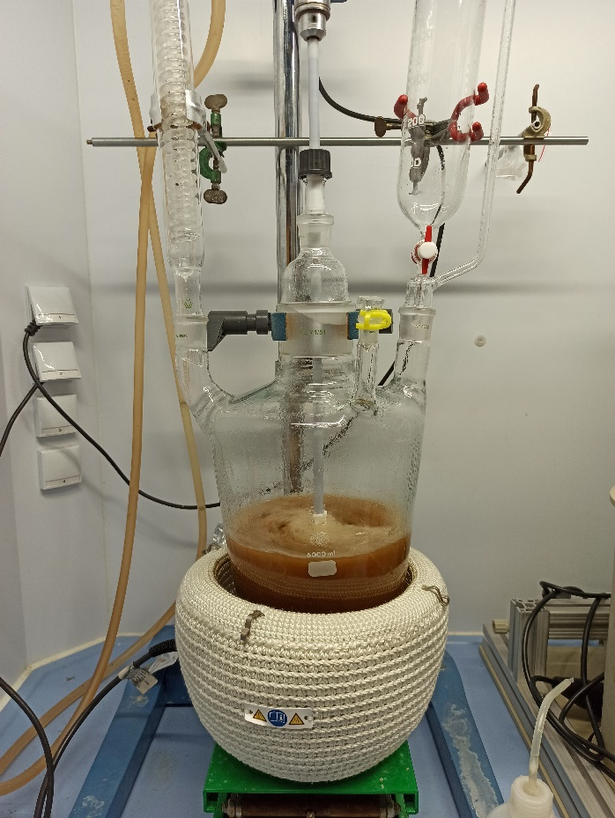
Miscanthus Fibres for Papermaking?
Investigation of mechanical and chemical Pulping Technologies:
  TMP-Refining and Acetosolv-Pulping
Measuring the Fibre Properties
  Lignin Content, Charge Properties, Degree of Polymerization, Fibre Morphology and Water Retention Value
Generation and Testing of Laboratory Paper Materials
  Tensile and Tear Strength

Slide 5
Miscanthus Fibre properties

Slide 6
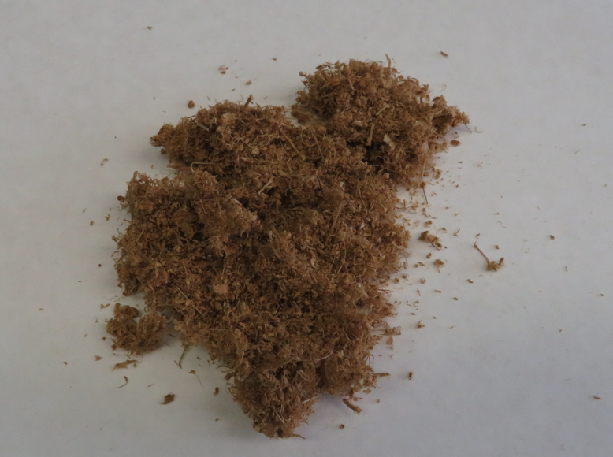
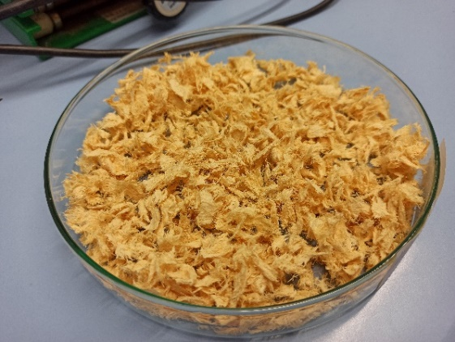
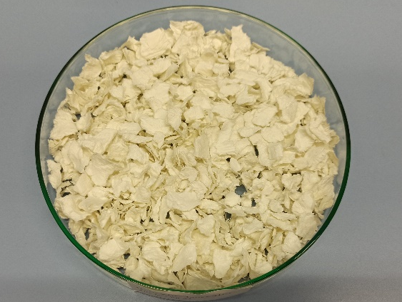
Chemical properties
sample | Lignin % | GVZ ml/g | Total charge mmol/kg | Surface charge µeq/g
TMP | - | 395 | - | -
CTMP V III | - | - | - | -
Acetosolv 1 | 8,0 | 263 | 65,2 | -195,6
Acetosolv 2 | 13,2 | 263 | 59,3 | -204,4
Acetosolv 3 | 15,9 | 208 | 43,7 | -191,6
Acetosolv 4 | 1,4 | 317 | 65,2 | -104,7
Sulphate pulp spruce/pine | <1 | 730 | 22,2 | - 54,1
Sulfat pulp eucalyptus | < 1 | 743 | 25,7 | - 71,2
Reference Wood Pulps: Datasheet values
Fibres from the acetosolv pulping have a significantly lower GVZ (limiting viscosity number) than the fibres from the sulphate digestion.
The total charge of the fibrous materials from acetosolv digestion is many times higher than the fibrous materials from sulphate digestion

Slide 7
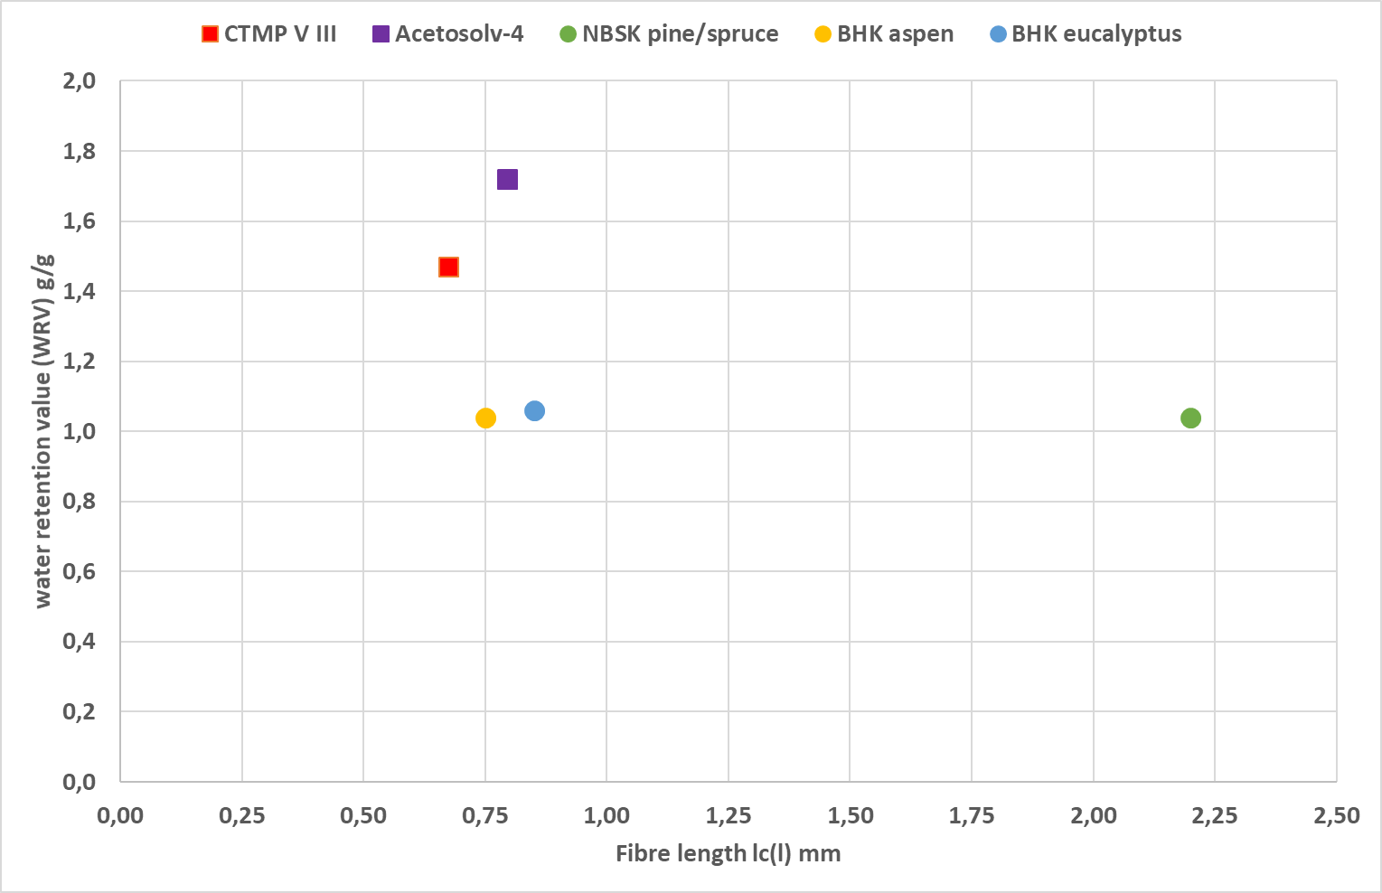
Fiber length vs Water retenention value WRV
Miscanthus pulps have short fibres, lots of fines -> a high specific surface area -> high WRV.
Sulphate pulps have significantly lower WRV values

Slide 8
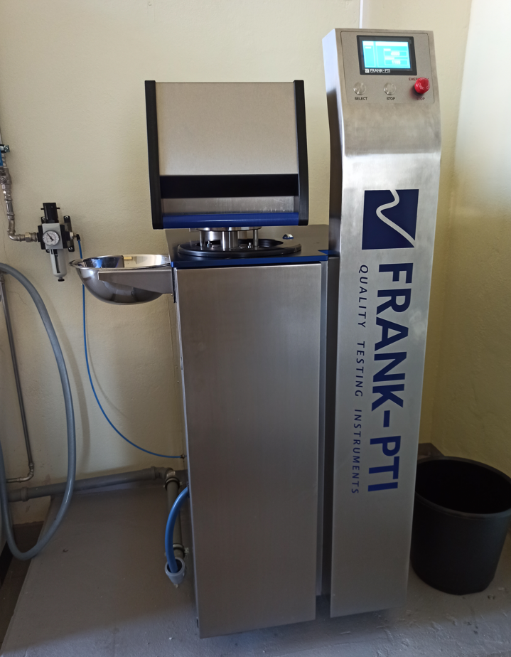
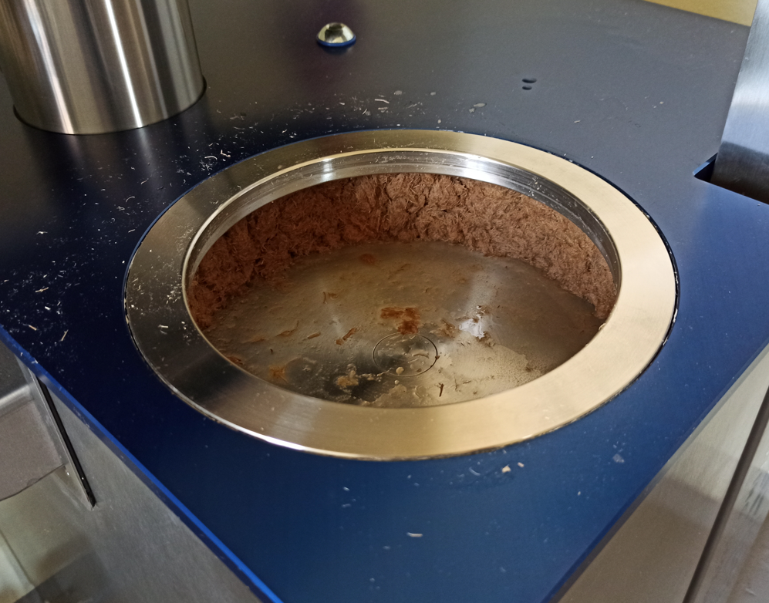
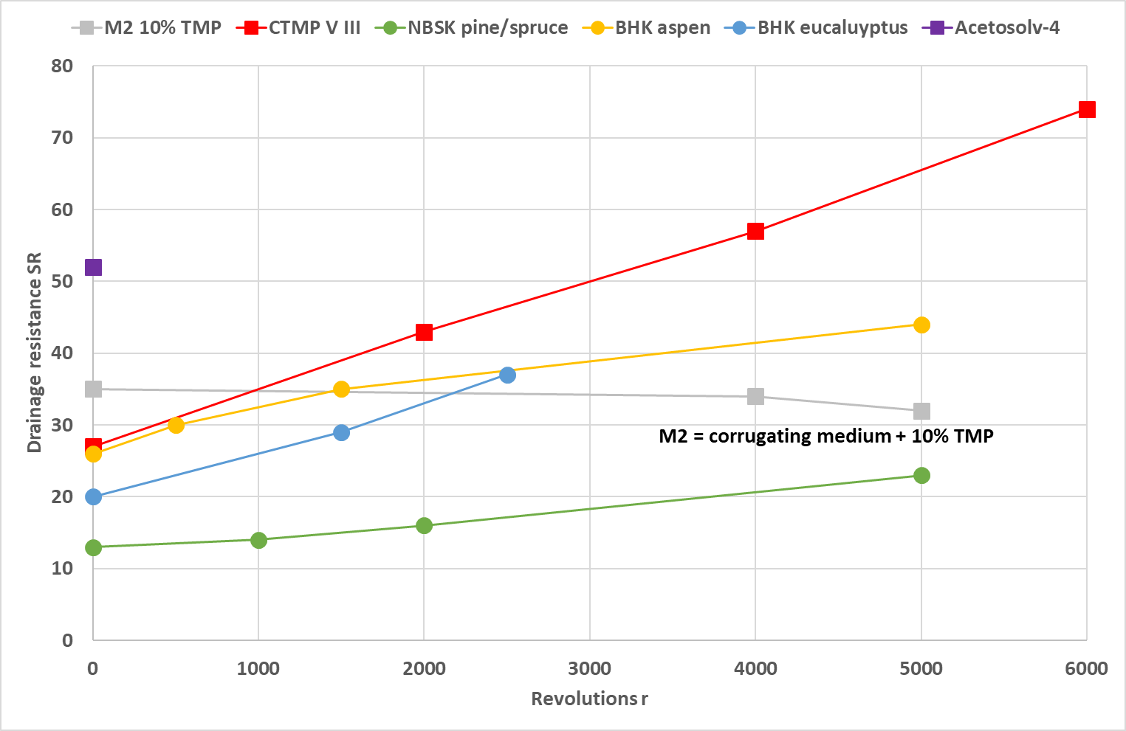
Drainage resistance SR – PFI Mill
the Miscanthus CTMP develops very high SR values when ground -> fines content increases
the pulps produced by the sulphate process are more resistant to grinding than the Miscanthus pulps

Slide 9
Paper properties

Slide 10
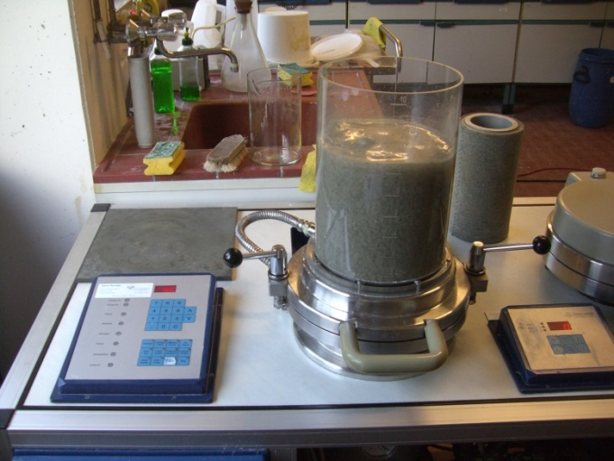
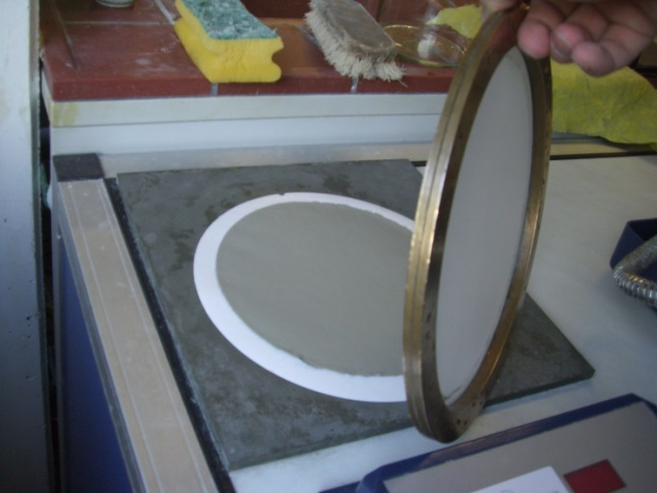
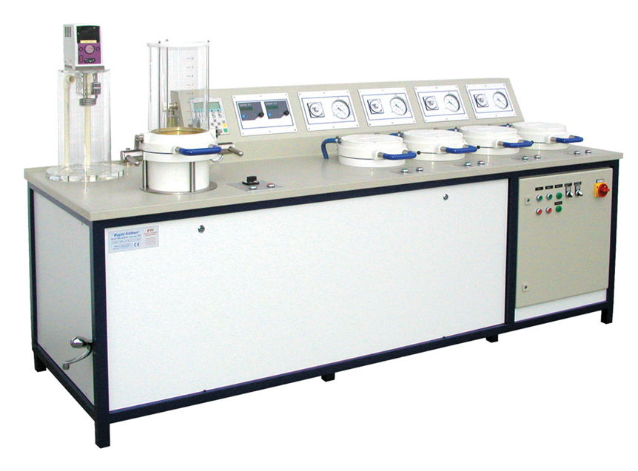
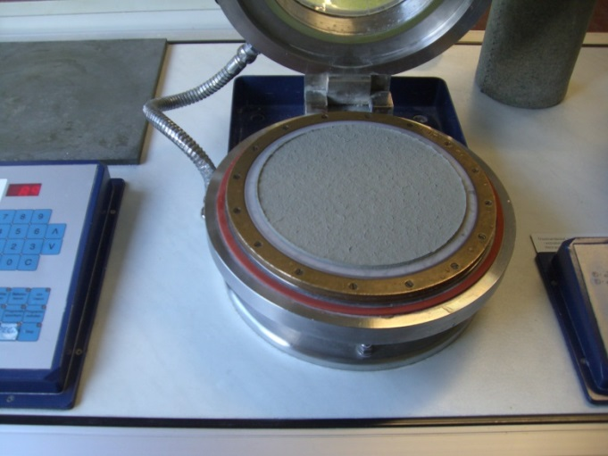
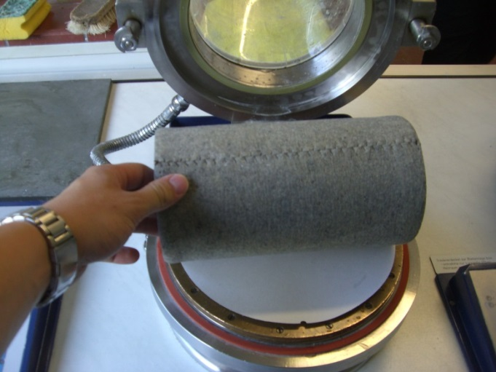
Laboratory Sheet Forming: Rapid Koethen
Sheet Forming
Sheet before Drying
Dewatering
Pressing

Slide 11
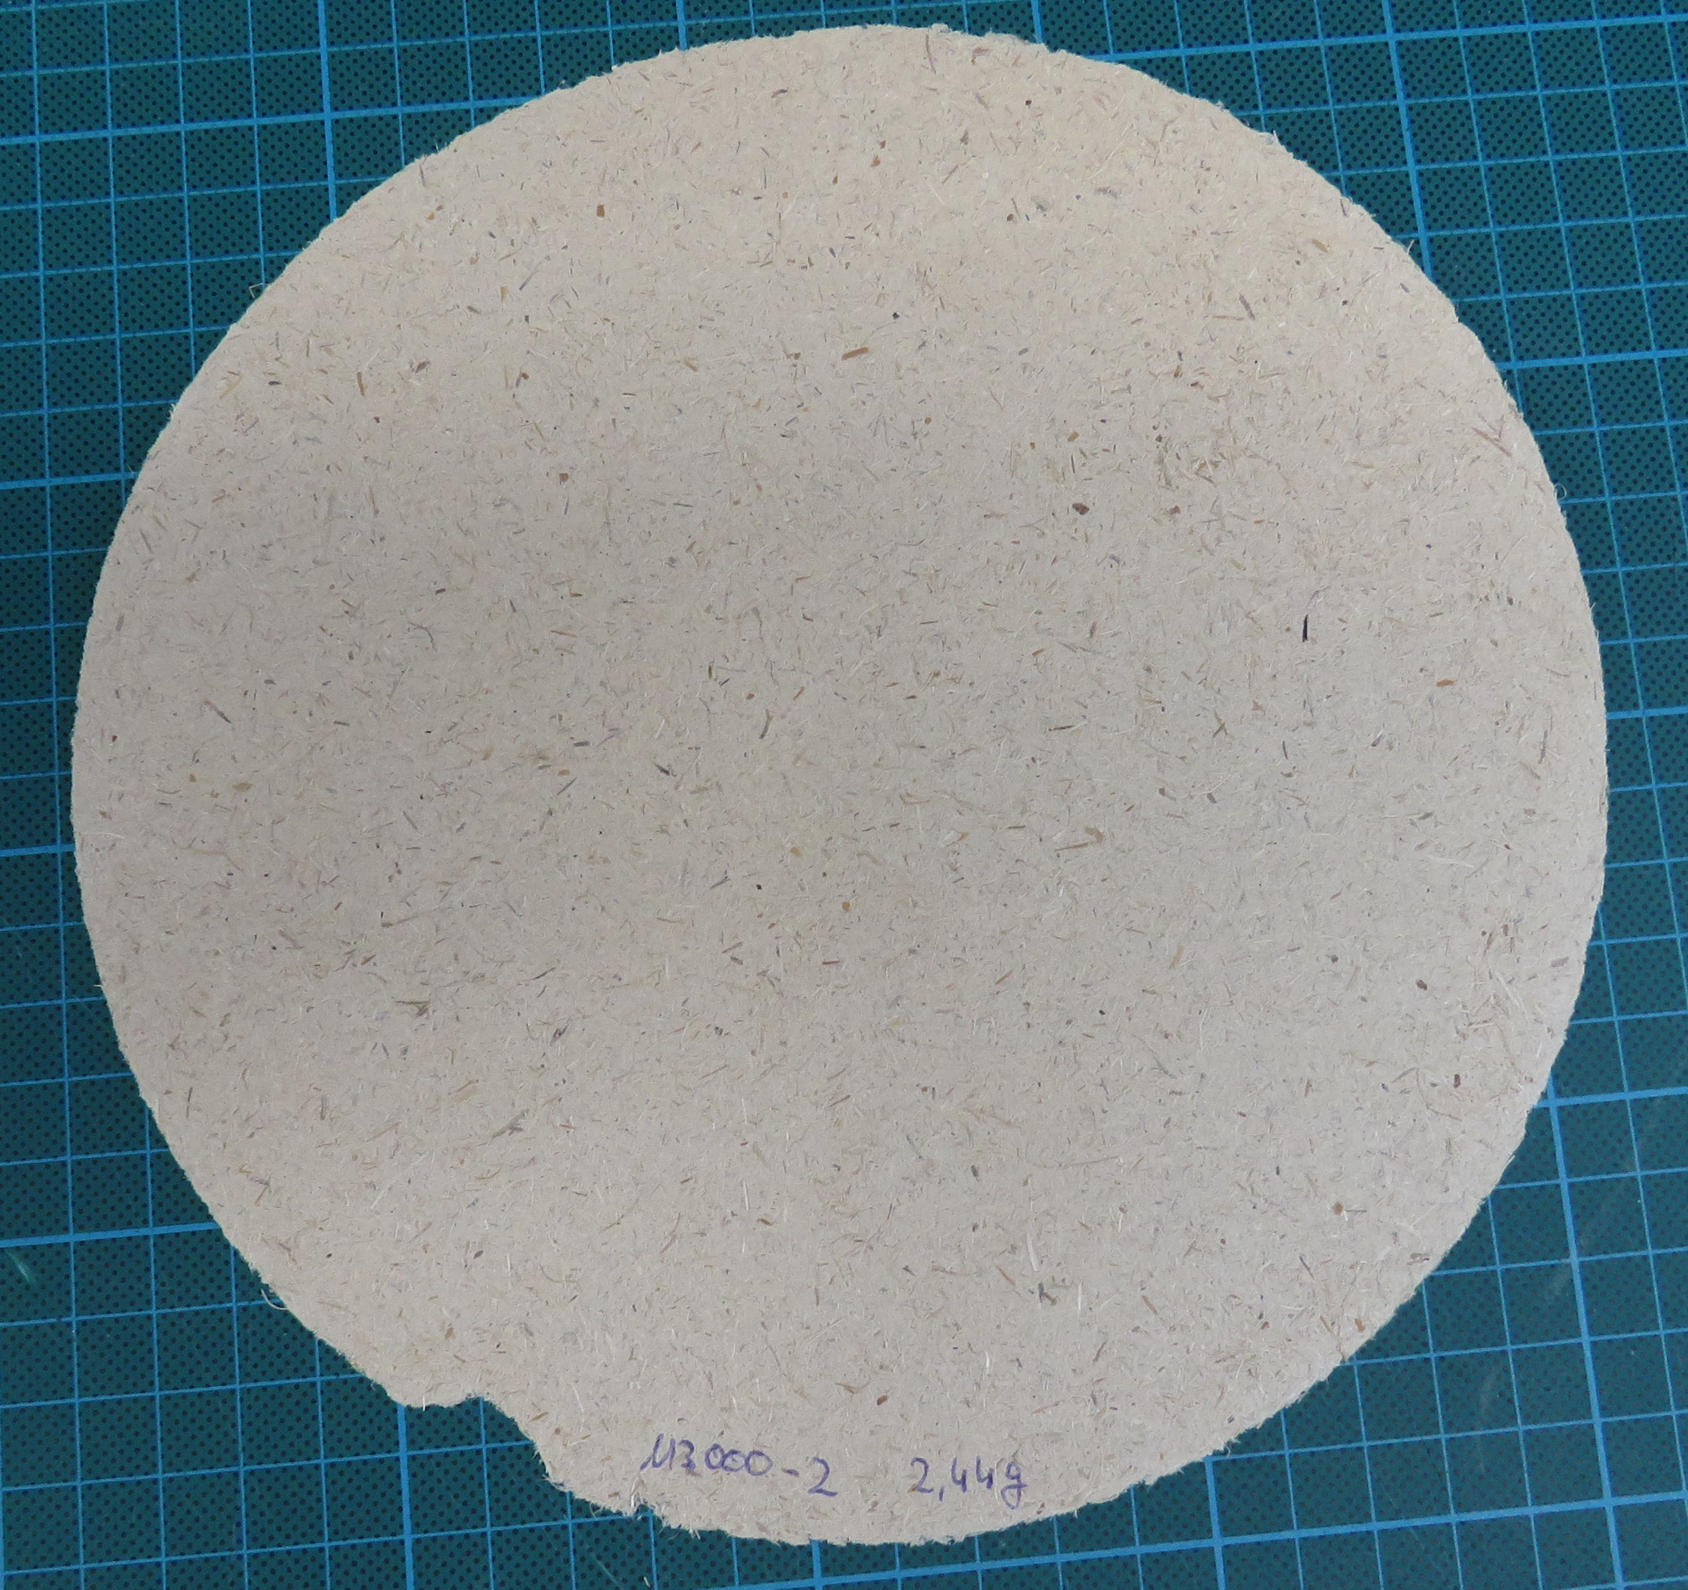
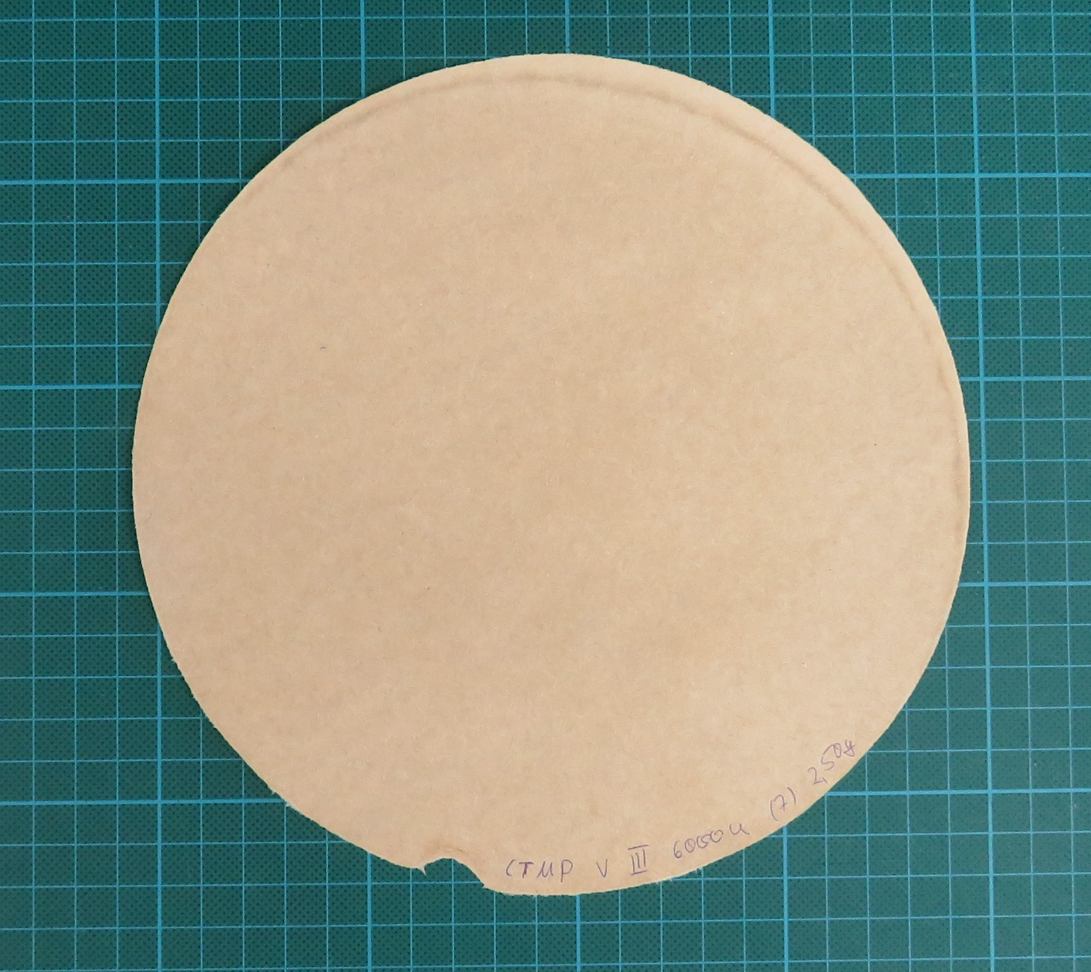
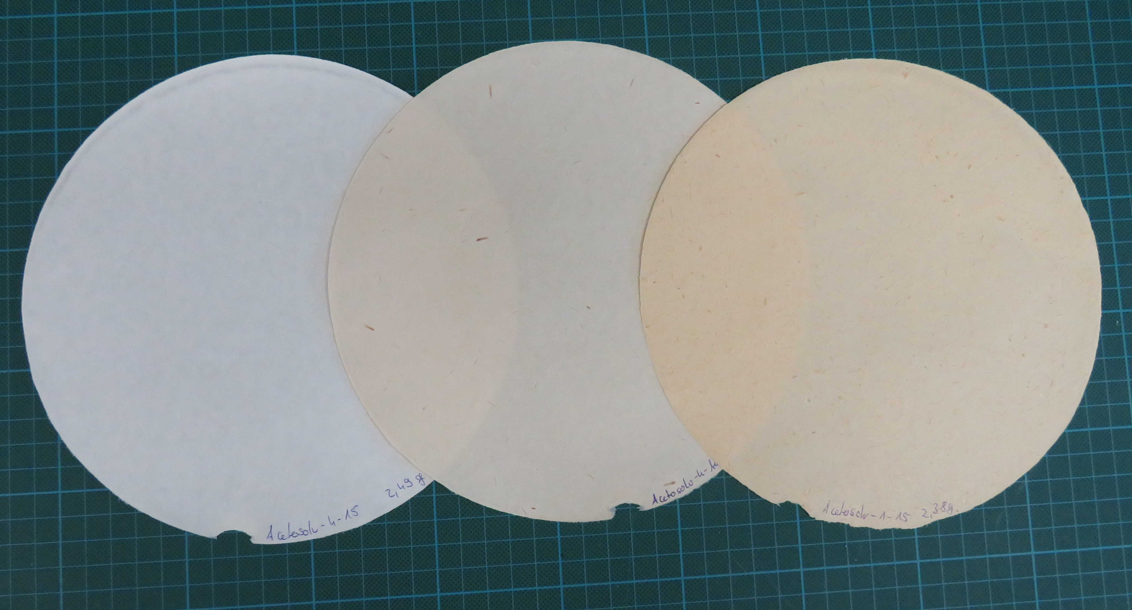
Handsheets
M2 + TMP
CTMP
Acetosolv

Slide 12
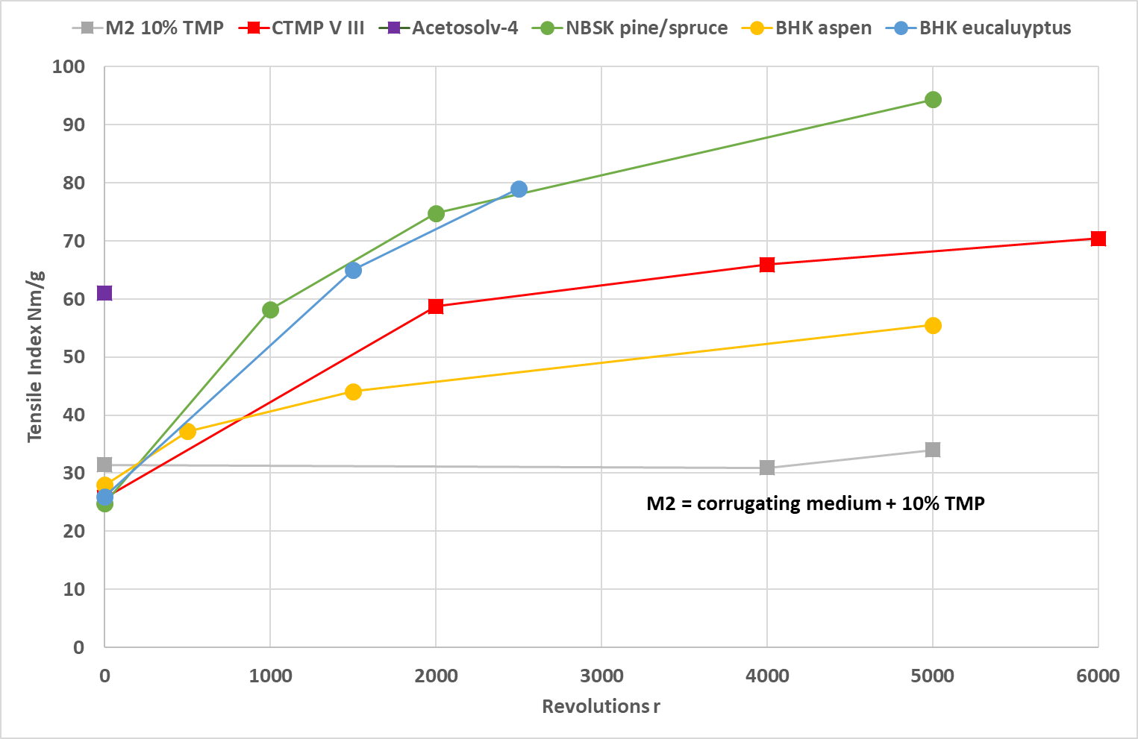
Tensile-Index – PFI Mill
the Tensile Index of the Acetosolv pulps (unrefined) is significantly higher than the pulps produced after sulphate digestion (unrefined)

Slide 13
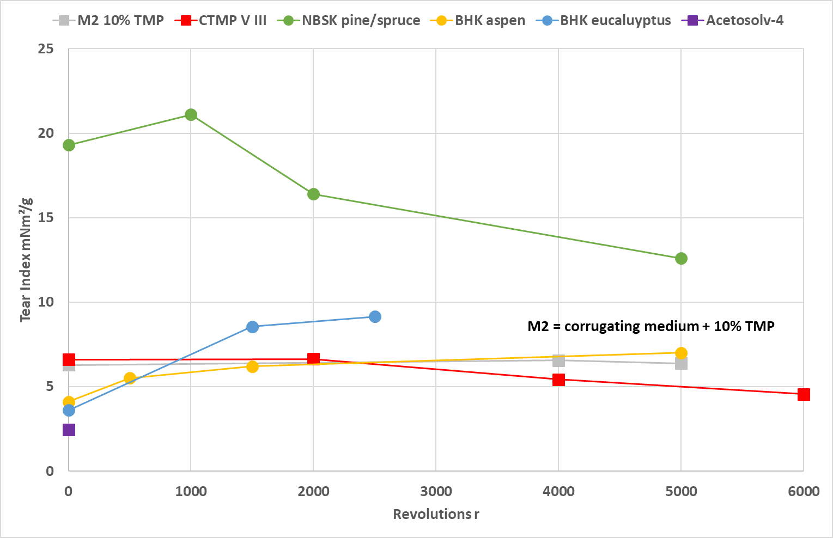
Tear-Index – PFI Mill
the tear index of the sulphate fibre spruce/pine is the highest
the Miscanthus fibres have a lower tear index which is only slightly changed by grinding.

Slide 14
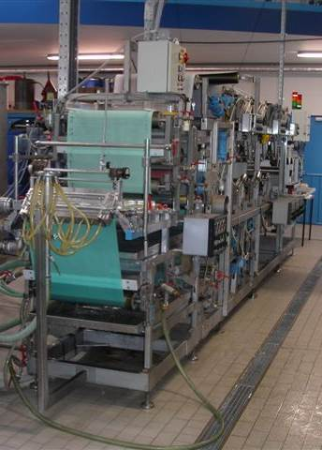
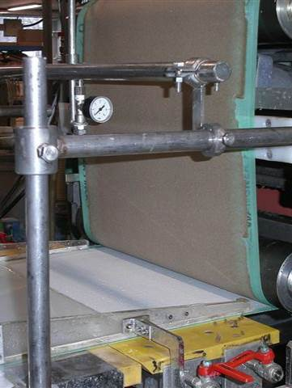
Next Steps: Preparing Paper at a Pilot Paper Machine
How do Miscanthus pulps behave towards additives?
In which paper grades could these fibres be used?

Slide 15

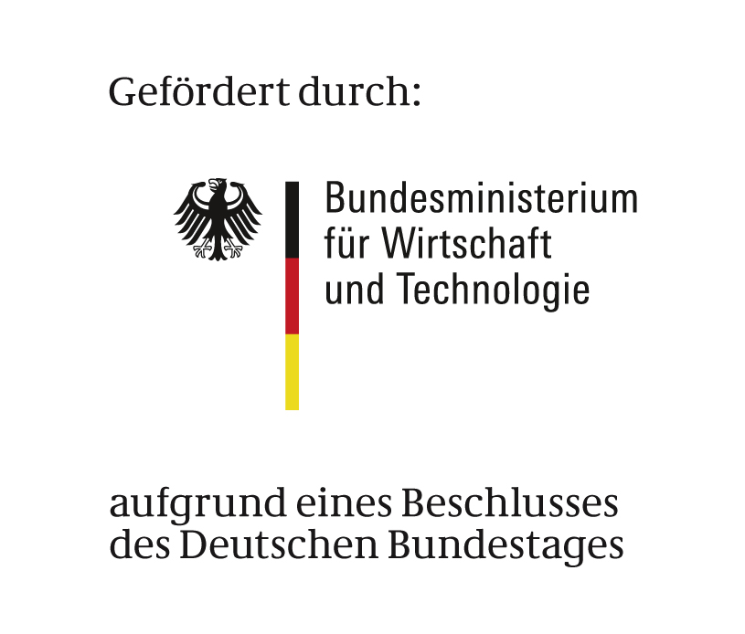

Summary
Miscanthus fibres have a higher total and surface charge than the sulphate fibres.
the Miscanthus fibres were not bleached -> higher lignin content
Miscanthus acetosolv pulps, unground, achieve significantly higher strength (Tensile Index) than pulps produced after sulphate digestion.
Low GVZ of Miscanthus Acetosolv fibres -> higher strength than sulphate fibres
Head of Business Division
Fibres &
Composites
Dr. Martin Zahel
T 03529-551-674
M 0176-12146-350
E martin.zahel@ptspaper.de
IGF CORNET 283 EBR

