Slide 1

Analýza produktů z pyrolýzy plastů plynovou chromatografií s detekcí ve vakuové UV oblasti

Slide 2
Pyrolysis Oils Analysis by GC-VUV

Slide 3

Vacuum Ultraviolet Detector for GC
Schug et al., Anal. Chem. 2014, 86, 8329-8335.

Slide 4
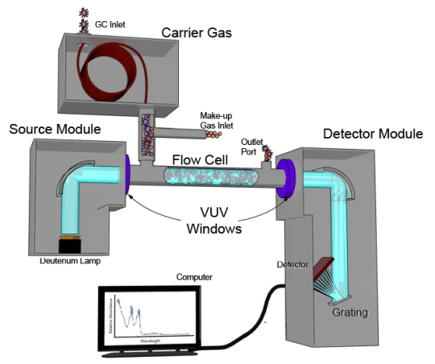
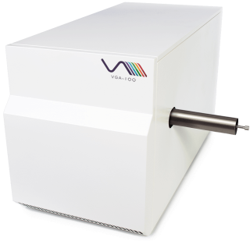
Characteristics of VGA-100 (VGA-101)
Carrier and make-up gases (He, H₂, N₂, Ar) largely VUV transparent. No vacuum required!!
Make-up gas mitigates/alleviates band-broadening
Nondestructive
Heated transfer line
(up to 320 ᵒC (420 ᵒC))
VUV/UV source lamp (D₂); stable signal and robust
Thermostatted flow cell (up to 320 ᵒC (420 ᵒC))
Full range 120 – 240 nm (430 nm) data acquisition at up to 100 Hz
Post-run processing for universal or selective detection; library spectral matching; etc.
Analyte-specific absorption based on Beer’s Law principles; Qualitative and quantitative analysis (wide linear range)
Schug et al., Anal. Chem. 2014, 86, 8329-8335.

Slide 5
Characteristics of VGA-100 (VGA-101)
Carrier and make-up gases (He, H₂, N₂, Ar) largely VUV transparent. No vacuum required!!
Make-up gas mitigates/alleviates band-broadening
Nondestructive
Heated transfer line
(up to 320 ᵒC (420 ᵒC))
VUV/UV source lamp (D₂); stable signal and robust
Thermostatted flow cell (up to 320 ᵒC (420 ᵒC))
Full range 120 – 240 nm (430 nm) data acquisition at up to 100 Hz
Post-run processing for universal or selective detection; library spectral matching; etc.
Analyte-specific absorption based on Beer’s Law principles; Qualitative and quantitative analysis (wide linear range)
Schug et al., Anal. Chem. 2014, 86, 8329-8335.

Slide 6
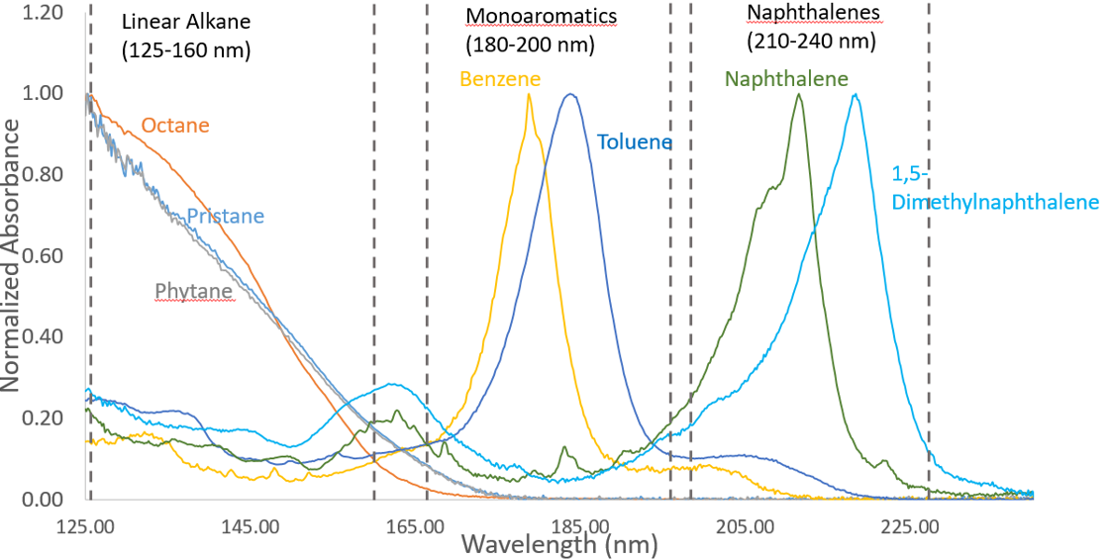
Key Features of GC-VUV
Alkanes vs. Aromatics
Universal and selective detection
Unique, class similar spectra
Optical differentiation of isomers
Deconvolution of coeluting analytes
Automated classification and speciation of mixtures
Good quantitative performance
Weathered diesel analysis
Aromatics and substituted aromatics
Note: The absorbance of e.g benzene at 180 nm is 10 000 more intense than at the typical 254 nm in HPLC
Bai et al., Revised

Slide 7
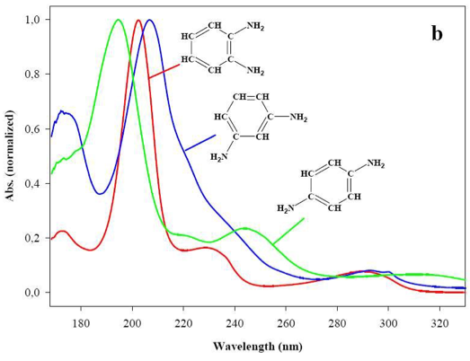
Optical Differentiation of Isomers
Diaminobenzene isomers (Handbook of UV Spectra, Chromalytica)
UV/Vis spectroscopy
Atom connectivity; overlap of molecular orbitals
Electron transition between orbitals
Energy gap and probability of transition dependent on molecular structure
Hexachlorocyclohexane isomers
Dimethylnaphthalene isomers

Slide 8
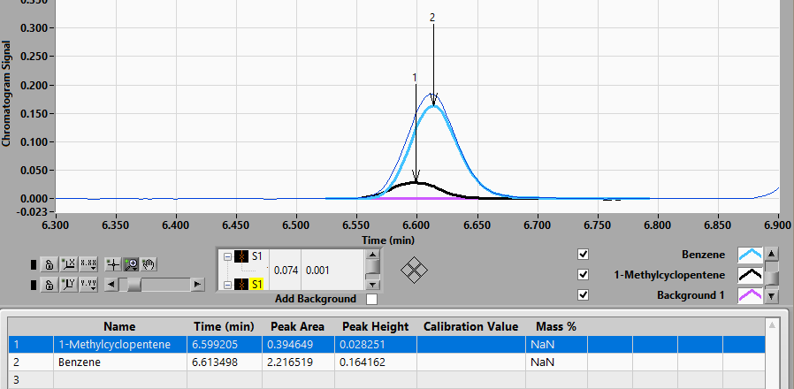
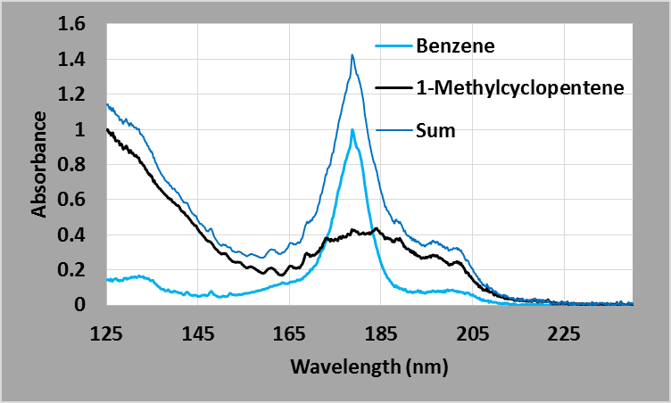
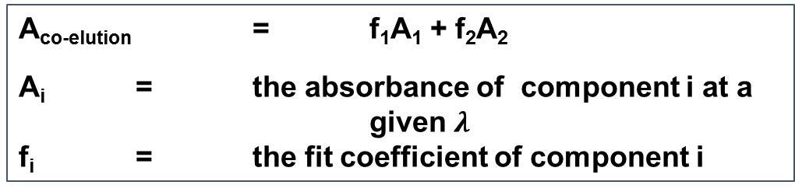

Deconvolution
Total absorption is proportional to the product of the concentration and the absorption cross section
Co-elution is a sum of these products
Linear regression allows for easy deconvolution of the compound concentrations; even for co-eluting compounds
Additive
Beer’s Law: A = ϵbC
A_{total} = A₁ + A₂ + … A_{n}
Deconvolve
A_{co-elution} = f₁A₁ + f₂A₂
A_{i} = the absorbance of component i at a given $λ$
f_{i} = the fit coefficient of component i

Slide 9
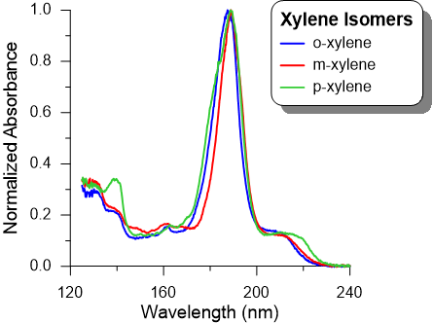
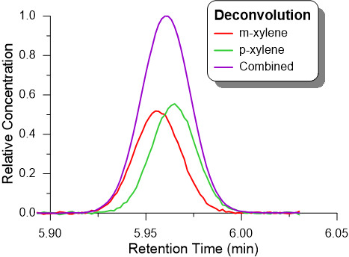
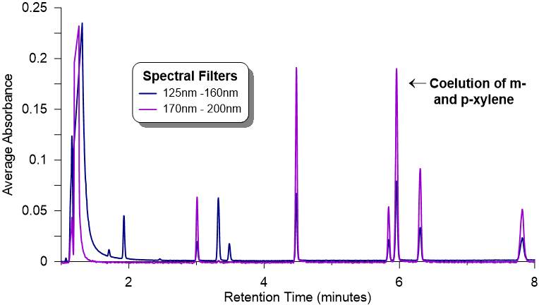
Spectral Deconvolution of m&p Xylene
o-xylene
p-xylene
m-xylene

Slide 10
Library search, purity check, tier search and deconvolution
ASTM D6730 Oxy-Setup
Benzene
1-Methylcyclopentene
Total
125 – 160nm
125 – 240nm
Deconvolution enables accurate determination of the co-eluting compound concentrations
Benzene +
1-Methylcyclopentene
The benzene identification and fitting yielded poor results
Benzene only
The addition of the
1-Methylcyclopentene proved co-elution

Slide 11
Key Features of GC-VUV
Time Interval Deconvolution (TID)
Universal and selective detection
Unique, class similar spectra
Optical differentiation of isomers
Deconvolution of coeluting analytes
Automated classification and speciation of mixtures (compositional analysis
Good quantitative performance
PIONA analysis of finished gasoline (ASTM D8071)
Walsh et al., Anal. Chem. 2016, 88, 11130 – 11138.

Slide 12
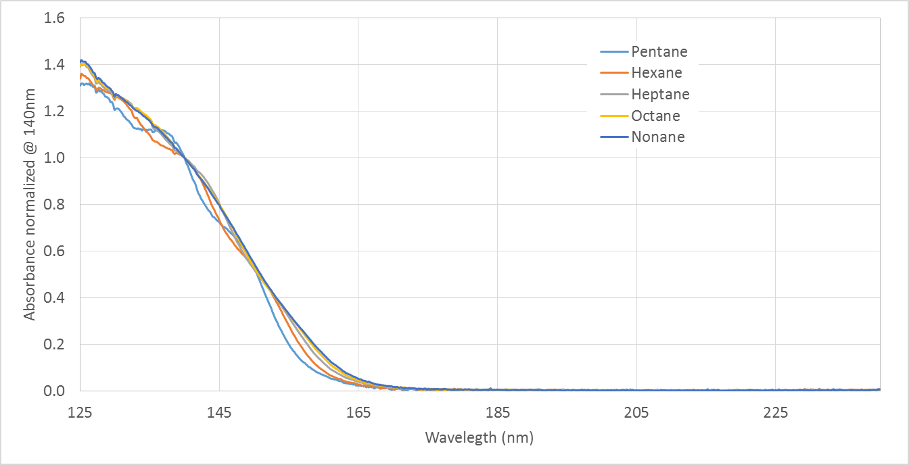
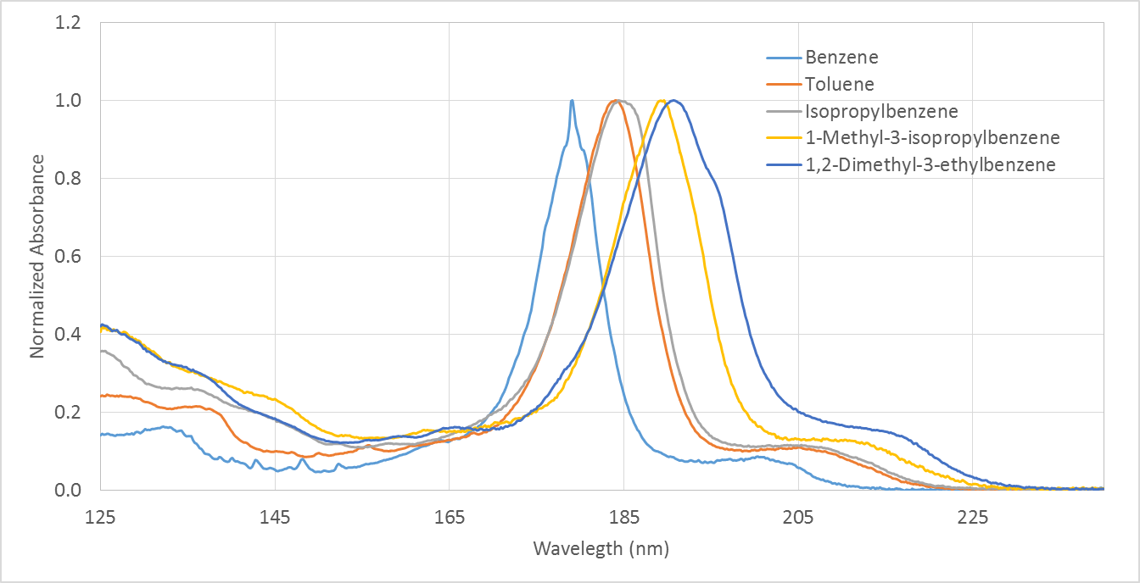
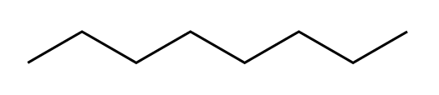
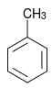
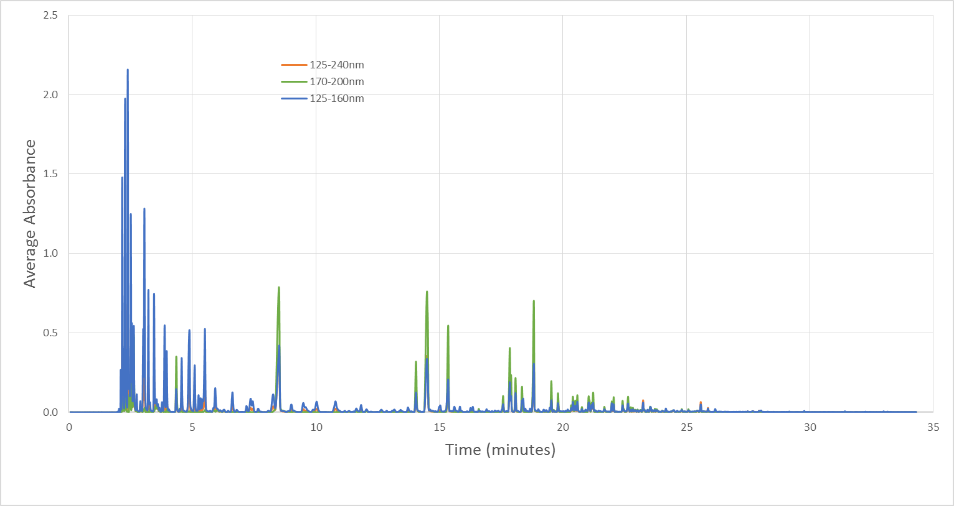
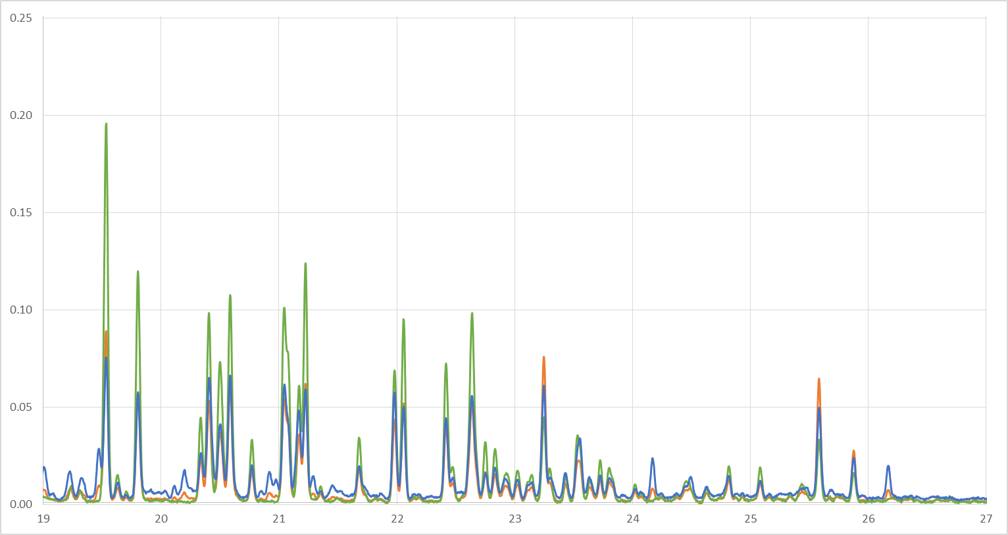
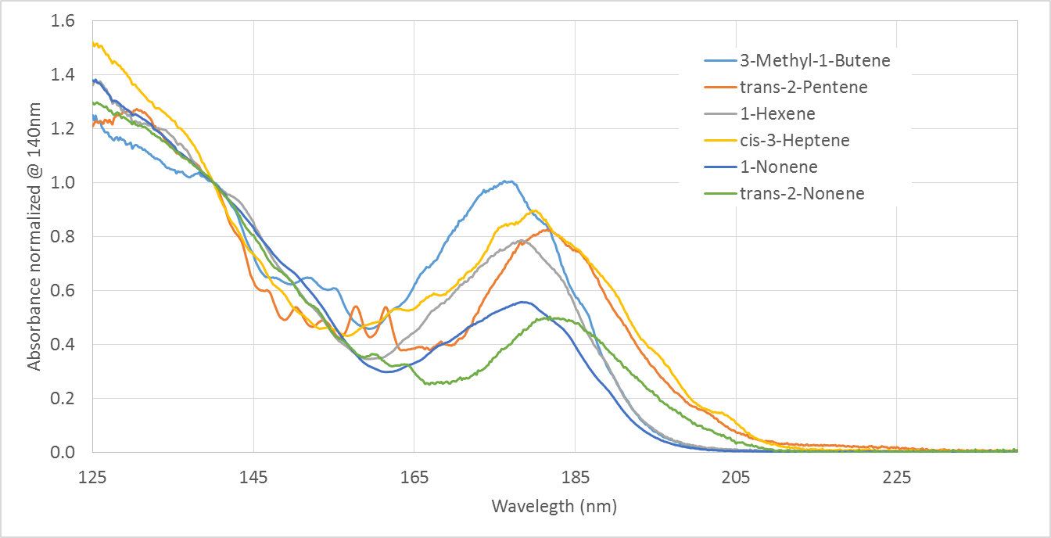
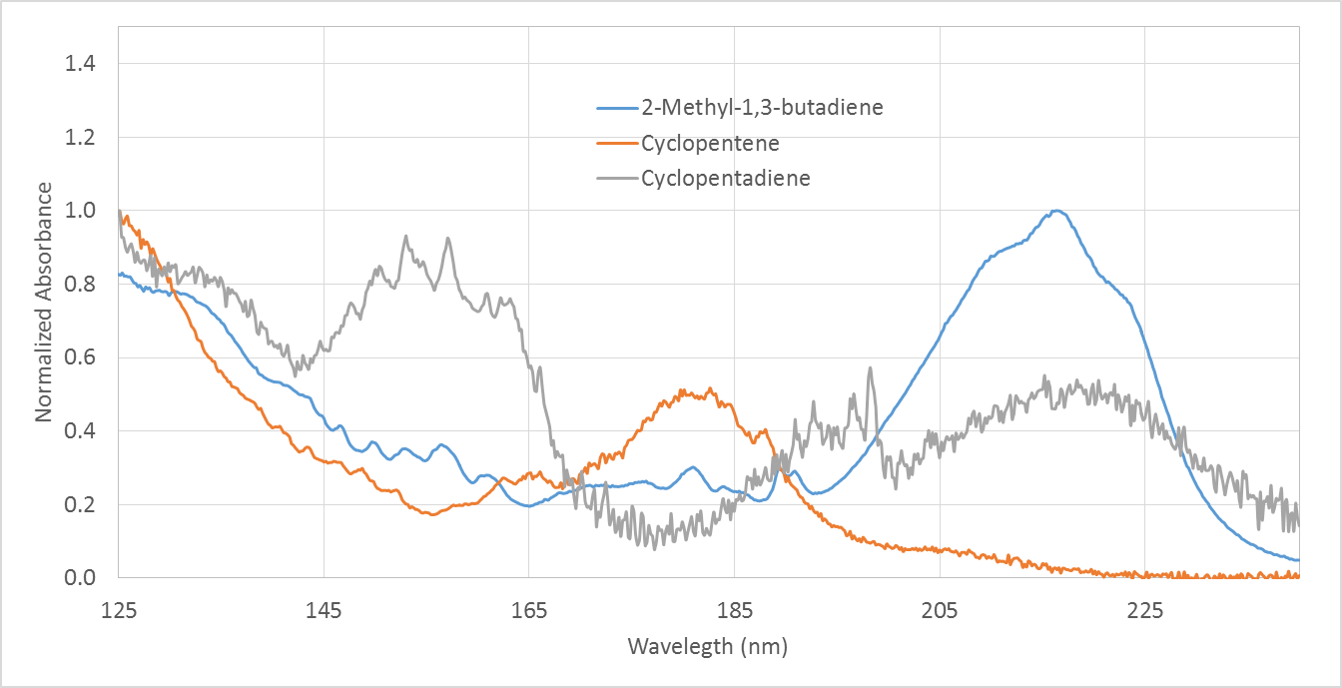
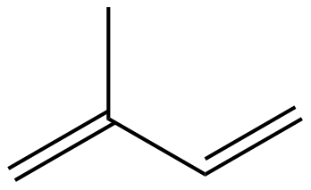

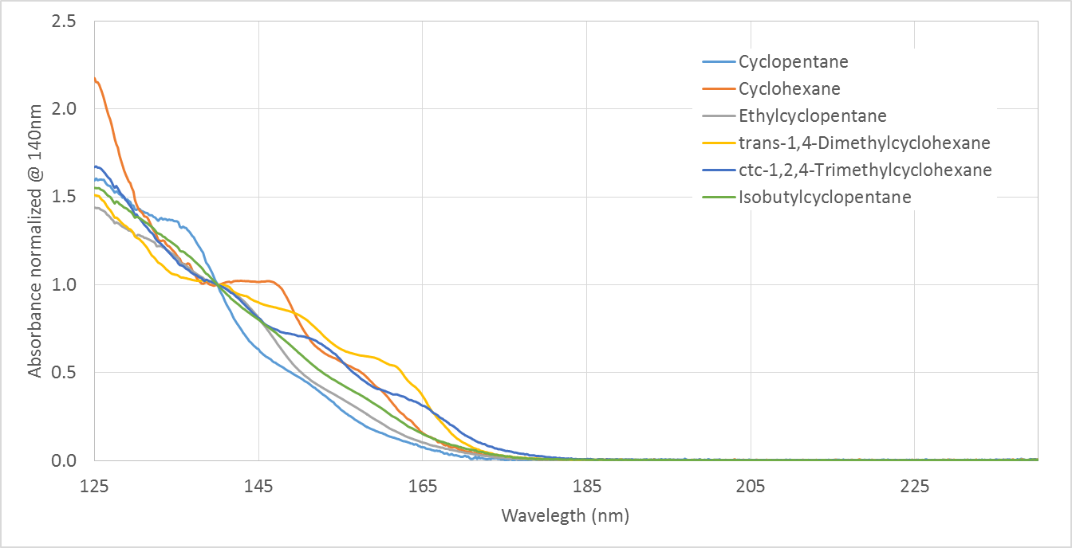
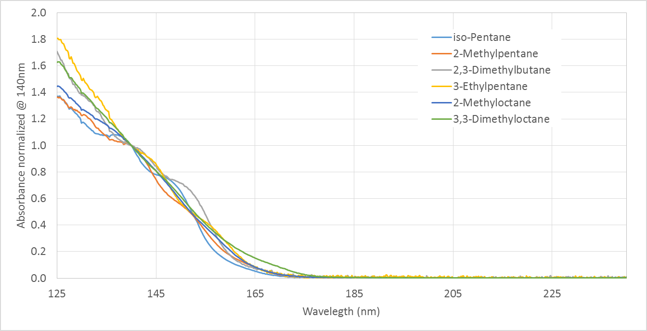
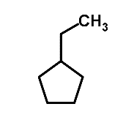
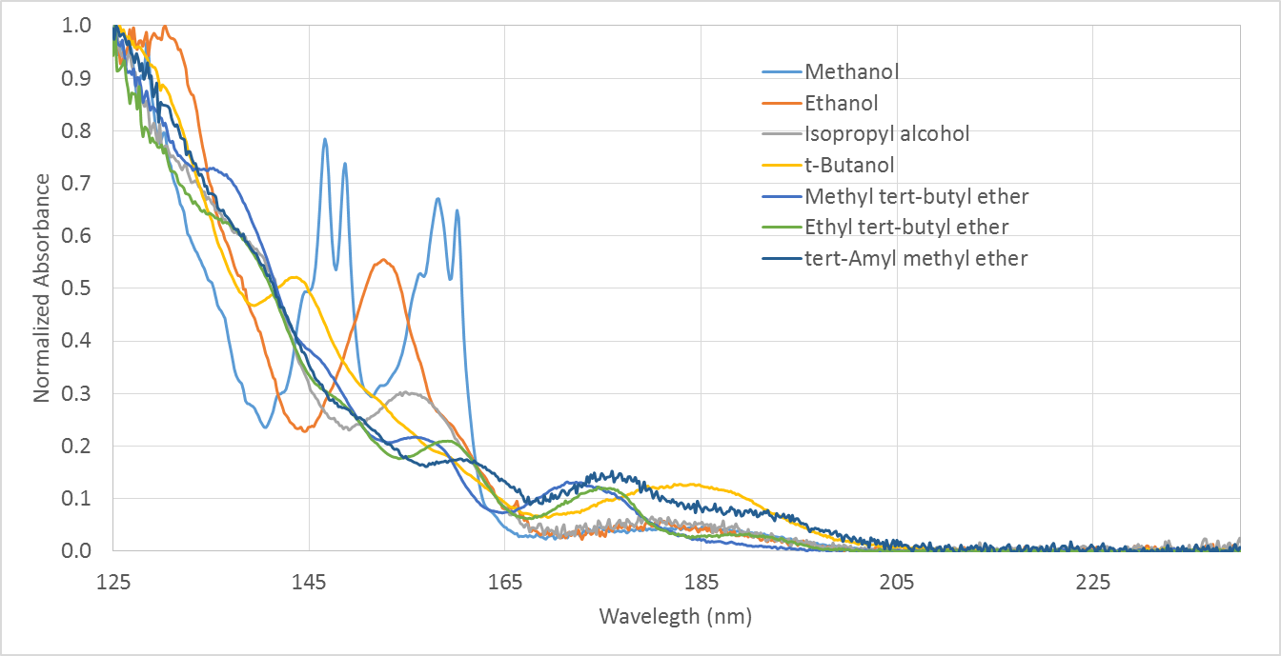
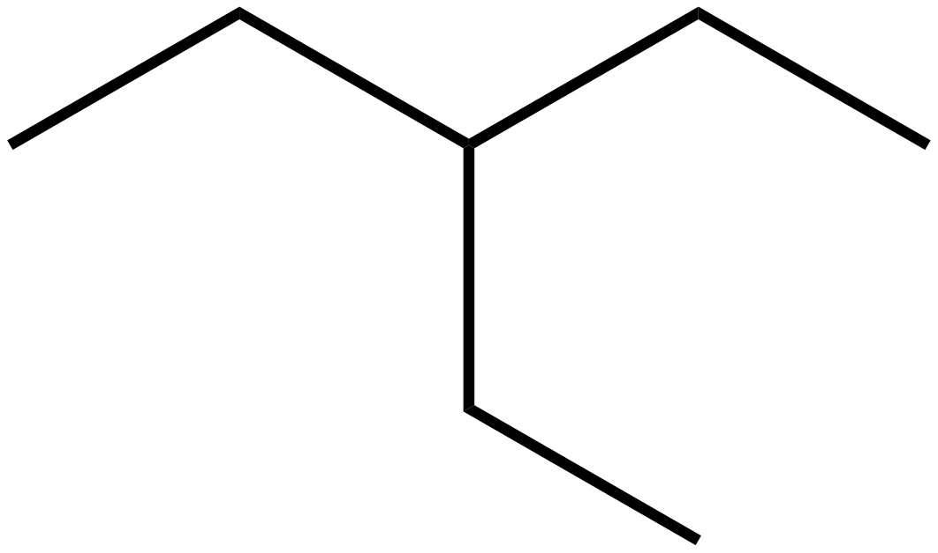

Group plus Compound Identification
Typical Gasoline Sample
Aromatics
Paraffins
Olefins
Diolefins
Naphthenes
Isoparaffins
Oxygenates

Slide 13
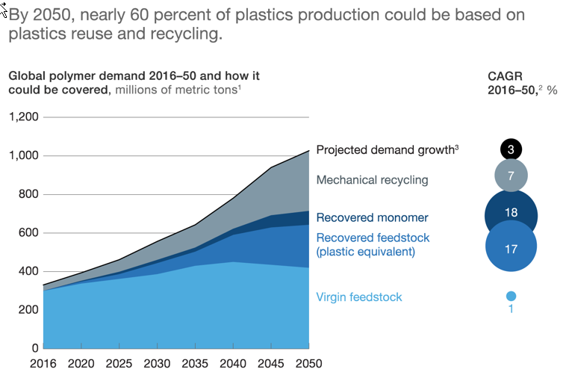
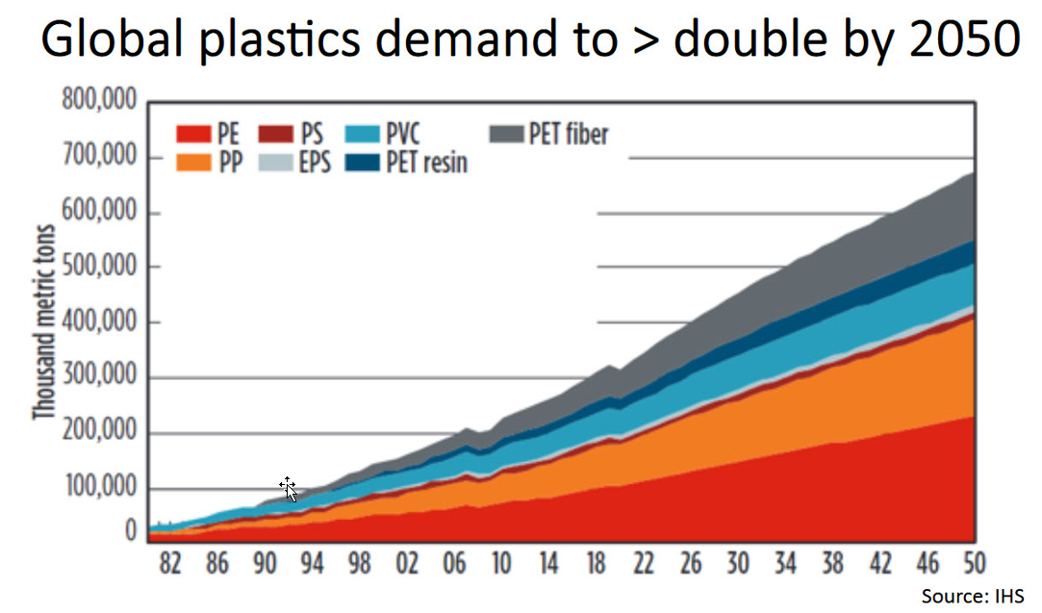
Plastics / Recycled Plastics Growth Projections
By 2050, the size of Recovered feedstocks and monomers could approach the entire size of the 2010 plastics market
More than 10MMTA globally pledged by 2030
  Total has pledged 1MMTA by 2030
  Lyondell has pledged 2MMTA by 2030
  Shell has pledged 1MMTA by 2025

Slide 14
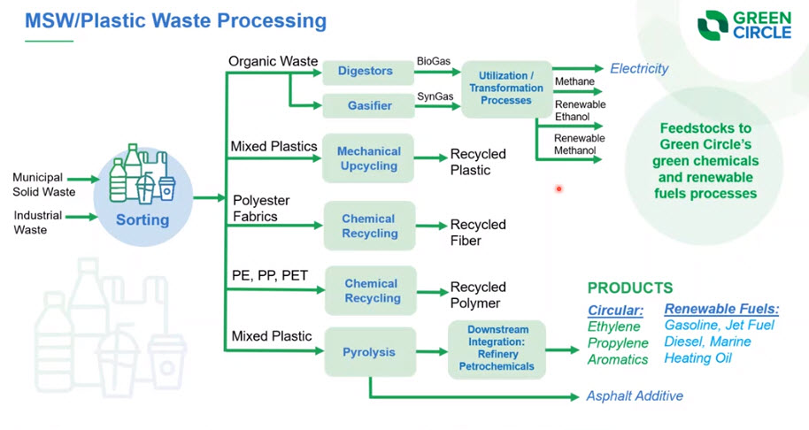
Plastic Waste
Pyrolysis oils can be fed into existing facilities with minimal to no modification
Co-processing can make use of currently financially unviable products (VGOs, oil shales, etc.)
Contamination products can be managed via understanding of heavy molecule cut points or olefin saturation
  Knowing the compound classes through the boiling point distribution becomes critical

Slide 15
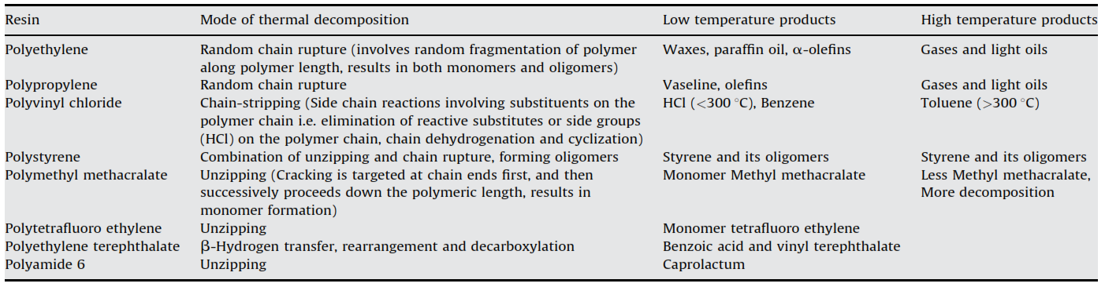
Product Breakdown & Produced Products
1st
2nd
Depolymerised via reversible synthesis reactions
Polyethylene and polypropylene decompose into a range of parafﬁn and oleﬁns and the parafﬁn to oleﬁn ratio decreases with increase temperature and time.
PONA distributions of FCC catalyzed decompositions show that the oleﬁn yield far exceeds the yield of parafﬁns, naphthenes, or aromatics (PNAs) in the pyrolysis of polypropylene and HDPE.
The catalytic degradation of waste LDPE produced more parafﬁns and aromatics than those of waste HDPE and polypropylene.

Slide 16
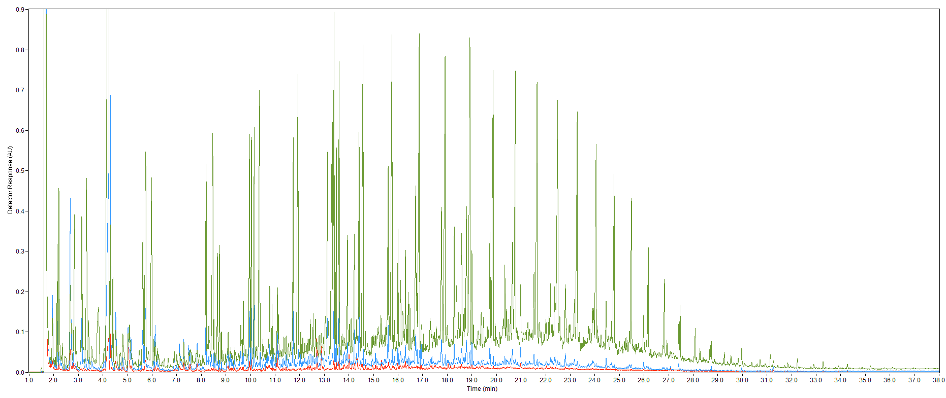
Highly Complex Samples vs. Traditional
C15
C20
125-160 nm
170-205 nm
200-240 nm
C6
C10
C25
C30
C35
C40
Notes:
In one of the more complex samples, a diesel-type of analysis was performed which was expanded to include the determination of dienes too.

Slide 17
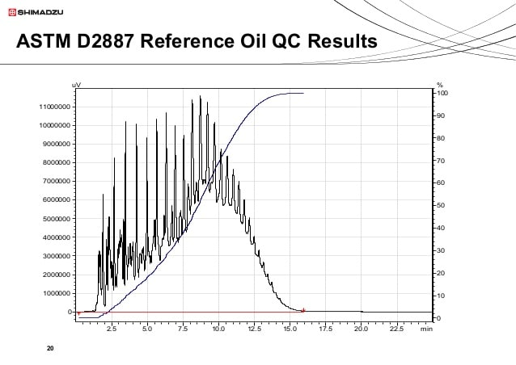
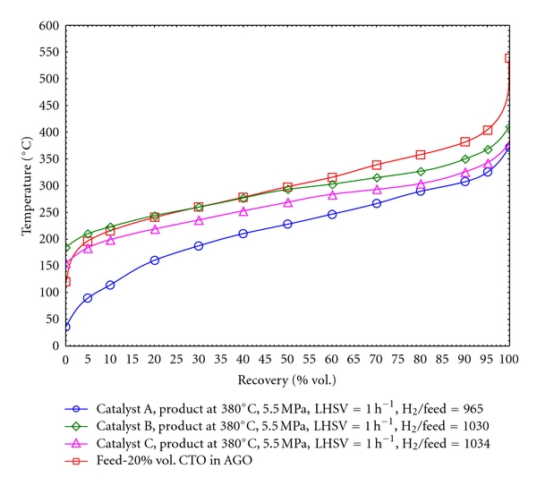
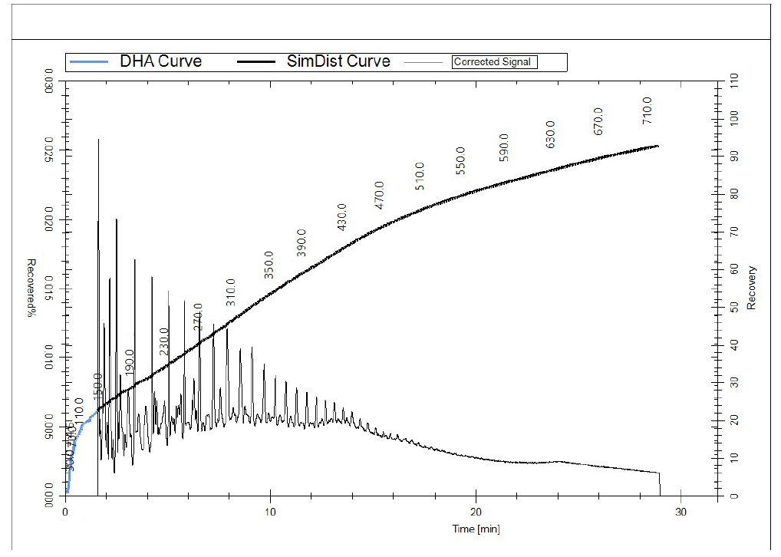
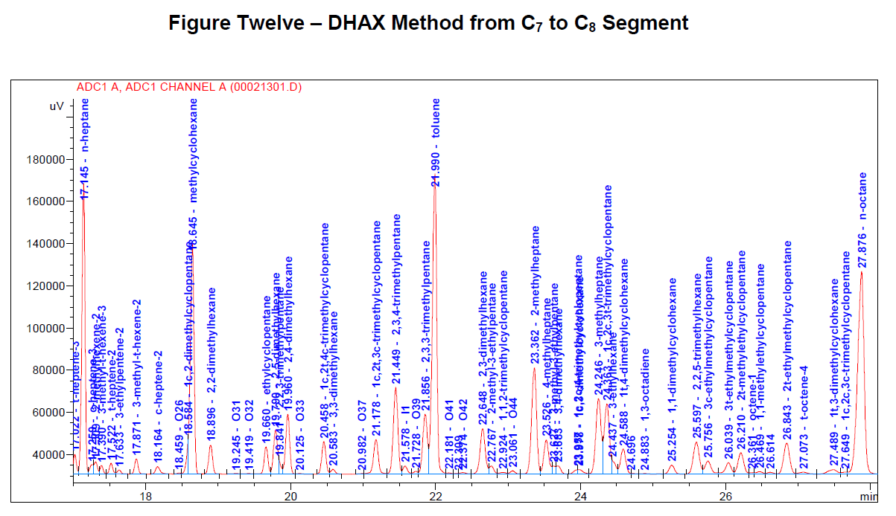
Today’s Analysis Not Adequate
No understanding of molecular makeup
First Injection Hi-Temp Analysis
2nd Injection Front-end Analysis
ASTM D7900 Merge Routine
DHA Analysis

Slide 18
Known Problem
Heavy Naphtha Method Comparisons – Mass%
D8071 - VUV
D6730 - DHA
 | P | I | O | N | A
C4 | 0.05
C5 | 0.30 | 0.19 |  | 0.15
C6 | 1.85 | 1.82 |  | 4.15 | 0.23
C7 | 3.47 | 4.60 |  | 11.83 | 1.64
C8 | 2.37 | 6.25 |  | 13.87 | 3.69
C9 | 1.98 | 6.23 | 0.07 | 11.96 | 4.11
C10 | 1.69 | 5.57 | 0.06 | 8.29 | 1.31
C11 | 0.16 | 1.76 |  | 0.38
C12
Totals | 11.88 | 26.40 | 0.14 | 50.62 | 10.97
 | P | I | O | N | A | Unknown
C4 | 0.06 | 0.01
C5 | 0.33 | 0.20 |  | 0.18
C6 | 1.82 | 1.76 |  | 4.04 | 0.22
C7 | 3.32 | 4.46 |  | 10.72 | 1.56
C8 | 2.62 | 8.43 | 0.20 | 10.64 | 5.10
C9 | 2.20 | 7.66 | 0.50 | 6.45 | 6.08 | 0.76
C10 | 1.88 | 7.20 | 0.04 | 2.72 | 2.98 | 2.09
C11 | 0.19 | 2.05 | 0.03 | 0.03 | 0.14 | 1.18
C12 |  |  |  |  | 0.02 | 0.08
Totals | 12.44 | 31.78 | 0.78 | 34.79 | 16.10 | 4.11
D6730-1 (2016)
“5.3 …..error will be encountered due to co-elution and a lack of identification of all components present. Samples containing significant amounts of olefinic or naphthenic, or both, constituents above octane may reflect significant errors in PONA-type groupings.”
D8071
Conditions

Slide 19
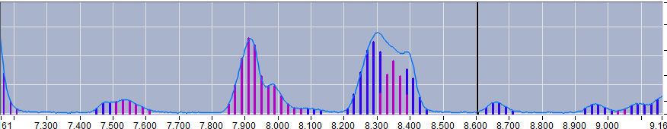
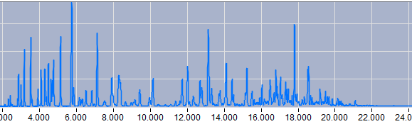
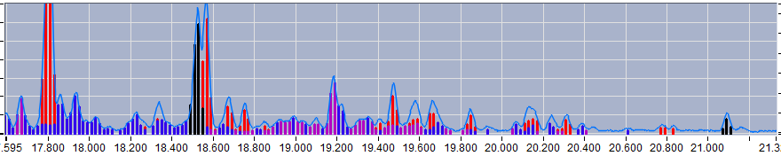
VUV Improves Quantitative and Qualitative Analysis
Heavy naphtha & pyrolysis samples contain significant co-elution which challenges accurate aromatic determination
Many pyrolysis oils are very similar to these heavy naphtha products, but with additional “non-crude compounds”
Unique spectral profiles enable the determination of identities and/or class and relative concentrations of new or co-eluting compounds
Heavy naphtha
Aromatic
nParaffin
isoParaffin
Naphthene

Slide 20
VUV’s Proposed Pyrolysis Oil Method – 1st Draft
Currently an open Work Item in ASTM with Collaboration Site
Targeting Sub-Committee ballot post June 2022 meeting
Standard Test Method for Determination of Saturate, Olefinic, Aromatic and Polyaromatic Content of Plastic Liquids from Chemical or Thermal Processes Using Gas Chromatography with Vacuum Ultraviolet Absorption Spectroscopy Detection (GC-VUV)
Scope
Applicable for plastic recycling and circular schemes including wide range density material from polyethylene and polypropylene.
Plastic liquids that are predominantly hydrocarbons in the boiling range of pentane, nC5 (36°C) to hexacontane, nC60 (615°C).
Group totals and sub-group totals are available
  Saturates totals are the result of the summation of normal paraffins, isoparaffins and naphthenes.
  Aromatics are the summation of monoaromatic and polyaromatic group types. Polyaromatic totals are the result of the summation of diaromatic and tri-plus aromatic group types.
  Olefin totals are the result of the sum of alpha olefins, mono-olefins, conjugated diolefins, non-conjugated diolefins and cyclic olefins.
Plastics liquids and oils from mixed plastic types such as polyethylene terephthalate PET, polystyrene and polyvinylchloride or from other material such as azo-dyes may contain compounds including hetero-compounds that may not be detected or speciated by this test method
Concentrations of group type totals are determined by percent mass or percent volume. The applicable working ranges are as follows:
Class | %Mass | Range
Total Aromatics | %Mass | 0.1 to 79
Monoaromatics | %Mass | 0.1 to 68
Diaromatics | %Mass | 0.027 to 35
Tri-plus aromatics | %Mass | 0.45 to 7
PAH | %Mass | 0.028 to 42
Saturates | %Mass | 0.1 to 80
Olefins | %Mass | 0.1 to 50

Slide 21
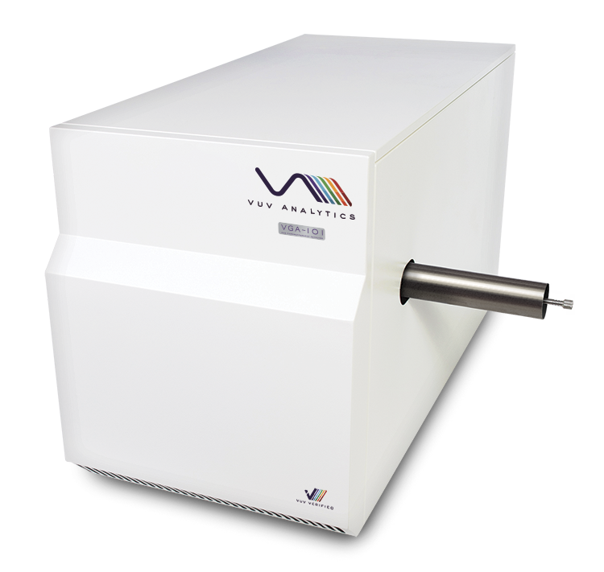
GC-VUV Run Conditions
Sample Prep Procedure
Inlet Conditions
  Injection Volume – 1 μL
  Inlet Temperature – 325°C
  Split ratio – 100:1
GC Conditions
  Single Column –
  Restek Rxi-1HT 30 m x 0.32 mm id x 0.10 um
  Column Flow – 2 mL/min He
  Oven Ramp – 35°C (hold 10 mins), 10°C/min to 400°C
VGA-101 Conditions
  Flow Cell and Transfer Line Temperature – 425°C
  Makeup Gas Pressure – 0.45 psi N₂
  Acquisition Range – 125-430 nm
  Acquisition Rate – 7 spectra/sec
Approximately 100-200 µL oil dissolved in 5 mL carbon disulfide
Mixture pulled into plastic syringe and dispensed into vial through a 0.45µm filter
Samples evaporated down to approximately 0.5-1 mL
VGA-101
Notes:
This early development activity has been focused on using the VGA-101 product given the ability to extend into higher carbon number ranges using the higher temperature range transfer line and flow cell. You can see the current GC conditions which have been used for this work to-date.
The early work has also involved a relatively simple sample preparation step that involves dissolving the sample in a carbon disulfide and then concentrating this back up.

Slide 22
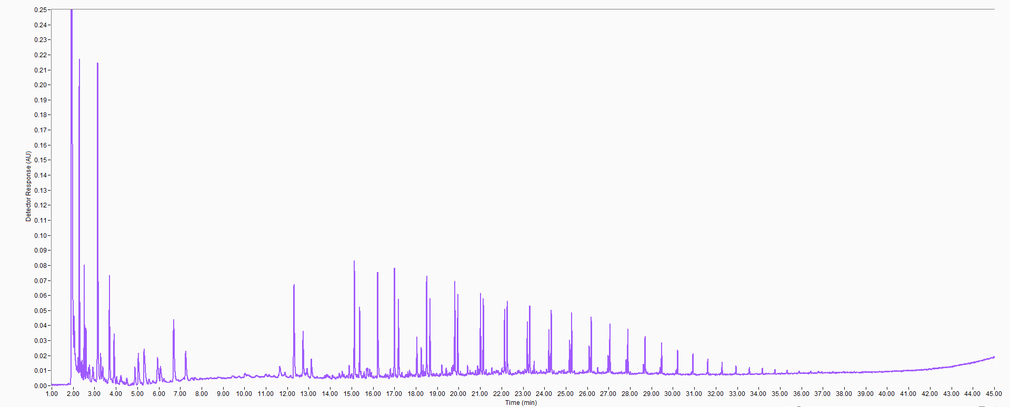
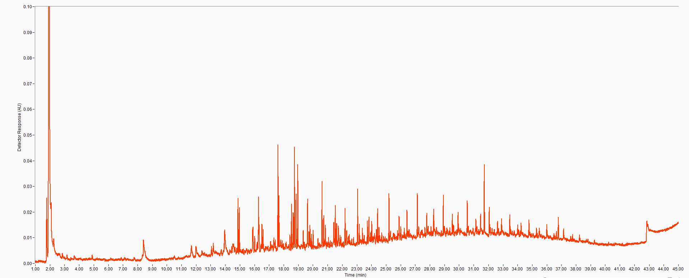
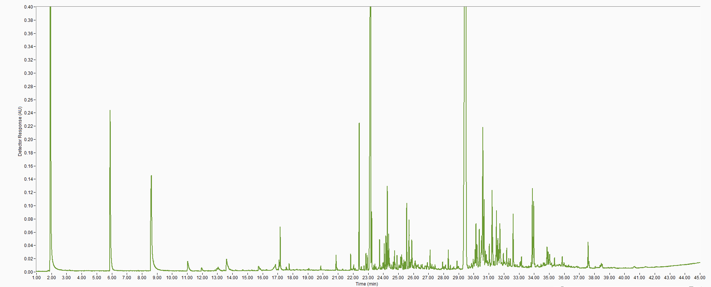
Recycled Plastics Oils – Full Chromatograms (125-240 nm)
1
 | Sample 1 | Sample 2 | Sample 3
Category | Mass % | Mass % | Mass %
Total Saturates | 48.4 | 68.0 | 0.261
Total Olefins | 38.5 | 25.8 | 0.382
Total Aromatics | 13.1 | 6.17 | 99.4
Total Mono-Aromatics | 11.0 | 5.78 | 96.8
Total Di-Aromatics | 2.09 | 0.0732 | 1.95
Total Tri-Aromatics | 0 | 0.315 | 0.637
Total Tetra-Aromatics | 0 | 0 | 0.0124
Total PAHs | 2.09 | 0.389 | 2.60
2
3
Notes:
Most of the samples which have been characterized to-date have fallen into these three general compositional categories. You can see via the chromatograms, from a non-polar column, that these samples are not typically as complex as one might expect.
Using the same software and spectral fitting tools, combined with an extended library, we are able to break down these samples to provide a critical analysis of the olefin and aromatic classes. This provides the customer a very unique look at these class totals as well as insight into their distribution by boiling point.

Slide 23
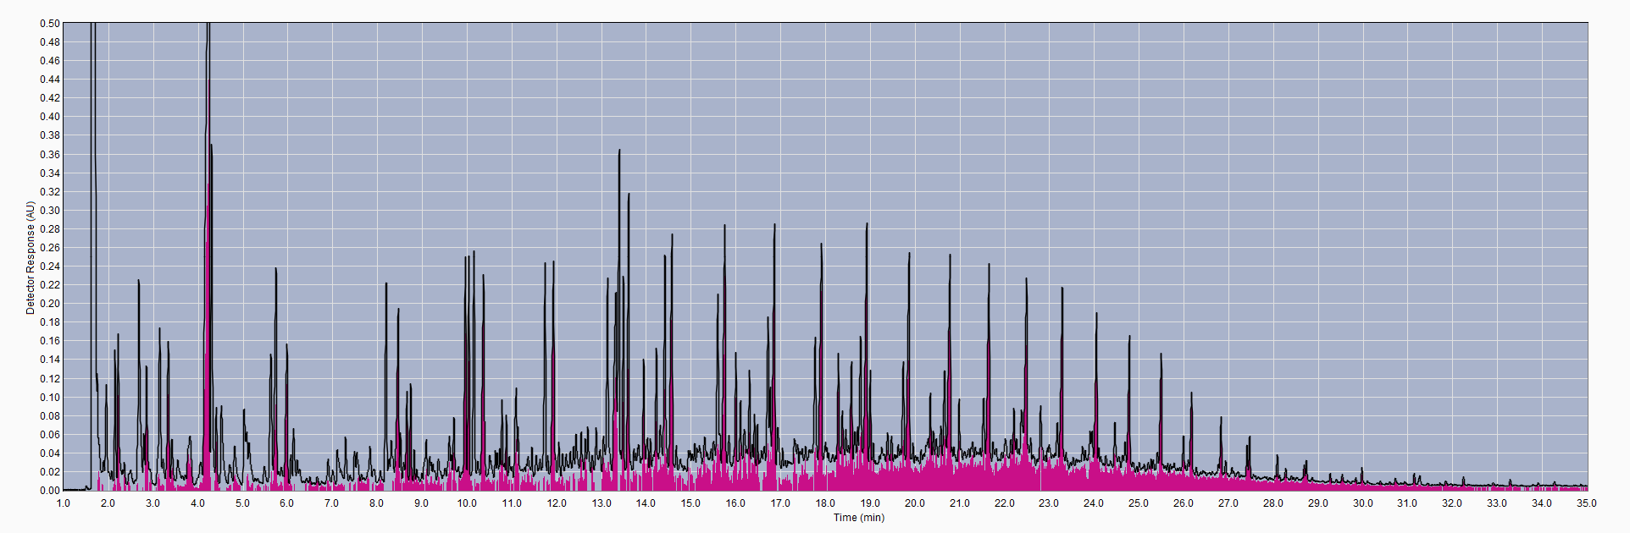
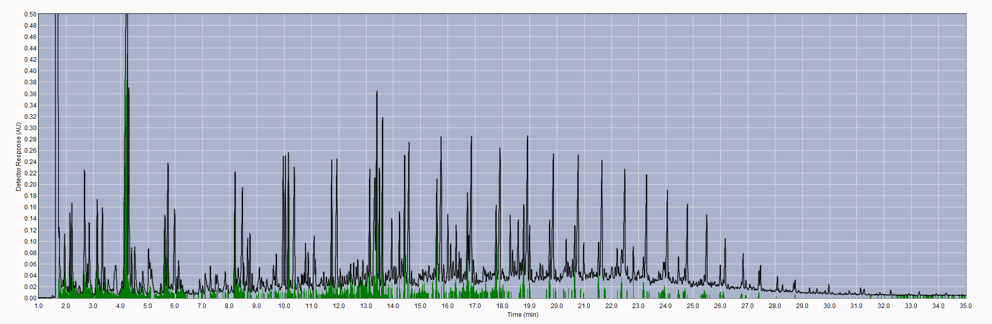
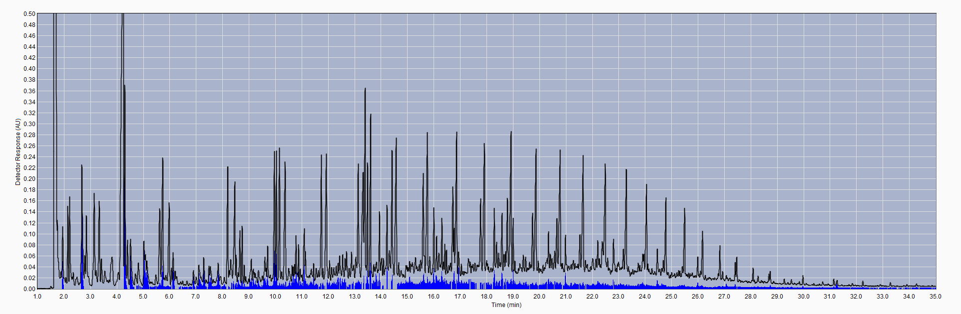
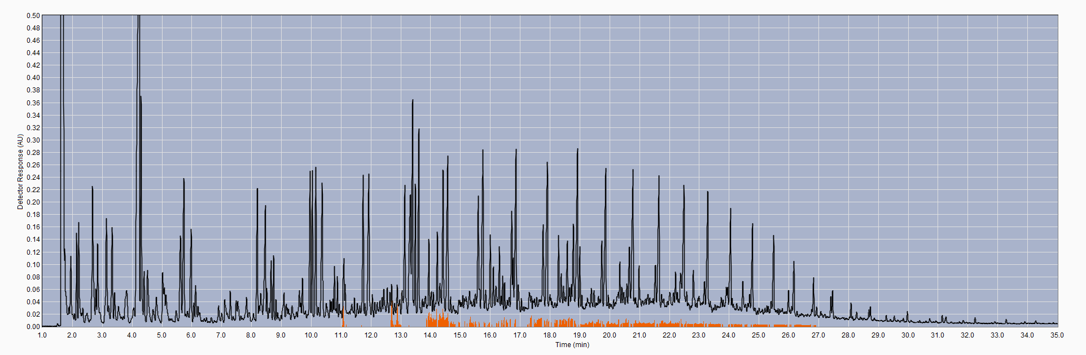
Results – By Boiling Point
Saturates
Olefins
Mono-Aromatics
Total PAHs
Notes:
Again, this technique provides the unique ability to view the breakdown of these hydrocarbon classes by boiling point.

Slide 24
Quantitative Results (Mass and Volume %)
Category | Mass % | Volume %
Total Olefins | 21.5 | 22.6
Total Dienes | 1.17 | 1.09
Total Conjugated Dienes | 0.299 | 0.327
C5 Conjugated Dienes | 0.0264 | 0.0309
C6 Conjugated Dienes | 0.0472 | 0.0523
C7 Conjugated Dienes | 0.215 | 0.233
C8 Conjugated Dienes | 0.0104 | 0.0107
Category | Mass % | Volume %
Total Saturates | 64.9 | 65.3
Total Olefins | 21.5 | 22.6
Total Aromatics | 13.6 | 12.2
Total Mono-Aromatics | 11.9 | 10.8
Total PAHs | 1.72 | 1.32
Notes:
The class and sub-class totals can easily be reported in both mass and volume percent.

Slide 25
Current Application Summary
A single library that combines the class information by carbon number and an extended VHA library
A HT Phenomenex column – ZB-1HT Inferno (30m x 0.32mm x 0.10um)
Setup and qualification standards are currently limited due to extended range and olefin presence
  Currently using VUV-1, VUV-RT and Diesel’s VUV-3 and Check Standard
  Exploring SIMDIS standards for RT file creation
  Setup and qualification standards are TBD
Process Flow
Single injection with single analysis run
  Automatically runs the analysis of an extended VHA on C3 – C15 and continues to run HC class and subclass analysis from C15 to C60
  Producing a single combined & normalized report
All data available by carbon number (Mass%, Volume% and Mole%)

Slide 26
Identifying Non-Standard and Non-Hydrocarbon Peaks
Anisole
Styrene
Nitrogenated phenyl compounds?
Benzaldehyde
Acetophenone
A key driver is to better understand the heteroatom content
  Intermediate hetero-element organic compounds or as stable inorganic compounds
The speciated compound library is under constant development
We continue to add as much as possible to this front-end speciation
  Focusing on high abundance and/or high frequency occurring compounds
  Standard VHA detection limits will still apply – 0.0X% level detection
Other compound groups proposed for group reporting
  Styrenes, Indanes, Etc.
What to do with no fit compounds? Currently counted at % uncertainty, then excluded from normalized results.
Component | % Range
Carbon | 84 – 87
Hydrogen | 11 - 14
Sulfur | 0.04 – 6.0
Oxygen | 0.1 – 0.5 to 20
Nitrogen | 0.1 – 1.5
Notes:
Through a more manual inspection of the sample one can begin to determine other possible alkyl-styrenes, phenylamines, cresols, alkyl-benzoic acids, etc. These could be potentially be included into the library for subsequent routine analysis if desired.

Slide 27
Sean.jameson@vuvanalytics.com

Slide 28
korba@amedis.cz

