Slide 1
Symposium ODPADOVÉ FÓRUM 2023
Karel Kolomazník and Carlos Beltran Prieto
Faculty of Applied Informatics
Tomas Bata University in Zlín
Czech Republic
kolomaznik@utb.cz
prieto@utb.cz

Slide 2
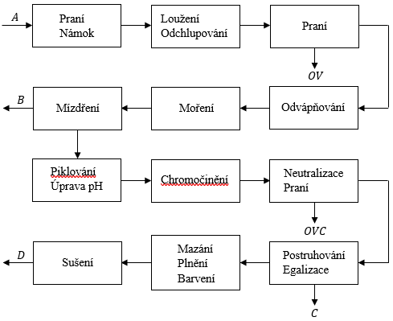

Slide 3
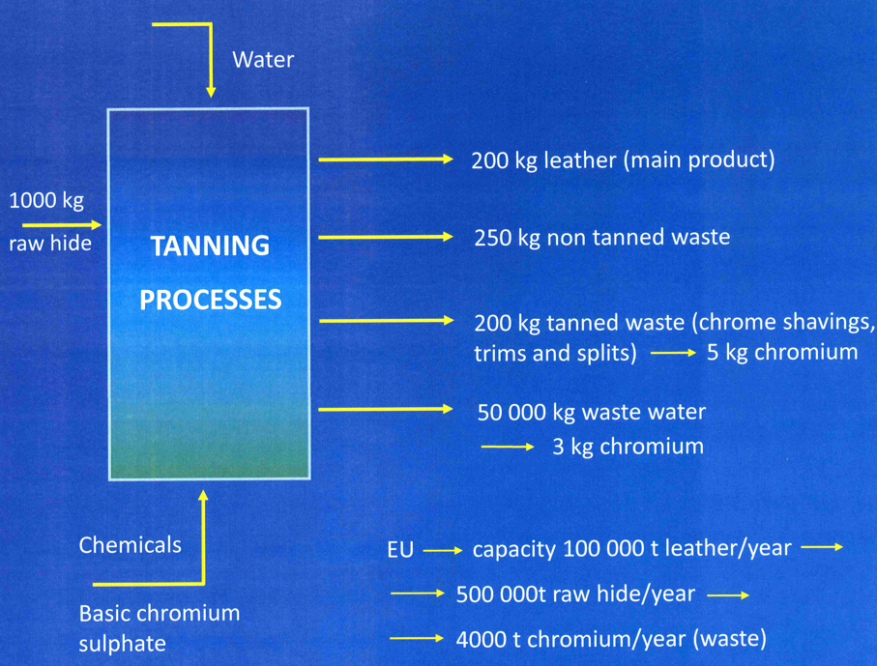
Figure 5. Mass balance of tanning processes

Slide 4
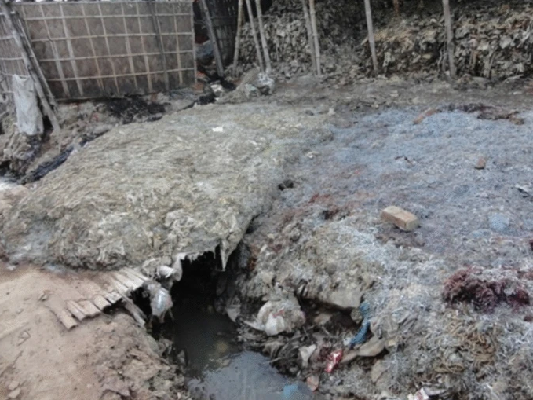
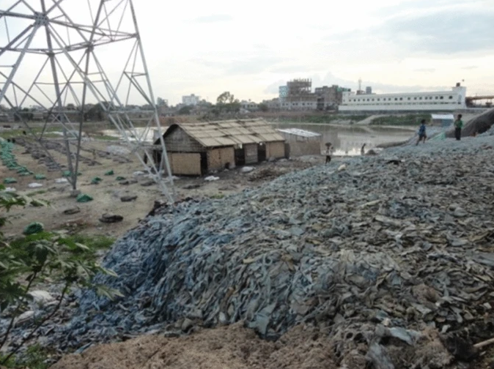
Figure 6. Tannery waste
containing chromium

Slide 5
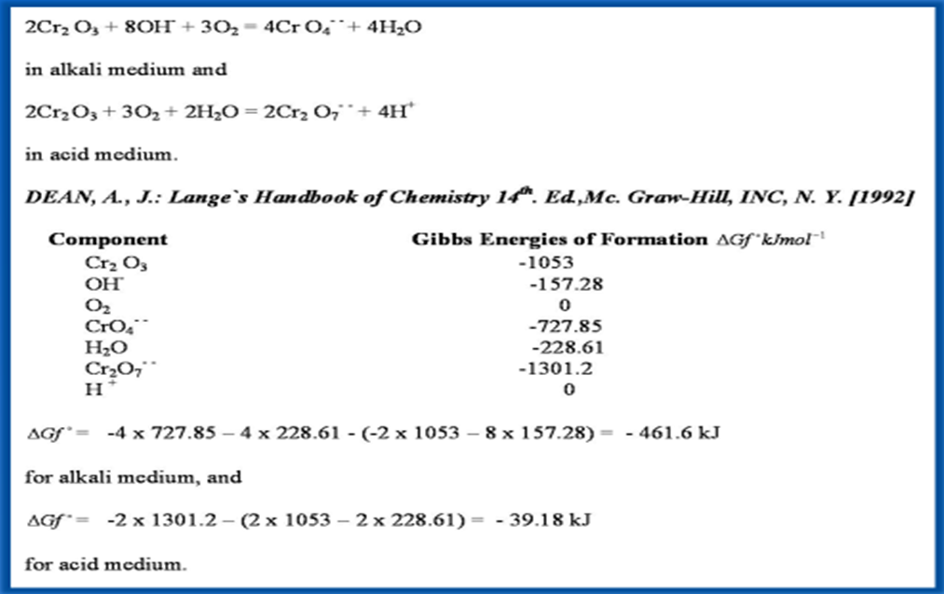

Slide 6
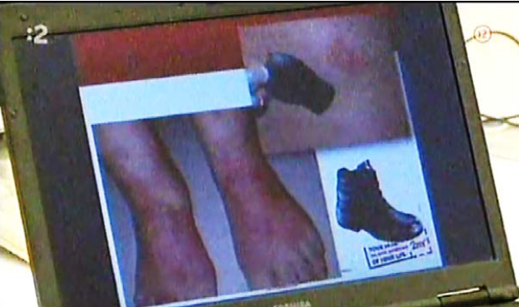
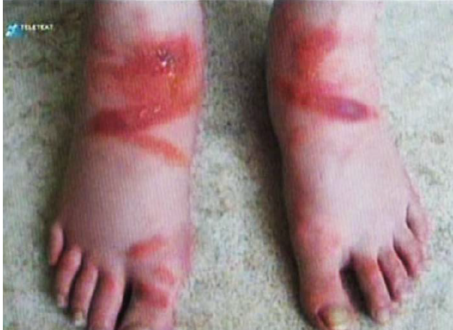
Figure 7. Skin damage caused by compounds of hexavalent chromium contained in shoes leather. Skin damage by caused by migrating compounds

Slide 7
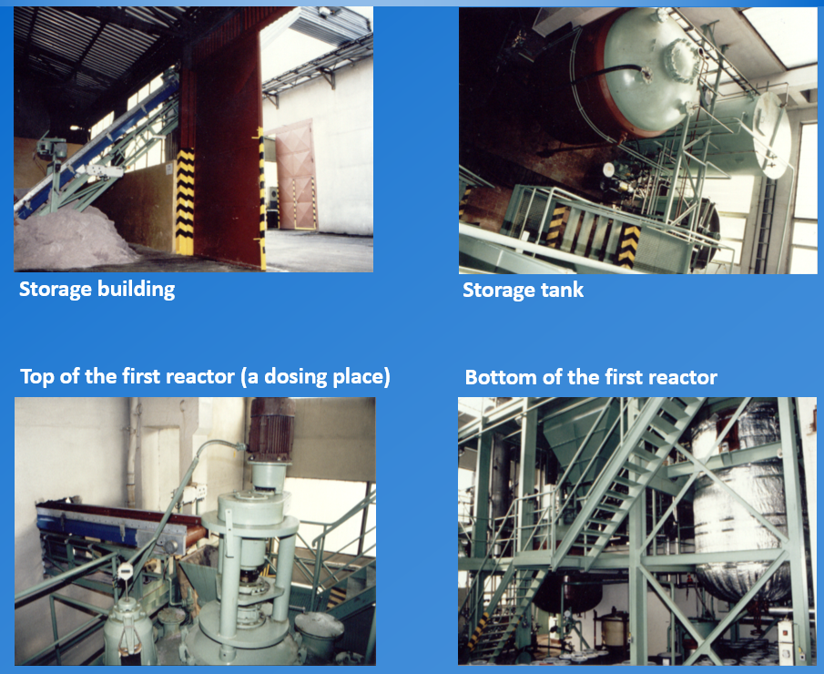
Figure 8. Premises built for chromium processing

Slide 8
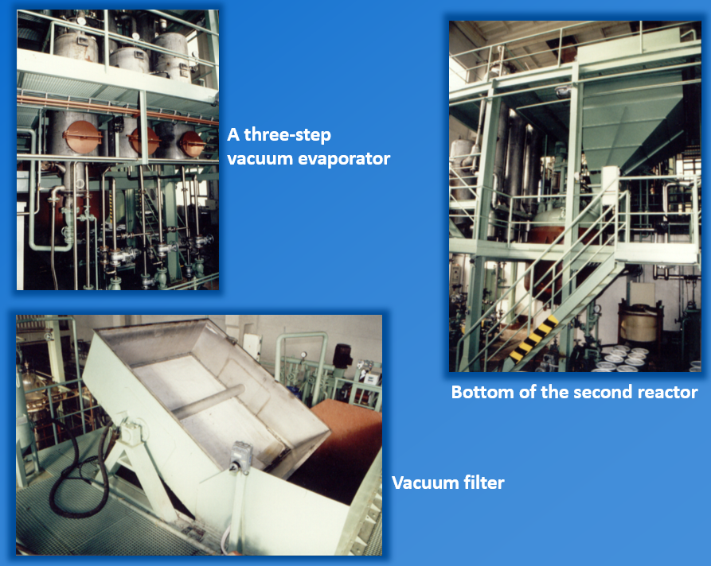
Figure 9. Premises built for chromium processing

Slide 9
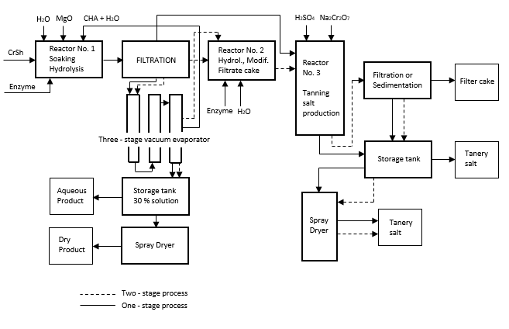
Figure 10. Total recycle of chromium wastes

Slide 10
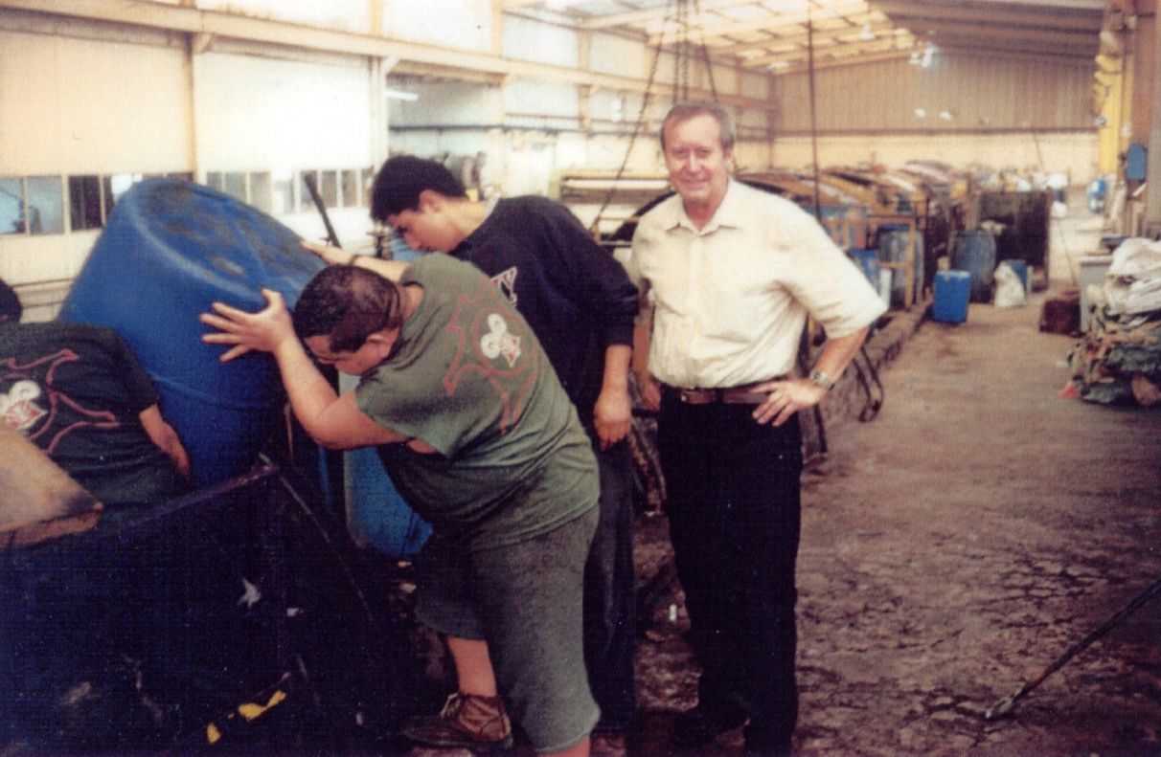
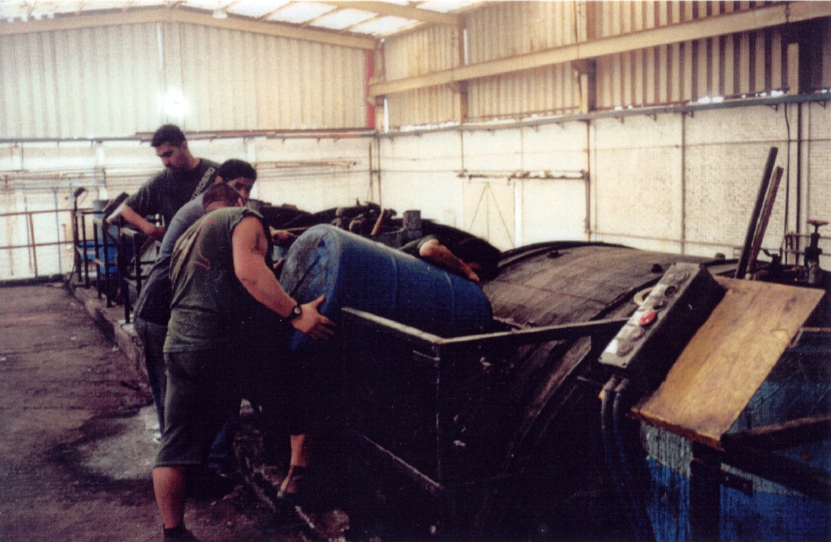
Industrial experimets in Beam house Fernandez, Leon, Mexico

Slide 11
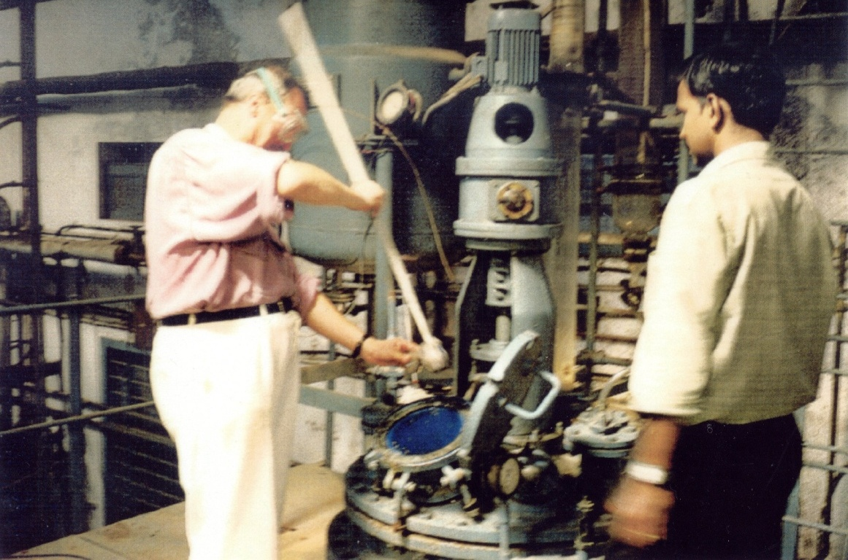
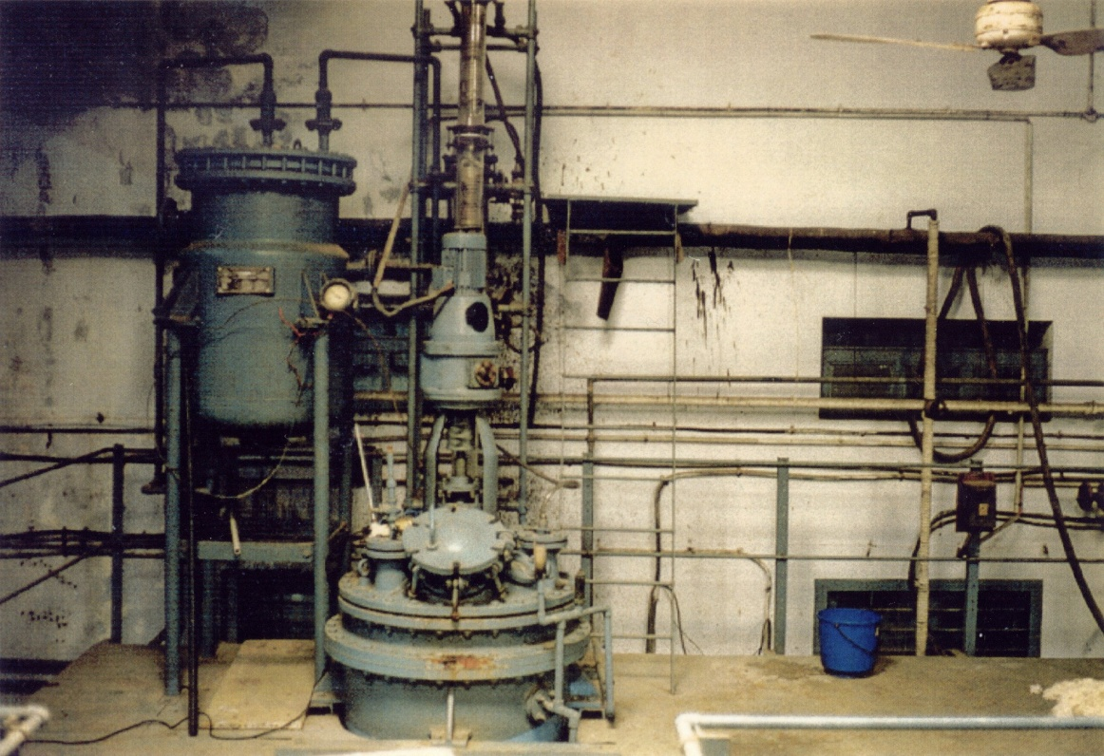
Pilot plant experiments in Central Leather Research Institute and Indian Technology Institute Chennai, (Madras

Slide 12
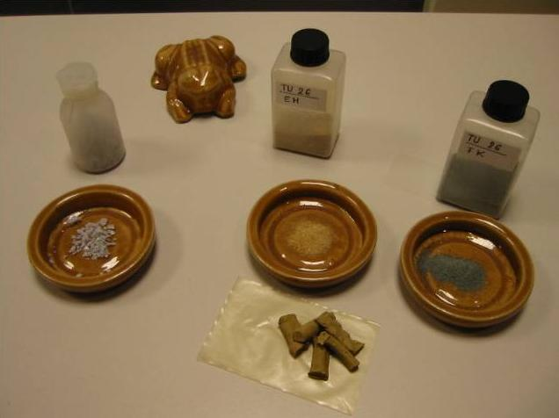
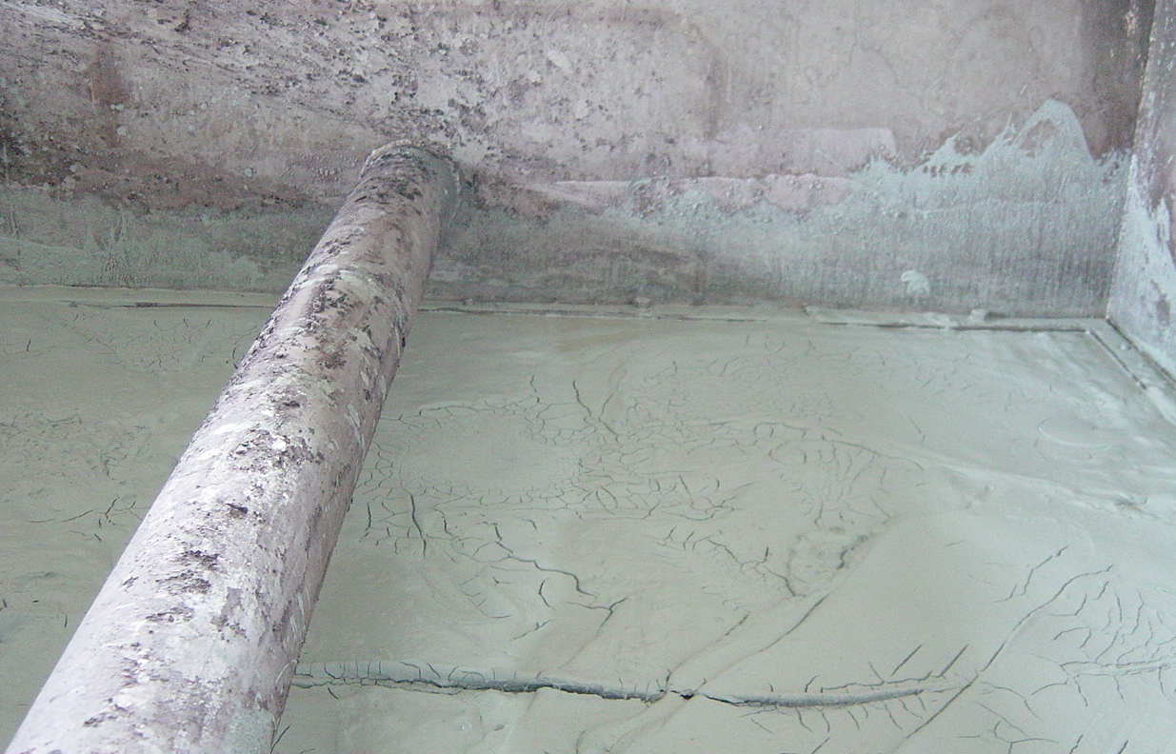
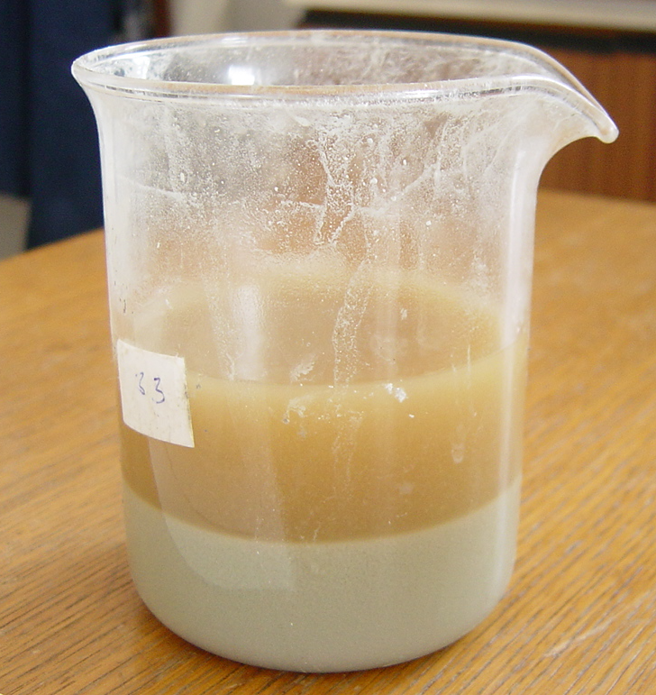
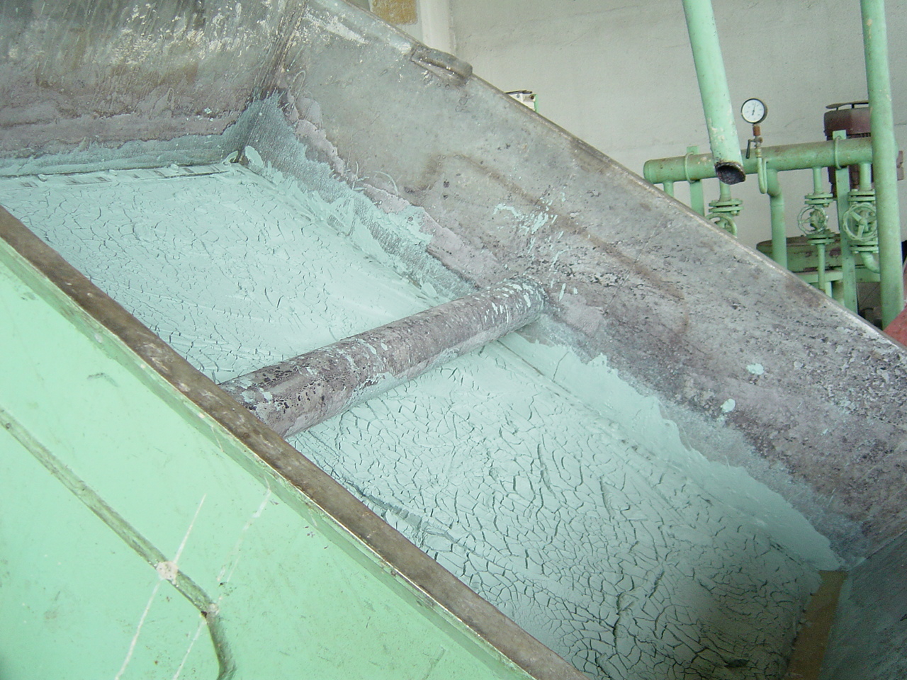
Manipulation waste. Separation of chromium-titanium tanning sludge as raw material for enamel of technical ceramic

Slide 13
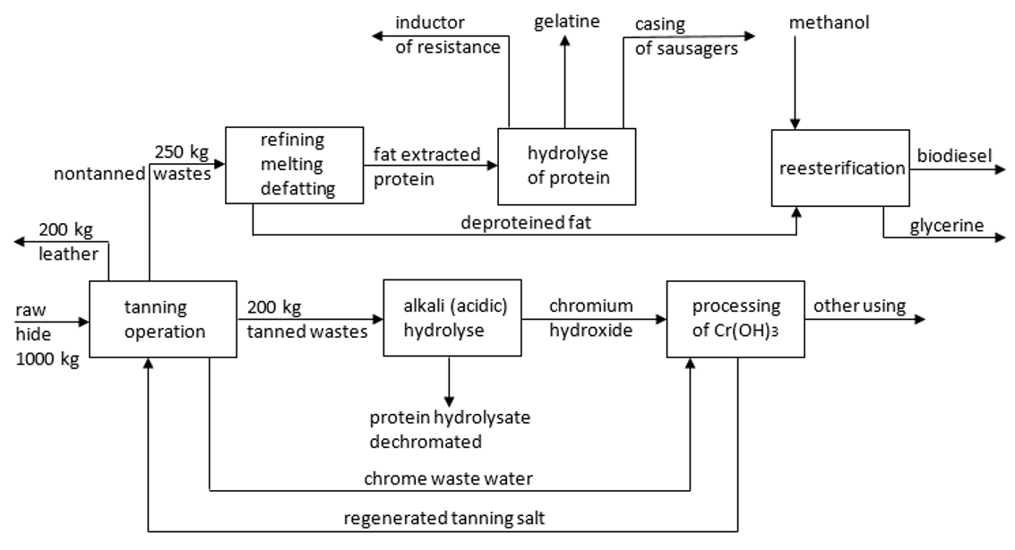
The complex waste-free technology

Slide 14
Table 1. Tests performed on plants
Fertilizer | Yield, g/Test Vessel | Nitrate Content, ppm NO₃
Commercial | 187 | 519
N-Hydrolysate | 164 | 23
Unfertilized | 105 | 52

Slide 15
Spojení odpadní drti polystyrenu pomocí kolagenního hydrolyzátu s betonovou směsí.
Regulační účinek na hydrataci sádry a cementu.
Usnadnění mletí cementových slínků.
Výroba lehčených betonových a sádrových panelů použitím stabilně vytvořené kolagenové pěny.
Usnadnění čištění oken po stavebních úpravách.

Slide 16
Acknowledgment:
US department of agriculture Eastern regional Research Center Wyndmoor, Pennsylvania for long-term cooperation in the field of tanning technology.
ROLEX Switzerland, Geneva for financial support and long-term interest in our research.

