Slide 1
Valorization of Chicken Deboner Residues: Gelatin Extraction and Application
Presenter: Orsolya Bystricky-Berezvai
Tomas Bata University in Zlín
Faculty of Technology
This study was financially supported by the Internal Grant Agency, in the project IGA/FT/2024/008.

Slide 2
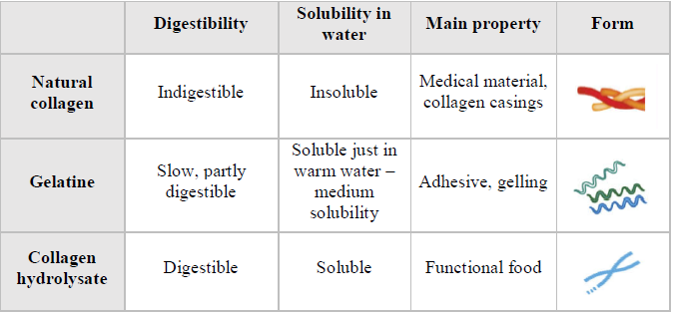
The gelatin’s parent molecule is collagen, the most abundant protein in human body.
Gelatin
Food industry
- Gelling agent
- Stabilizin agent
- Foaming agent
- Clarifying agent
Cosmetic industry
- Gelling agent
Medical sector
- Tissue engineering
- Implants
- 3D scaffolds
Pharmaceutical sector
- Soft and hard capsules
- Injection drug delivery microspheres
- Additives
Photographic industry
- Adhesive additive
Forensic sicence
- Gelatin-lifter
Collagen, the most abundant structural protein in animals and humans, constitutes about 30% of the total protein content. It is primarily found in connective tissues, providing strength and flexibility.
The properties of gelatin are significantly influenced by factors such as the raw material, the age of the animal, the type of collagen, the processing method, the tissue type, and the species involved.

Slide 3
Gelatin production annually (2021):
677 200 tons

Slide 4
Poultry meat consumption is yearly around 12,386 million tons and it continuously increasing.
Beak
Trachea
Blood
Feathers
Skin
Viscera
Bones
Head and leads
Feet
Yearly increasing consumption
Huge potentials in its by-products
Not well discovered by-product: chicken deboner residue
Chicken deboner residues (CDR) ”are parts from chicken waste, where meat is separated from a slurry of ground meat and bones using pressure in a mechanical deboner.”
Typically, chicken deboner residues consist of about 20% protein, of which approximately 30-40% is collagen

Slide 5
Yearly food waste in the Czech Republic (2022):
1 080 608 tons
5687 times heavier than the heaviest animal on Earth, the Antarctic blue whale (~190 t)
Primary production: 2.8 %
Processing and manufacturing: 10.3 %
Retail and other distribution of food: 6.6 %
Restaurants and food services: 3.9 %
Households: 76.4 %

Slide 6
Why food waste is a problem?
Discarding food
Waste:
Energy
Water
Labor work
Money
Increasing:
Greenhouse gas emission
Eutrophication
Acidification
Water scarcity
Cropland use
Disposal cost
Result:
Exacerbates climate change as natural disasters, habitat and biodiversity loss, and freshwater scarcity in food systems

Slide 7
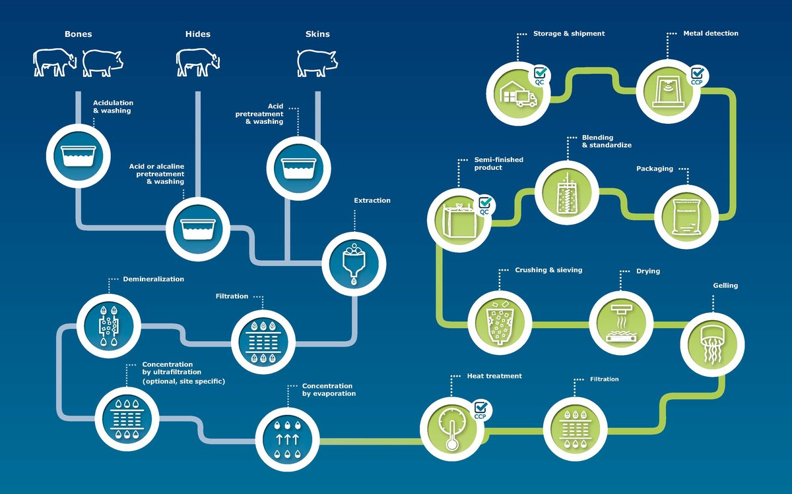

Slide 8
Results
Measured parameter | Measured value
Gel strength (Bloom) | 200 – 334
Dynamic viscosity (mPa.s) | 3.2 – 7.6
Water holding capacity (%) | 21.7 – 41.6
Fat binding capacity (mL/g) | 4.2 – 9.5
Emulsifying capacity (%) | 43.3 – 50
Emulsifying stability (%) | 92.6 – 100
Ash content (%) | 0.004 – 0.01
Foaming capacity (%) | 30 – 60
Foaming stability (%) | 0 - 12
Melting point (°C) | 32.3 – 37.8
Gelling point (°C) | 15.6 – 23.8
Interval of viscous state (°C) | 10.4 – 19.6
Yield (%) | 8.74 – 20.58

Slide 9
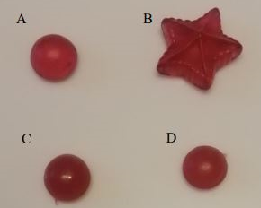
Sensory testing
Sample | Appearance | Chewiness | Color | Smell | Taste | Overall score
A | 2.3 | 2.8 | 1.8 | 2.9 | 2.5 | 2.4
B | 1.7 | 2.9 | 1.8 | 2.2 | 2.5 | 2.3
C | 4.8 | 2.7 | 4.5 | 3.8 | 3.1 | 3.8
D | 4.8 | 4.6 | 4.3 | 3.9 | 3.5 | 4.8
During this testing, 13 individuals aged between 26 and 65, all from Central Europe
A: 260 Bloom porcine skin gelatin, bottom-like shape;
B: 260 Bloom porcine skin gelatin, sea creature shape
C: 289 Bloom CDR gelatin (9th experiment, 2nd fraction), bottom-like shape
D: 268 Bloom CDR gelatin (9th experiment, 3rd fraction), bottom-like shape

Slide 10
Conclusion
The properties of the extracted gelatin are comparable to those of conventional gelatins, making CDR gelatin a suitable substitute.
This applies to various industries:
  pharmaceuticals (for nano- and microsphere containers, and hydrogels),
  medicine (as an encapsulating material for drugs or chemicals), and
  food (for jellies, gelatin desserts, and meat emulsions).
Sensory testing on jellies made from CDR gelatin confirmed its potential in the food industry. However, a higher Bloom value (>260 Bloom) was necessary to achieve a texture similar to commercial jellies during candy production.

Slide 11
Future
Future steps:
  Determining the chemical composition, amino acid content, and molecular weight distribution of the CDR gelatin.
  Jelly production could be optimized for gaining better properties for the jelly products and wider the CDR gelatine applicability opportunities in the food and other industries.
Investigate
  other potential raw materials as warm-water fish like Clarias gariepinus
  fish meat deboner residues as well

Slide 12
Thank you for your attention!
Team members:
prof. Ing. Pavel Mokrejš, Ph.D.,
Ing. Robert Gál, Ph.D.,
Ing. Jana Pavlačková, Ph.D.
Questions?

Slide 13
Taguchi Design
3-step gelatine extraction
  Receiving a higher extraction yield
  1st fraction: 56°C for 2 minutes and then 85°C for 7 minutes
  3rd fraction: 80°C for 60 minutes
*without enzyme pretreatment, control experiment
Experiment | Factor A Extraction time (min) of the 2nd fraction | Factor B Extraction temperature (°C) of the 2nd fraction
1. | 20 | 60
2. | 20 | 64
3. | 20 | 68
4. | 40 | 60
5. | 40 | 64
6. | 40 | 68
7. | 60 | 60
8. | 60 | 64
9. | 60 | 68
10. | 40* | 64*

Slide 14
Sources
Dr. Jockers.com Supercharge your health accessible from https://drjockers.com/gelatin-vs-collagen-what-is-the-difference/ [cit. 06.11.2024]
ChemAnalyst accessible from https://www.chemanalyst.com/industry-report/gelatin-market-3065 [cit. 06.11.2024]
EU Food Loss and Waste Prevention Hub https://ec.europa.eu/food/safety/food_waste/eu-food-loss-waste-prevention-hub/eu-member-state-page/show/CZ [cit. 06.11.2024]
Russelot.com accessable from https://www.rousselot.com/functional/rousselot-gelatins/materials-from-nature [cit. 06.11.2024]

Slide 15
Why poultry?
Poultry gelatin is preferable to fish gelatin due to its lack of unpleasant odor
Gelatin out of pork and beef
Additionally, porcine and bovine gelatin products have limited permission in Jewish and Muslim areas
By 2035 insufficient amount of gelatin for global demand
Alternative collagen sources desirable

